Slide 1
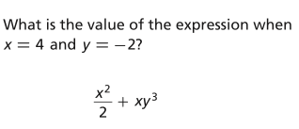
Starter Challenge
1)
Have HW out on your desk
(it was in your composition book.) .
2) Explain the difference between many solutions or no solutions.

Slide 2
Equation Practice
I can and I will solve equations with variables on both sides.

Slide 3
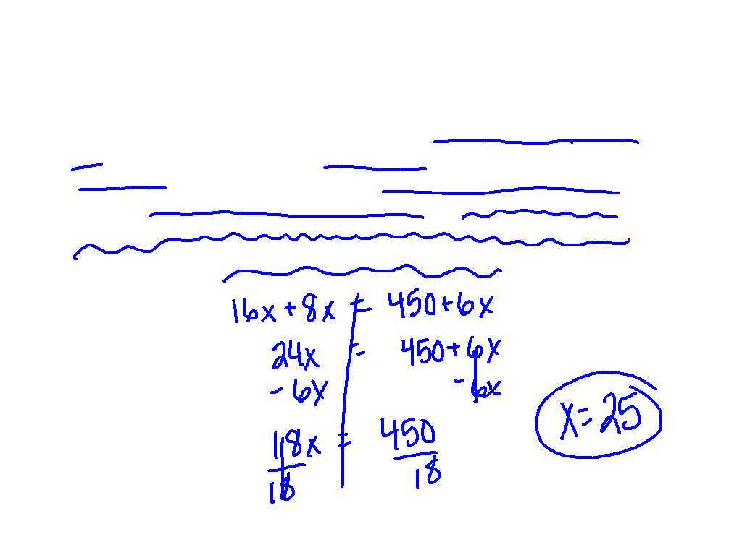
When will I use this?
Ex. 5) A rock-climbing gym charges nonmembers $16 per day to use the gym and $8 per day for equipment rental. Members pay a yearly fee of $450 for unlimited climbing and $6 per day for equipment rental. Write and solve an equation to find how many times you must use the gym to justify becoming a member.

Slide 4
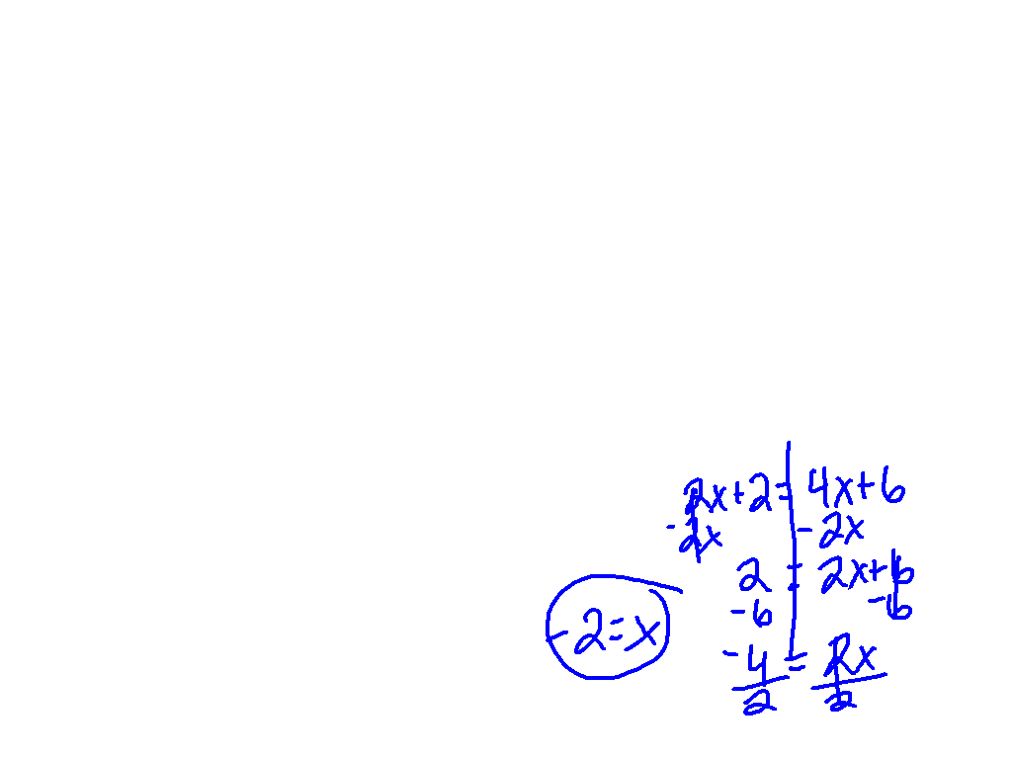
f(x) = g(x)
Another way equations with variables on both sides may be written.
It doesn’t mean f times x, it is a special way to write a function. (Something we will talk about LOTS more later.)
f(x)=2x+2 and g(x)=4x+6

Slide 5
Ex. 6)
f(x) = 9x – 12
g(x) = 9x + 3

Slide 6
Scavenger Hunt

Slide 7
A gym offers two packages for yearly memberships. Plan A charges $50 for a membership fee plus $8 per visit. Plan B has a $200 membership fee plus $2 per visit. Which plan is best? Explain your solution in terms of stating which plan would be best and why?

Slide 8
Let’s Reflect
1) I don’t know what to do
when ____________.
2) I need more help with
___________.
3) I understand _________
really well.

