Slide 1
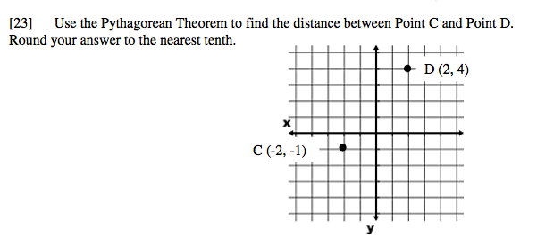
Starter Challenge

Slide 2
More Practice with Variables on Both Sides

Slide 3
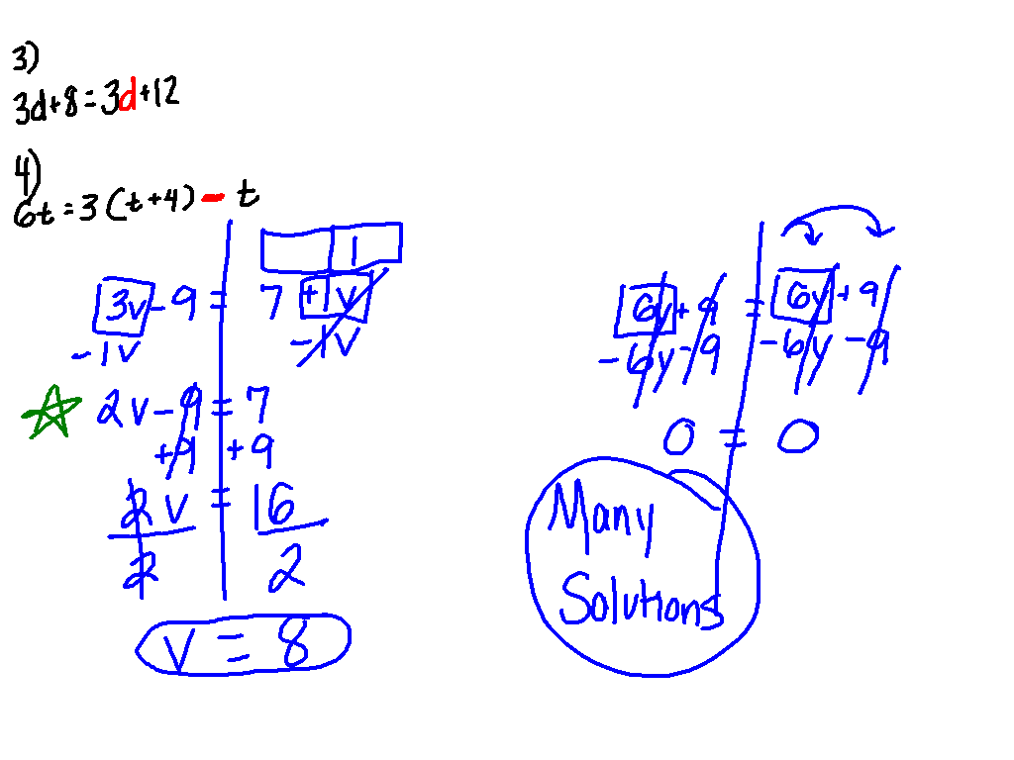
Solving Equations with Variables on Both Sides
3v – 9 = 7 + 2v – v
6y + 9 = 3(2y + 3)

Slide 4
A gym offers two packages for yearly memberships. Plan A charges $50 for a membership fee plus $8 per visit. Plan B has a $200 membership fee plus $2 per visit. Which plan is best? Explain your solution in terms of stating which plan would be best and why?

Slide 5
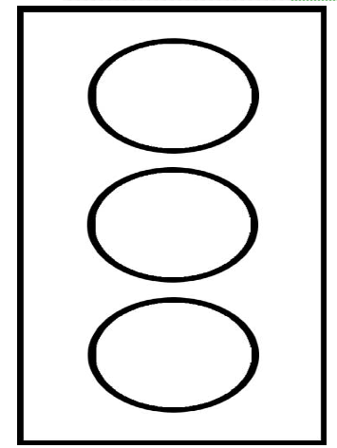
Let’s Reflect
1) I don’t know what to do
when ____________.
2) I need more help with
___________.
3) I understand _________
really well.

