Slide 1
Using Intercepts
Objective: I can and I will define and find intercepts.

Slide 2
Finding Intercepts
x-intercept
= where the line crosses the x-axis
y-intercept
= where the line crosses the y-axis
x-intercept
y
(5, 0)
y-intercept
(0, 5)
x

Slide 3
Finding Intercepts
y = 2x + 3
x-intercept
y-intercept
(set y = 0)
(set x = 0)
x
y
y = 2x + 3
y = 2x + 3
-3
-2
-1
0
1
2
y
-3
0 = 2x + 3
y = 2(0) + 3
-1
0-3 = 2x + 3-3
y = 3
1
-3 = 2x
3
x
2 2
5
7

Slide 4
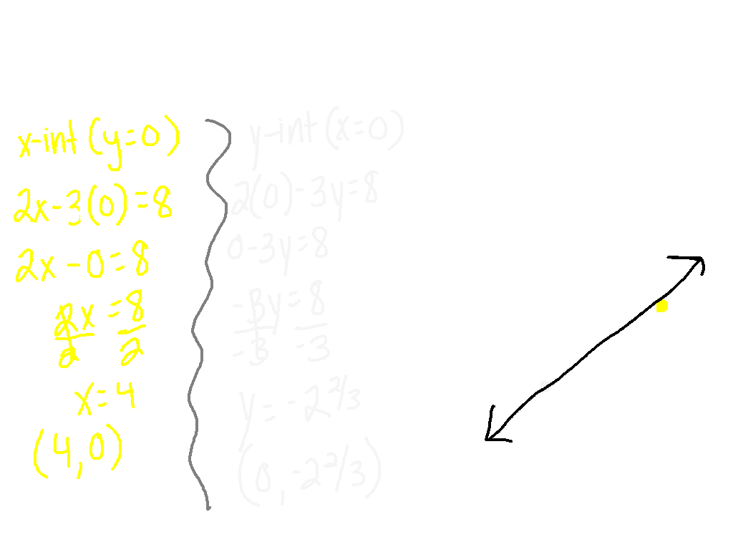
Graph using the x-intercept and y-intercept
Ex. 1) 2x - 3y = 8
y
x

Slide 5
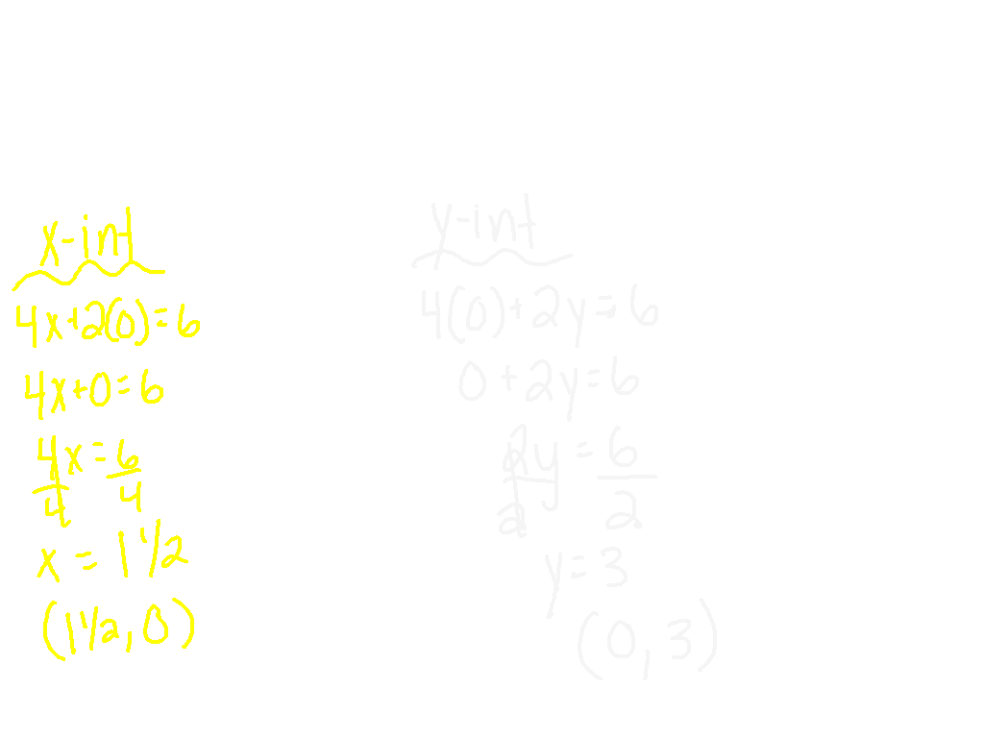
Find the x-intercept and y-intercept
Ex. 2) 4x + 2y = 6
Notes:
Graph on white boards

Slide 6
Find the x-intercept and y-intercept
Ex. 3) 2y = 4 – 1x
3 2
←Put in standard form (Ax + By = C)
Notes:
Graph on white boards

Slide 7
The National Junior Honor Society is having a car wash to raise money for West Valley Middle School. They charge $5 for cars and $10 for trucks and vans. They hope to raise at least $250. Let x = the number of cars and y = the number of trucks and vans. Find the x & y intercepts. Graph the function.
40
30
20
10
-10
-20
-30
-40
What does the x-intercept
represent in this situation?
What does the y-intercept
represent in this situation?
-50 -40 -30 -20 -10 0 10 20 30 40 50
Notes:
x = 50. It represents the number of cars that must be washed if no trucks or vans are washed.
Y=25 It represents the number of trucks or vans that must be washed if no cars are washed.

Slide 8
Practice
Pg. 310 #9 – 21
Due tomorrow with your homework from Friday.

Slide 9
On a Post It…
Please give specific instructions for an absent student telling him/her how to graph a linear equation using x and y intercepts.

