Slide 1
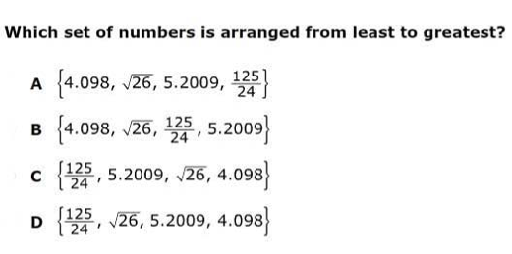
1)
2)

Slide 2
What should I study?
Multi-Step Equations with 1 Variable (3)
Variable on Both Sides (5)
1/No/Many Solutions (3)
Given Variable (2)
Absolute Value Equations (3)
Rational / Irrational (2)

Slide 3
Variable on Both Sides
A gym offers two packages for yearly memberships. Plan A charges $50 for a membership fee plus $8 per visit. Plan B has a $200 membership fee plus $2 per visit. Which plan is best? Explain your solution in terms of stating which plan would be best and why?

Slide 4
1/No/Many Solutions
12x – 11 = −2(-1 + 4x)

Slide 5
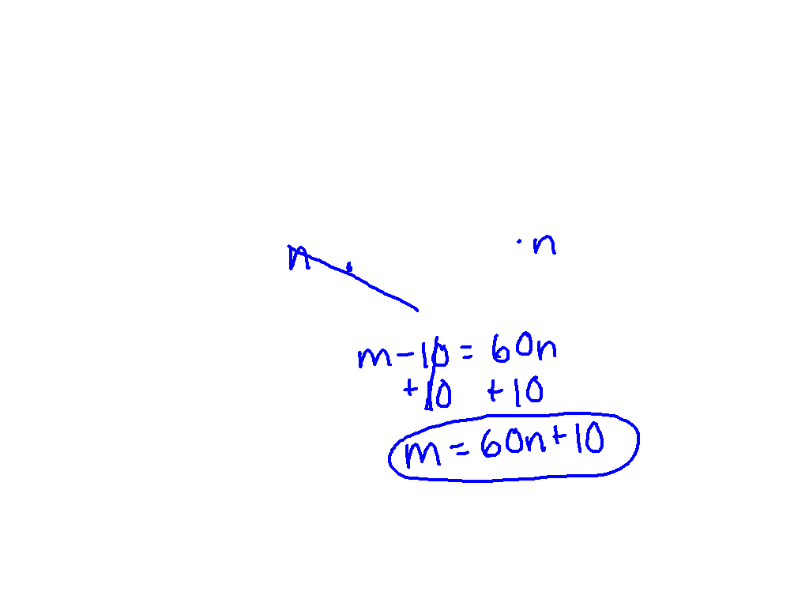
Given Variable
Solve for m.
m - 10 = 60
n

Slide 6
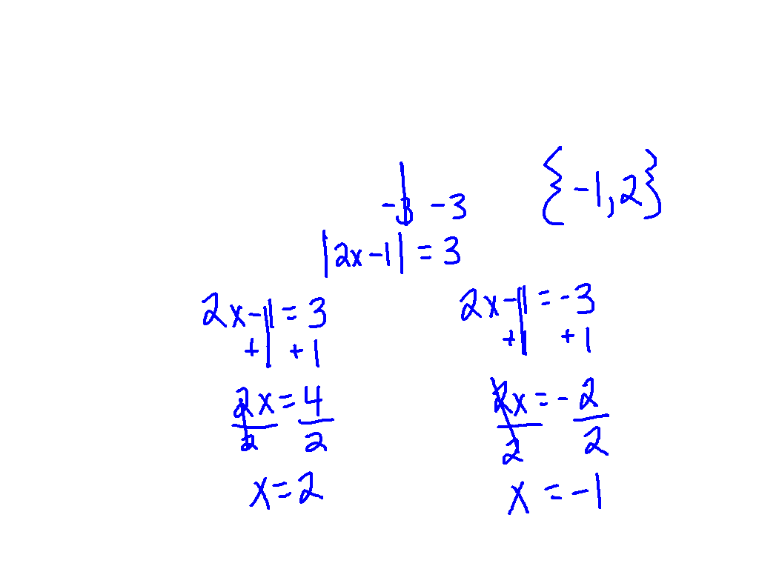
Absolute Value Equations
|2x - 1| + 3 = 6

Slide 7
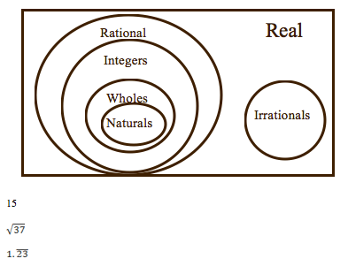
Rational/Irrational

