Slide 1
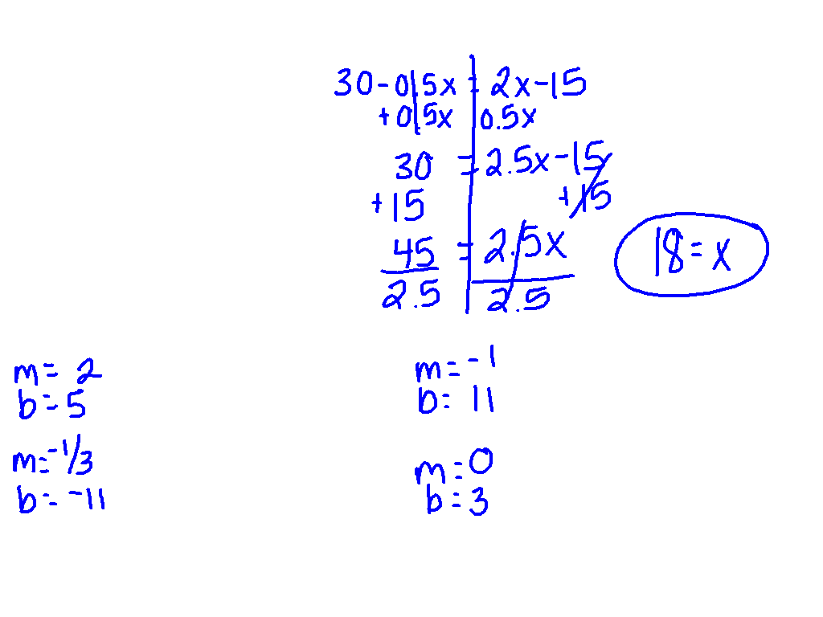
Pick the slope and y – intercept for each equation.
y = 2x + 5 y = -x + 11
y = -1/3x – 11 y = 3

Slide 2
Solving Systems of Equations by Graphing
I CAN and I WILL solve system of equations problems by graphing.

Slide 3
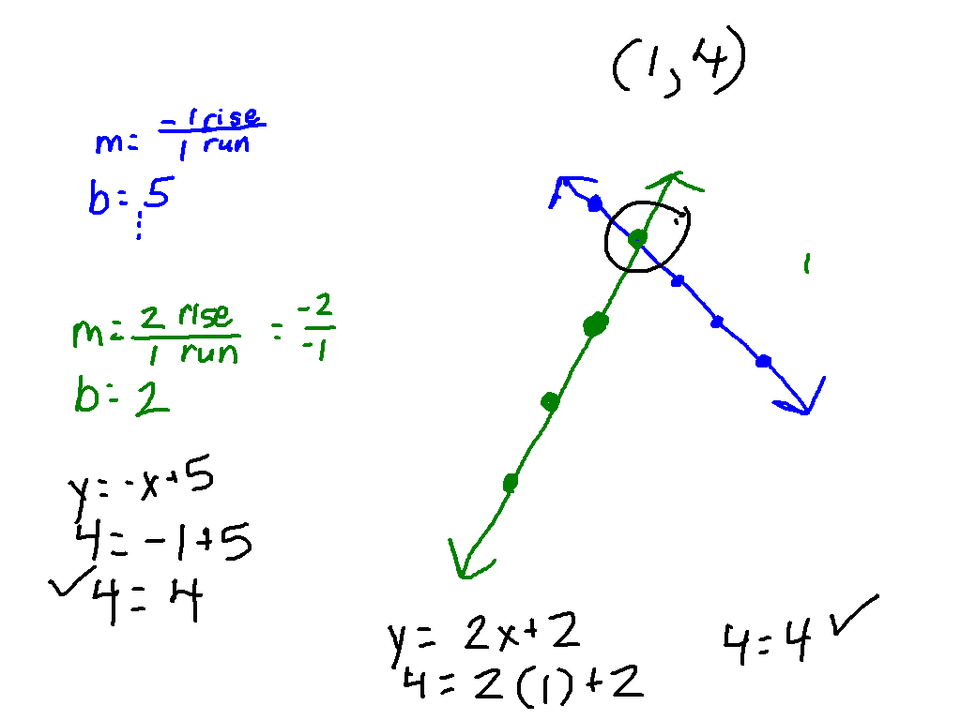
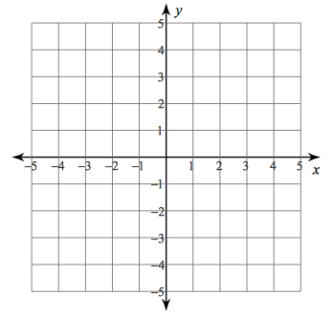
Watch This!
y = -x + 5
y = 2x + 2

Slide 4
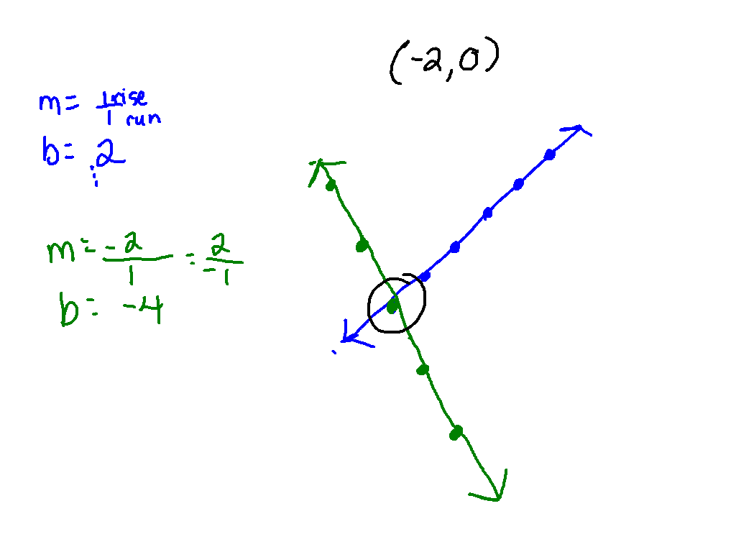
Ex. 1)
y = x + 2
y = -2x – 4

Slide 5
Ex. 2)
y = -x + 1
y = x – 5

Slide 6
What am I doing?
Put your name on your paper.
Pick one of the highlighters and highlight your name.
For each problem, graph one of the equations and then highlight your line. Your partner will graph the other and highlight their line.
You and your partner, select the point of intersection.
Write your coordinate points and circle the answer. (x, y)

