Slide 1
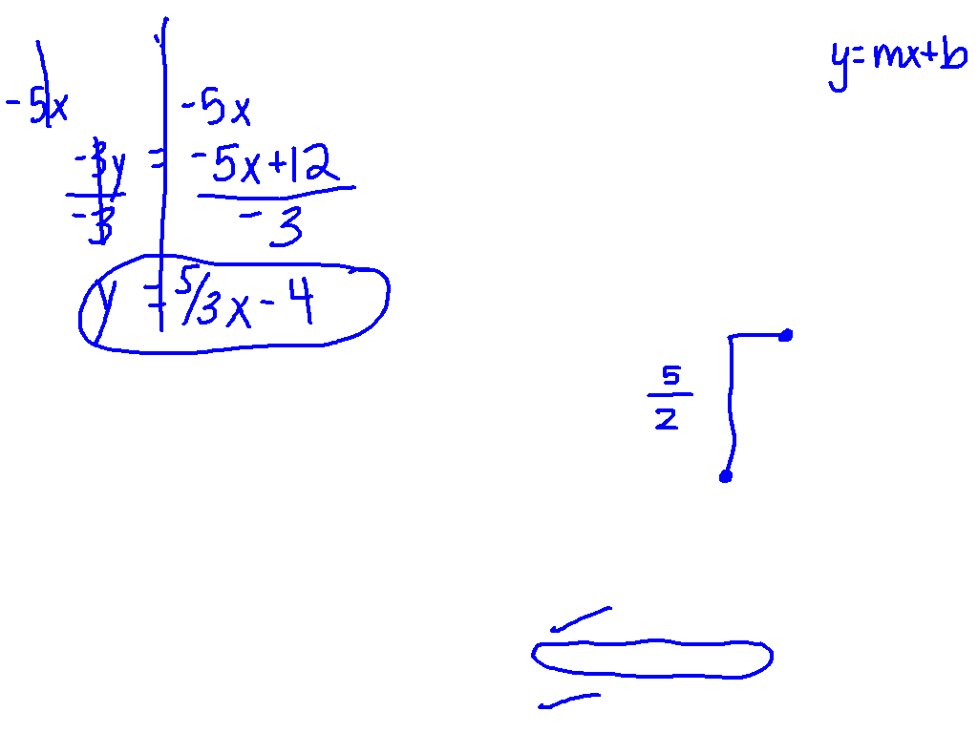
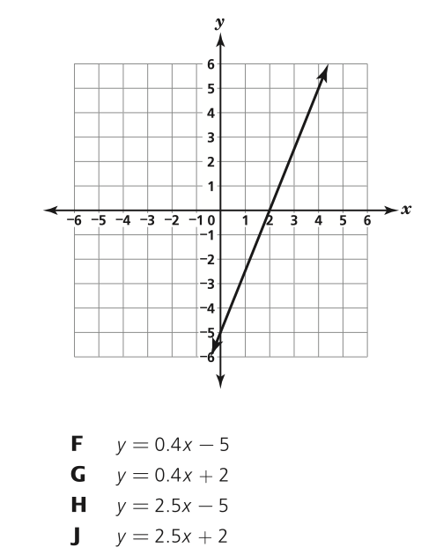
Put the equation in slope intercept form.

Slide 2
Solving Systems Using Substitution
I CAN and I WILL solve systems of linear equations by substitution.

Slide 3
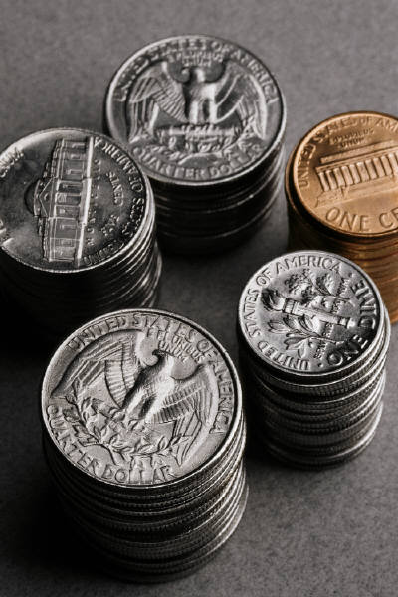
Jar of Change…
There are 22 coins in a jar, all nickels and quarters. The total value of the coins is $4.50. How many of each type coin are there?

Slide 4
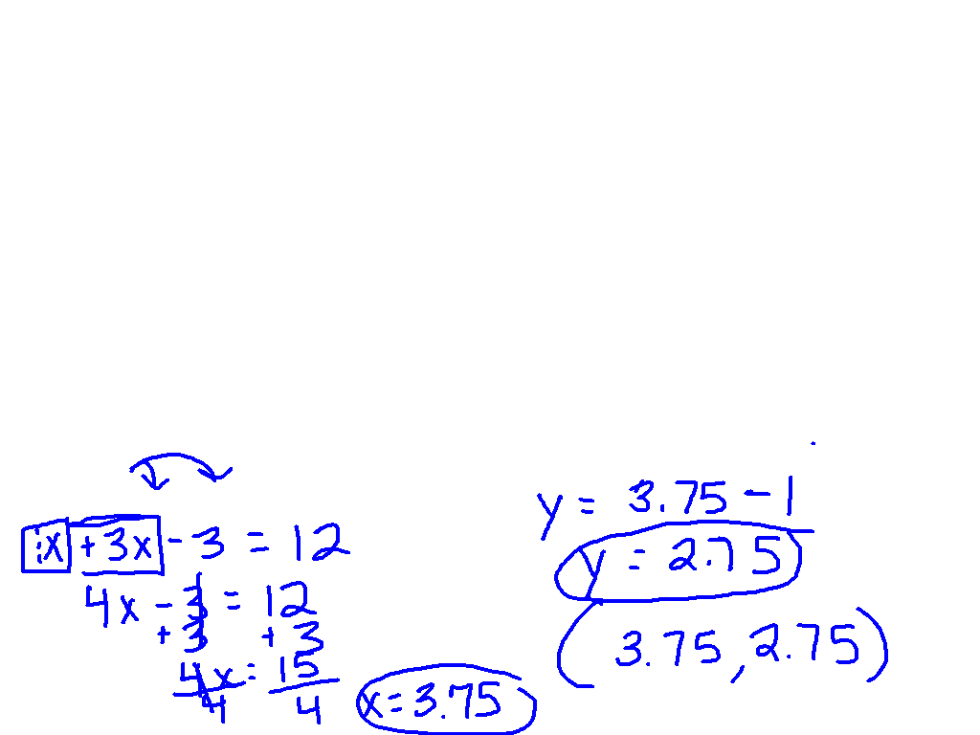
Graphing Method
Substitution

Slide 5
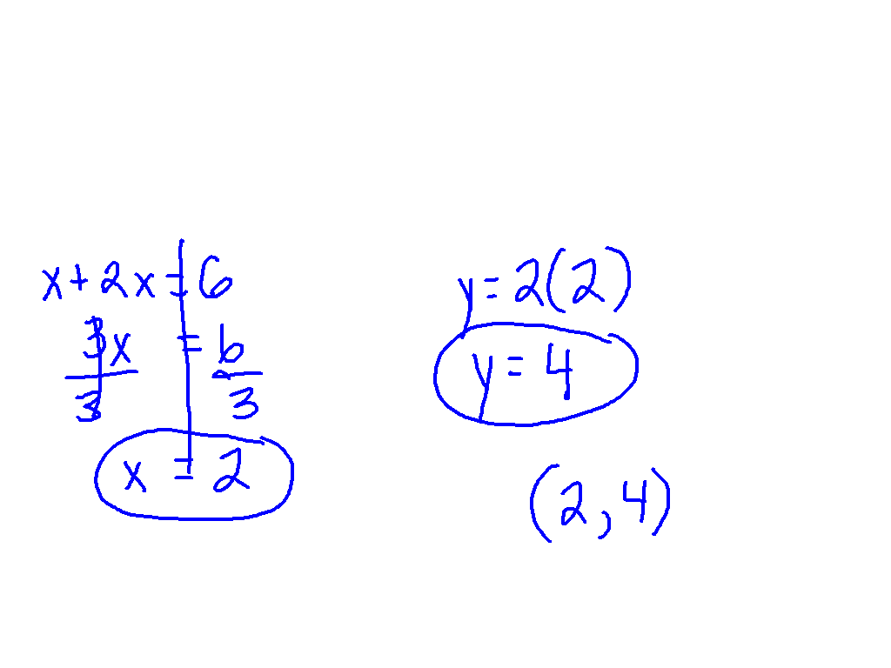
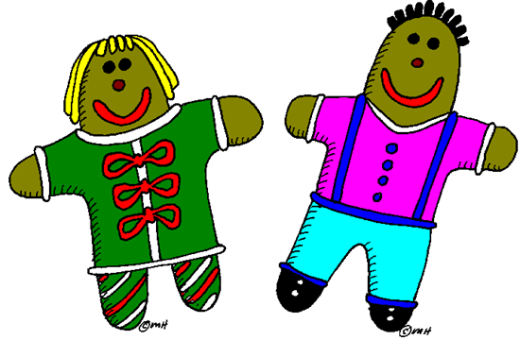
Ex. 1)

Slide 6
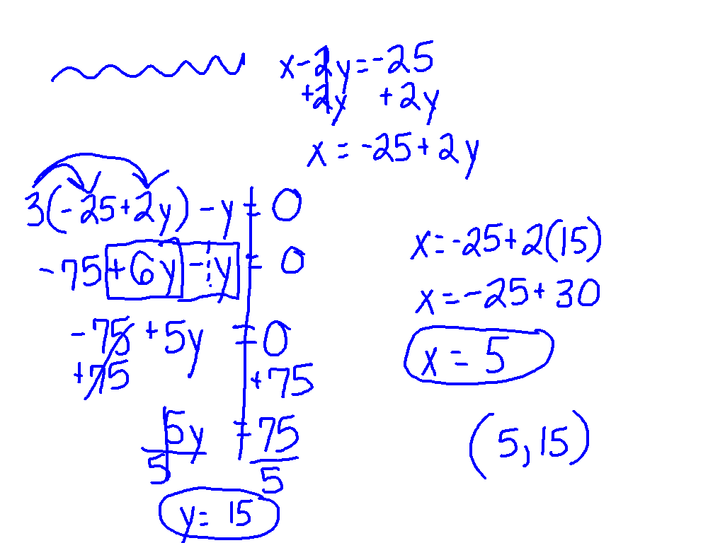
Ex. 2)

Slide 7
On Your Own!

Slide 8
Back to the Jar of Change…
There are 22 coins in a jar, all nickels and quarters. The total value of the coins is $4.50. How many of each type coin are there?

