Slide 1
Solving for a variable
I CAN and I WILL solve a formula for a given variable.

Slide 2
Formulas
Distance = rate x time
What is an average marathoner’s speed if they complete the 26.2 miles in 1.3 hours?

Slide 3
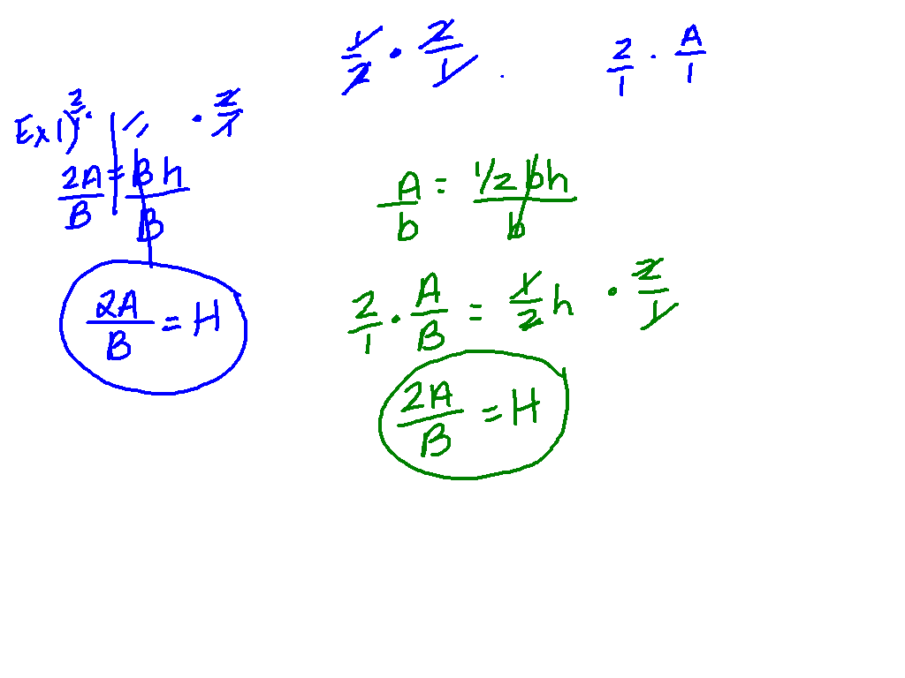
Formulas
A = ½ bh
Solve the formula for h.

Slide 4
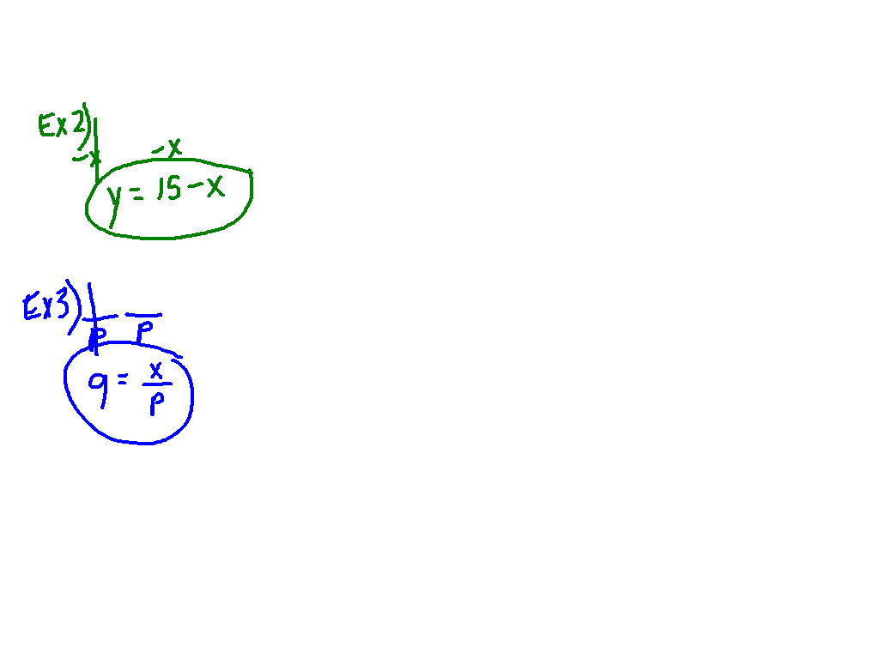
Equations
x + y = 15
pq = x
Solve for y.
Solve for q.

Slide 5
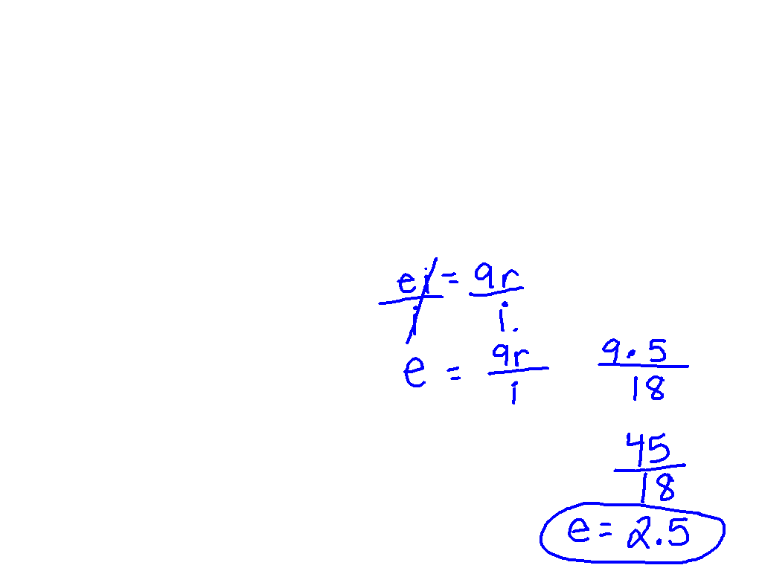
To find a baseball pitcher’s earned run average (ERA), you can use the formula ei = 9r, where e represents ERA, i represents number of innings pitched, and r represents number of earned runs allowed. Solve the equation for E. What is the pitcher’s ERA if he allows 5 earned runs in 18 innings pitched?

