Slide 1
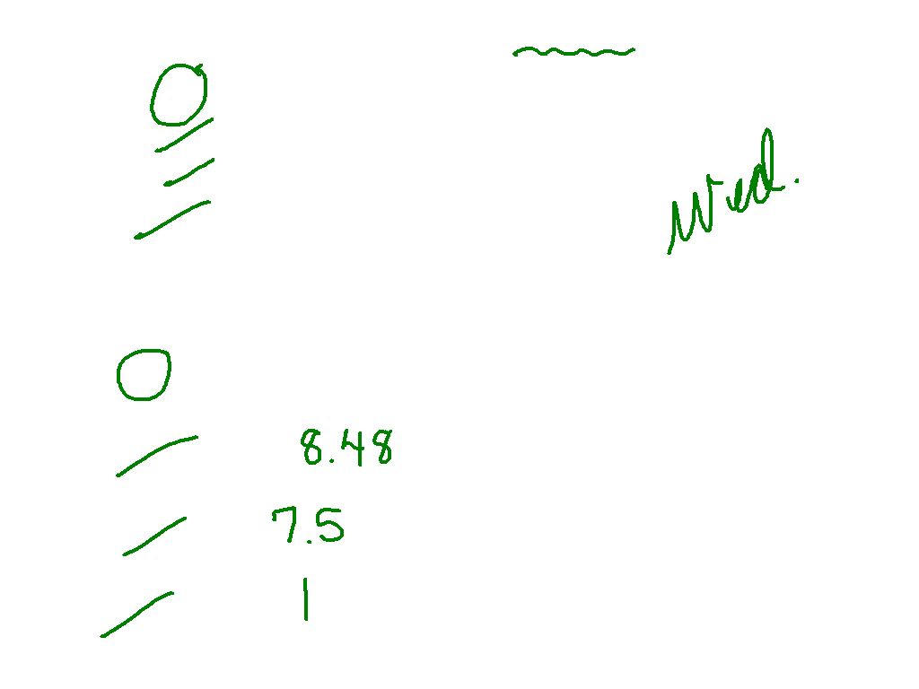
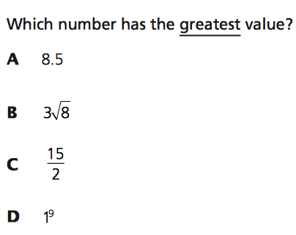
Which type of decimal is an irrational number?
A. nonrepeating, nonterminating decimal
B. terminating decimal
C. repeating decimal
D. all decimals

Slide 2
Slope Intercept Form
I can and I will identify slope and y intercept, write an equation in slope intercept form, and graph.

Slide 3
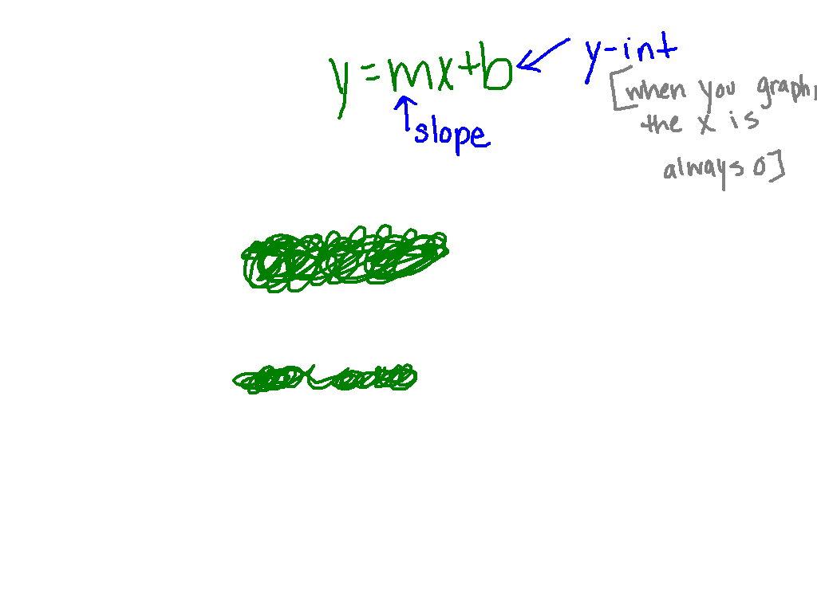

Slide 4
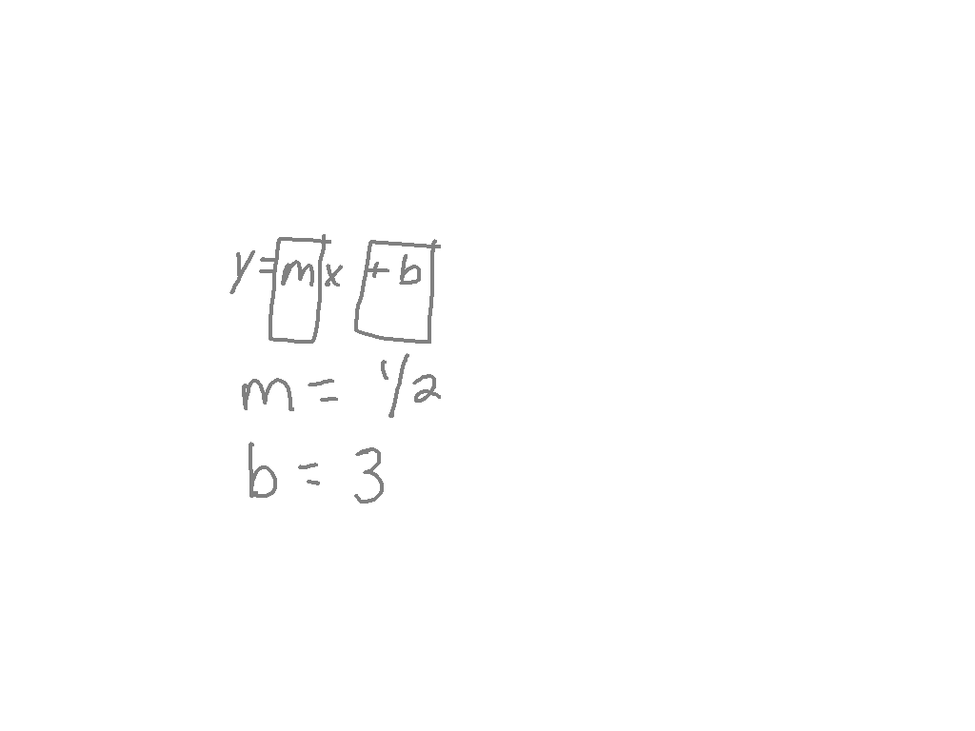
Ex. 1)
Find the slope and y intercept.
y = ½ x + 3

Slide 5
Name the slope and y intercept
y = 3x + 9 y = -6x - 11
y = ¾ x y = -9x + 0.23
Slope = 3
Y-Int. = 9
Slope = -6
Y-Int. = -11
Slope = ¾
Y-Int. = 0
Slope = -9
Y-Int. = 0.23

Slide 6
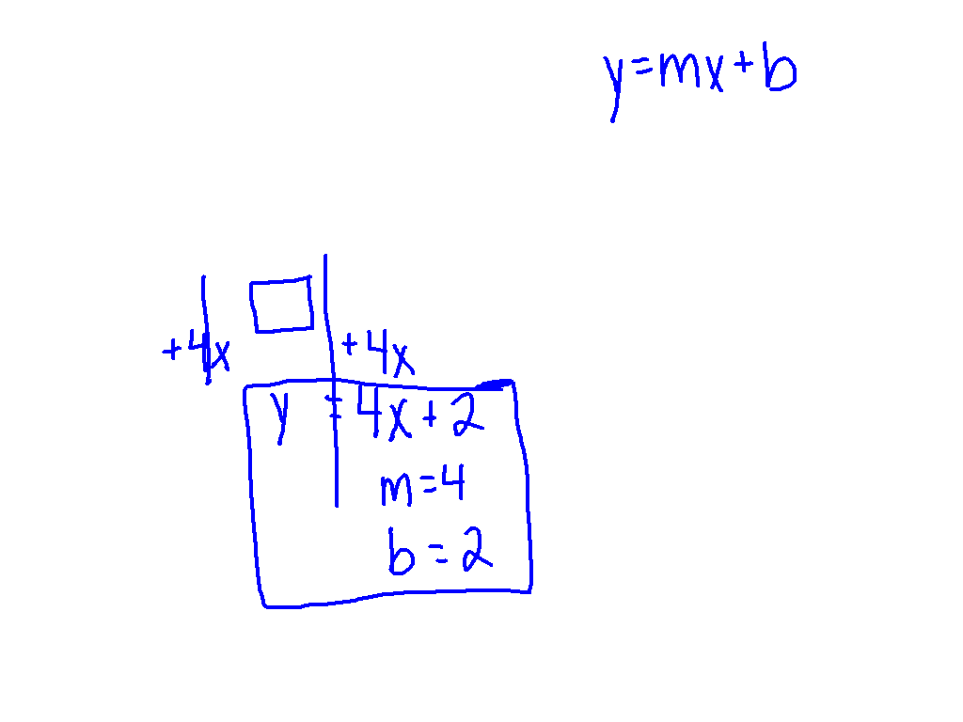
Watch This!
State the slope and the y-intercept.
- 4x + y = 2

Slide 7
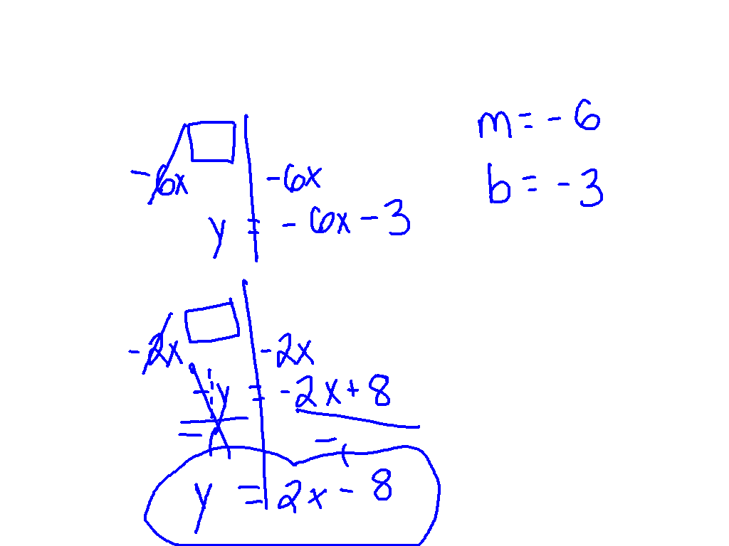
Ex 2)
6x + y = -3
2x – y = 8

Slide 8
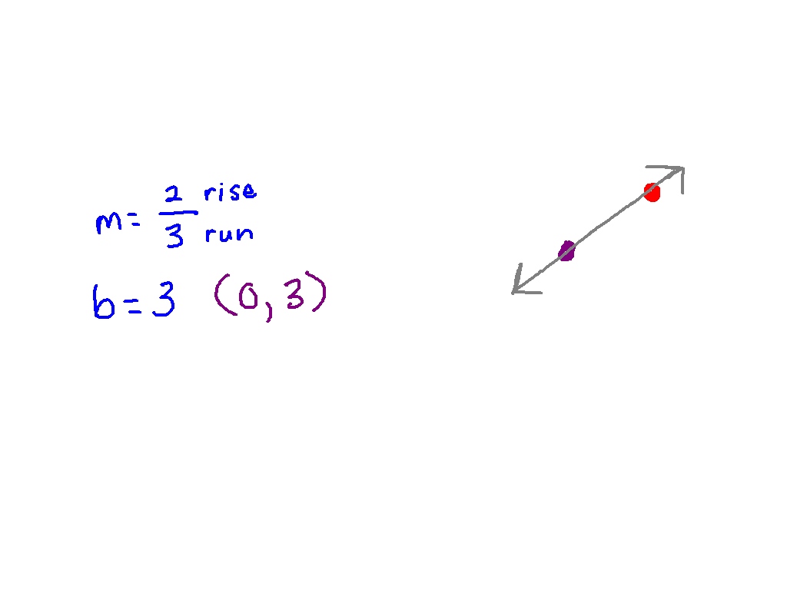
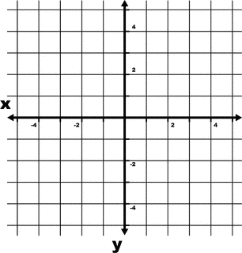
Graph using slope and y-intercept
y = 2/3x + 3

Slide 9
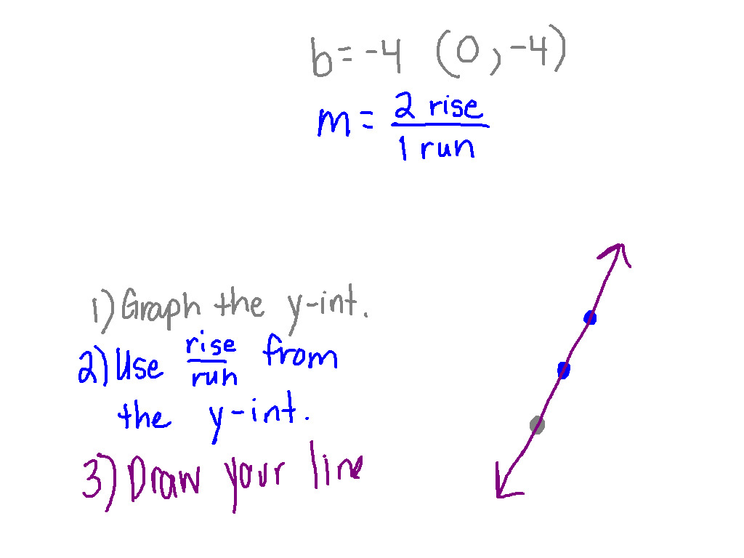
Ex. 3)
y = 2x - 4

Slide 10
Wrap Up!
What does the m stand for?
What does the b represent?
When putting an equation in slope intercept form, what do we isolate?
To graph the y intercept, what is your point for x?

