Slide 1
Put the equation in slope intercept form.
2x + 3y = 18

Slide 2
Slope Intercept Form
I can and I will identify slope and y intercept, write an equation in slope intercept form, and graph.

Slide 3
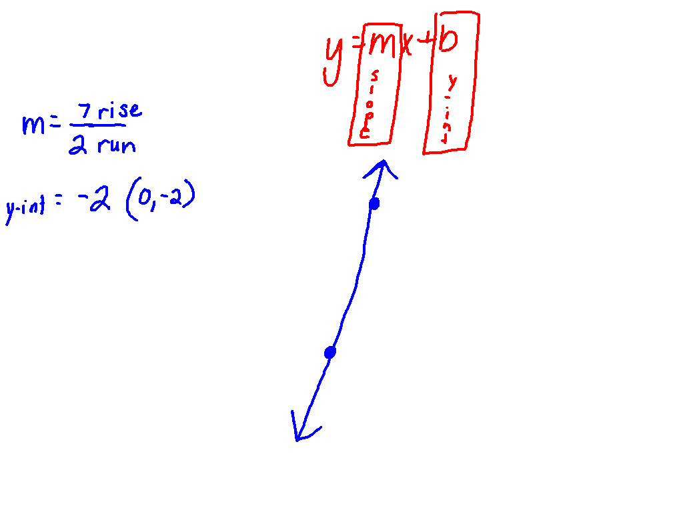
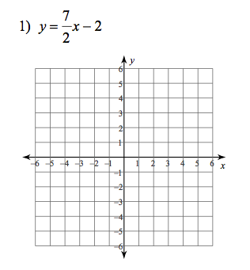
Let’s Review!

Slide 4
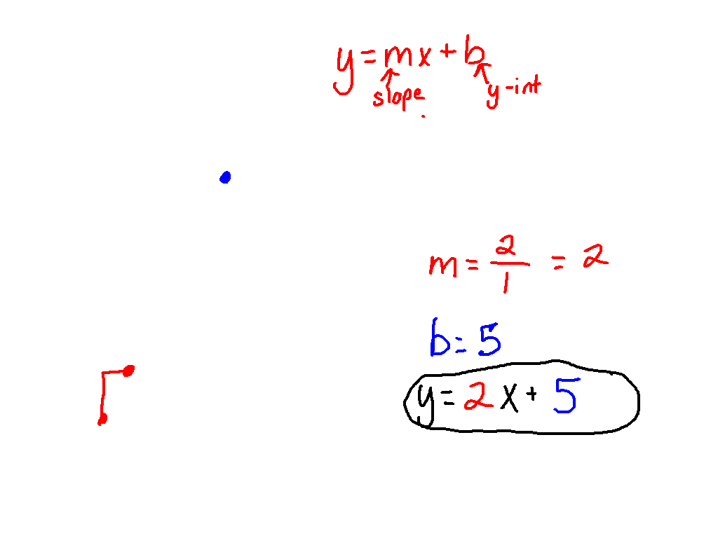
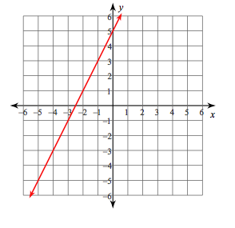
What’s New?
Write an equation in slope intercept form.

Slide 5
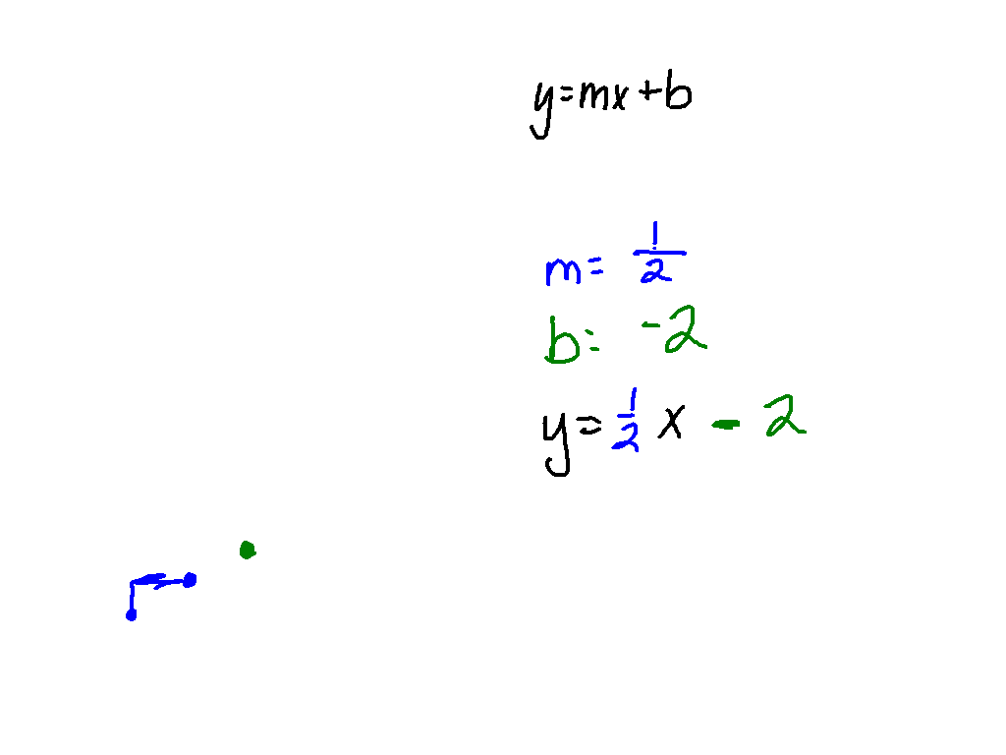
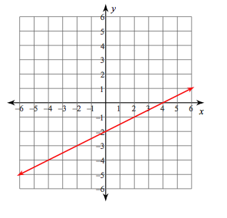
Let’s Try Together!

Slide 6
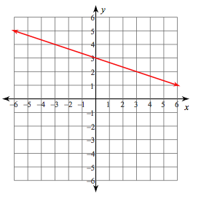
Let’s Try Together!

Slide 7
Get your desks ready for partner practice.

Slide 8
00
15
14
13
12
11
10
09
08
07
06
05
04
03
02
01
00
Back to Clock Home
Countdown Clock By Dr. Jeff Ertzberger

Slide 9
CARD PARTNERS

Slide 10
00
45
44
43
42
41
40
39
38
37
36
35
34
33
32
31
30
29
28
27
26
25
24
23
22
21
20
19
18
17
16
15
14
13
12
11
10
09
08
07
06
05
04
03
02
01
00
Back to Clock Home
Countdown Clock By Dr. Jeff Ertzberger

Slide 11
WRITE AN EQUATION FOR THE GRAPH

Slide 12
Get your desks back into rows.

Slide 13
00
45
44
43
42
41
40
39
38
37
36
35
34
33
32
31
30
29
28
27
26
25
24
23
22
21
20
19
18
17
16
15
14
13
12
11
10
09
08
07
06
05
04
03
02
01
00
Back to Clock Home
Countdown Clock By Dr. Jeff Ertzberger

