Slide 1
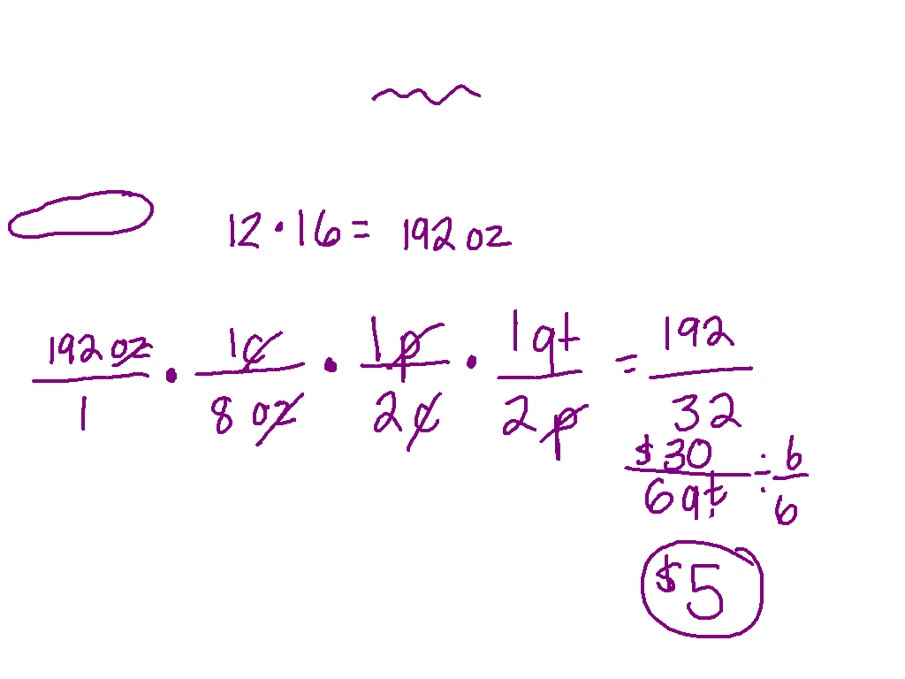
8 oz = 1 cup
1 pint = 2 cups
1 qt = 2 pints

Slide 2
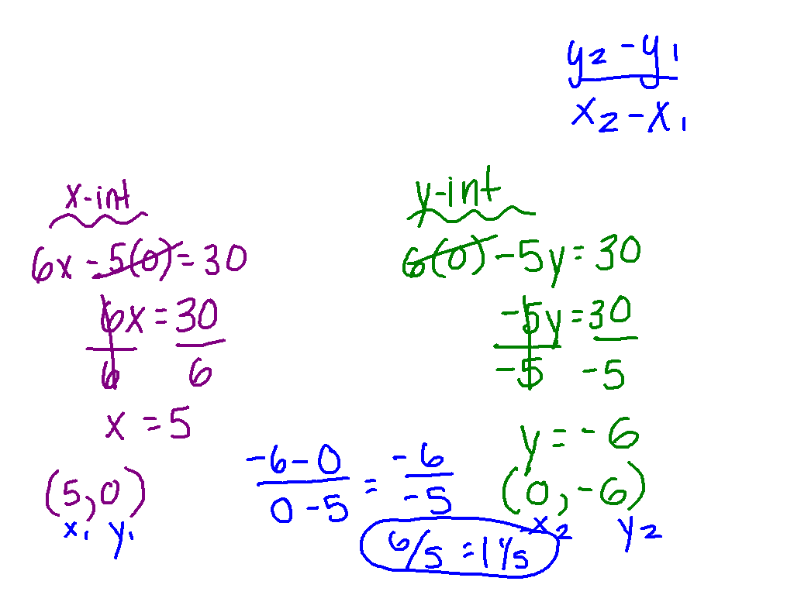
Slope from an Equation
6x – 5y = 30
Find the x intercept
Find the y intercept
Use the slope formula

Slide 3
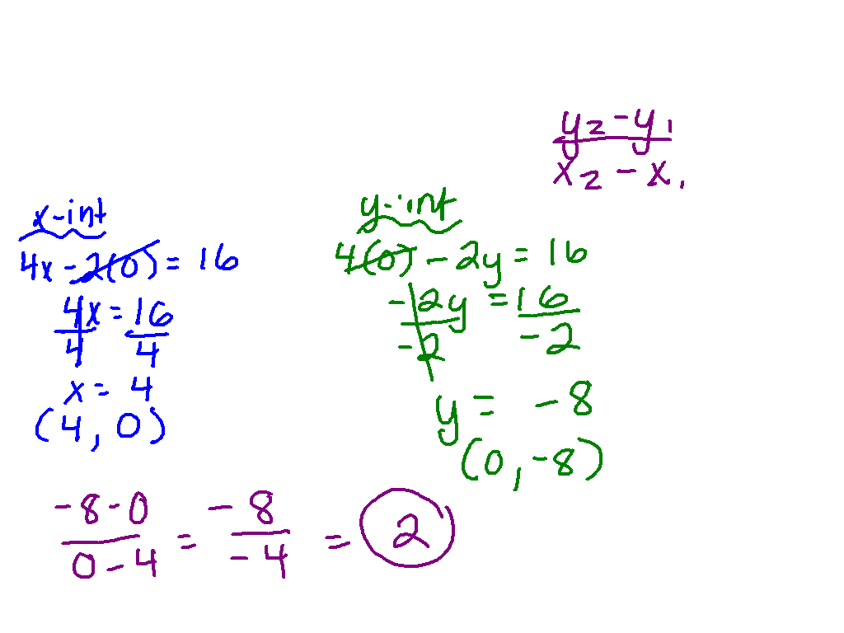
Slope from an Equation
Ex. 6) 4x – 2y = 16

Slide 4
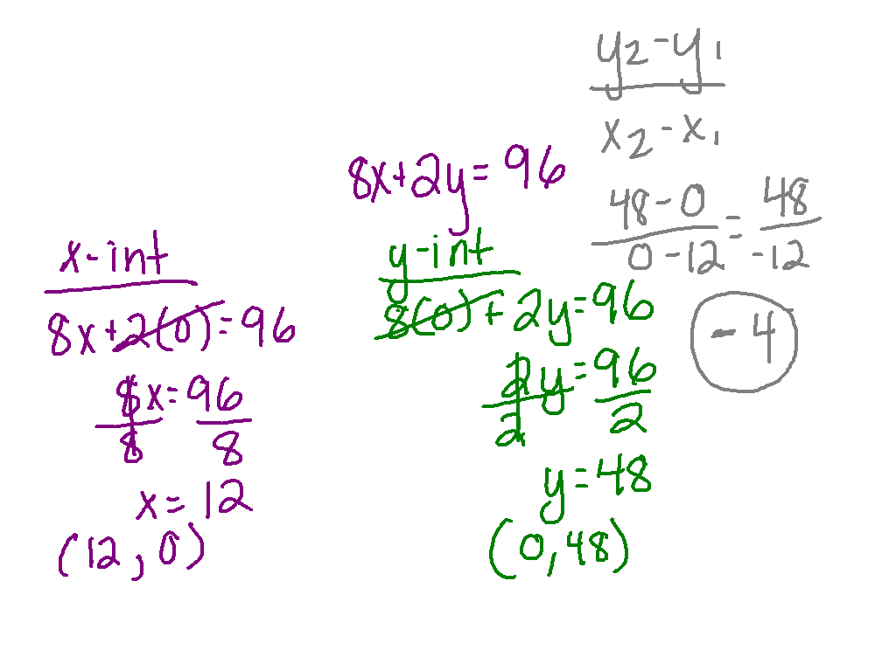
Practice
Pg. #8 - 13

