Slide 1
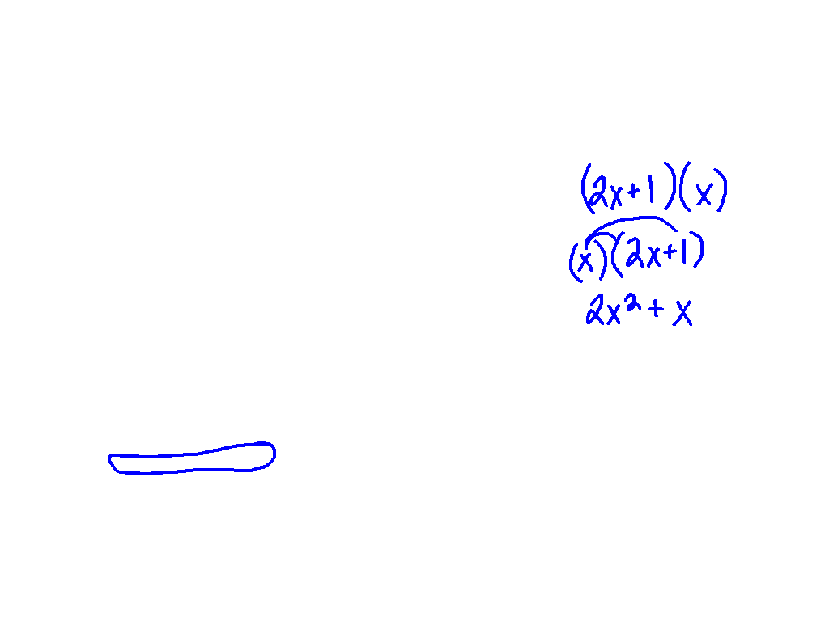
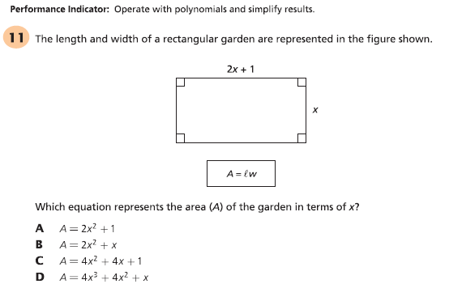
Starter Challenge

Slide 2
Simplifying Rational Expressions
I CAN and I WILL simplify rational expressions.

Slide 3
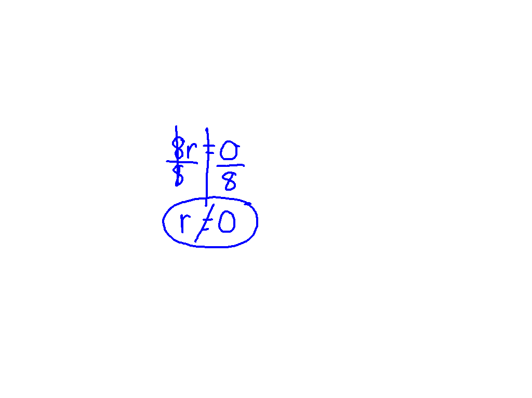
Excluded Values
5
8r

Slide 4
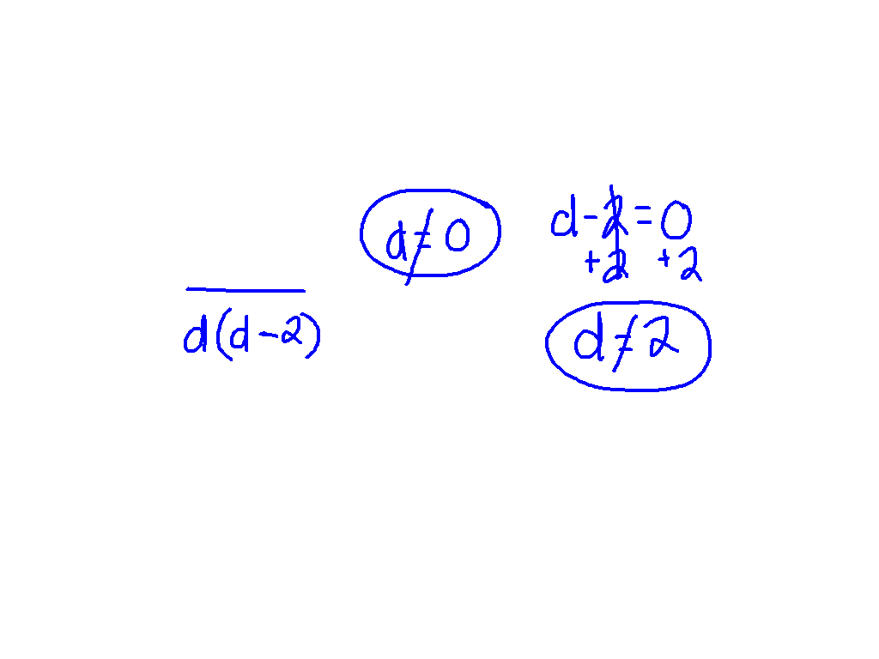
Excluded Values
Ex. 1) 9d + 1
d² – 2d

Slide 5
Excluded Values
Ex. 2) x + 4
x² + 5x + 6

Slide 6
Simplify Rational Expressions
3t³
12t

Slide 7
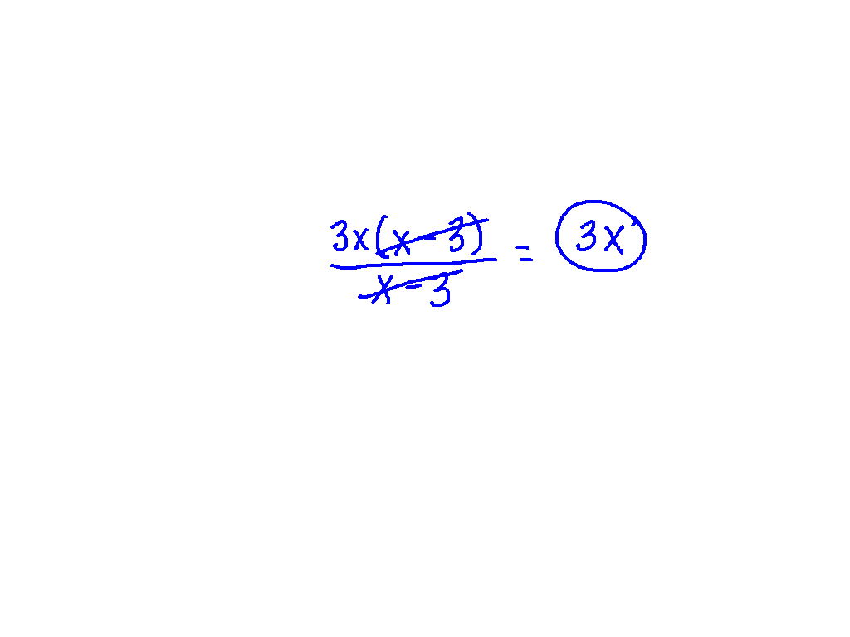
Simplify Rational Expressions
Ex. 3) 3x² – 9x
x – 3

Slide 8
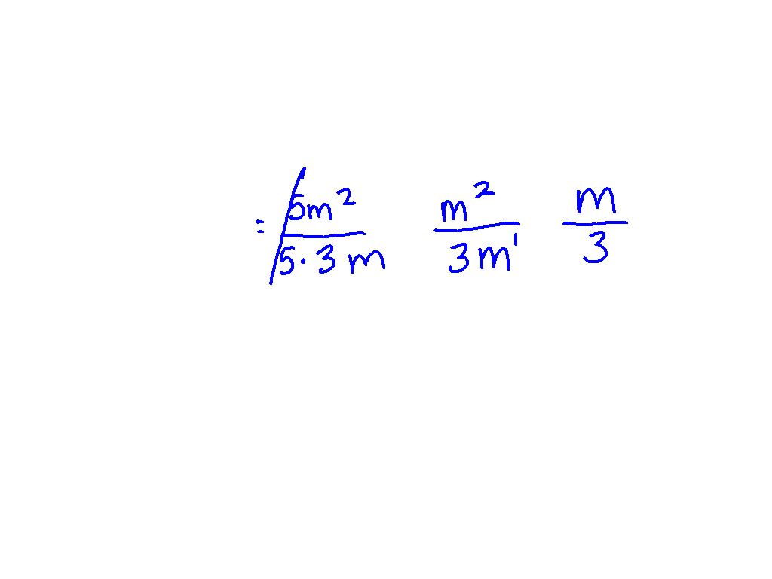
Simplify Rational Expressions
Ex. 4) 5m²
15m

Slide 9
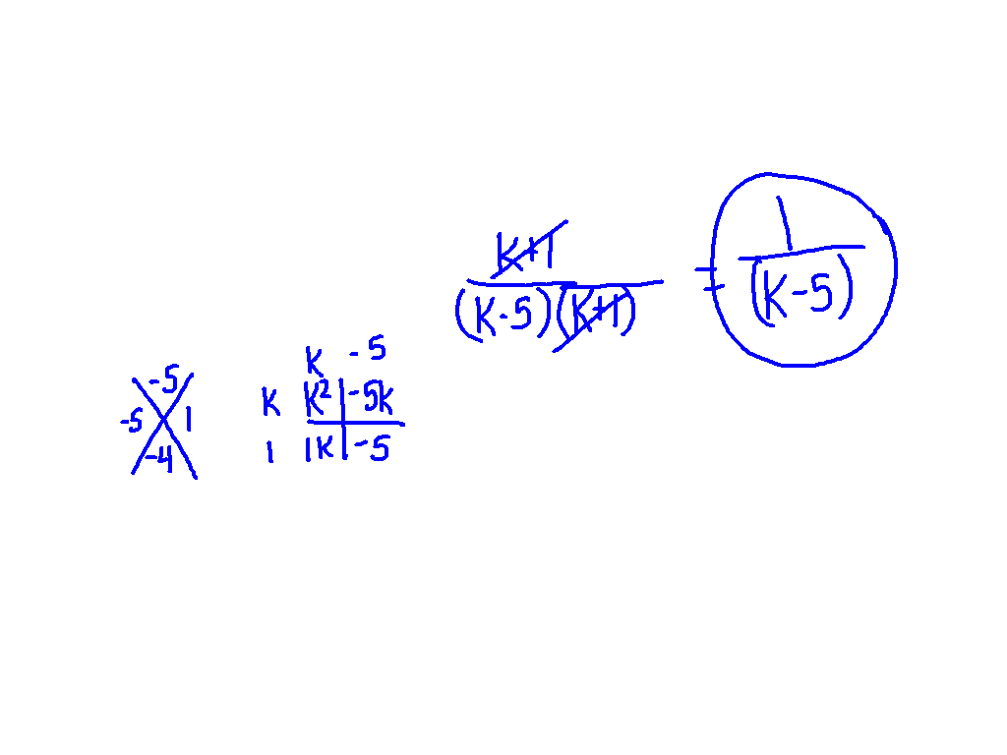
Simplify Rational Expressions
k + 1
k² – 4k - 5

Slide 10
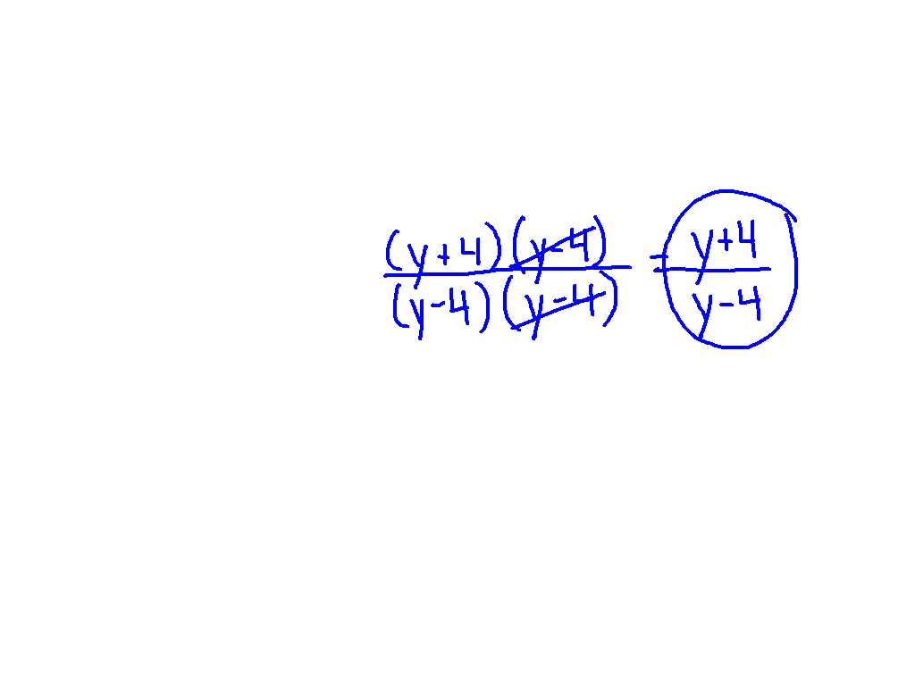
Simplify Rational Expressions
Ex. 5) y² – 16
y² – 8y +16

Slide 11
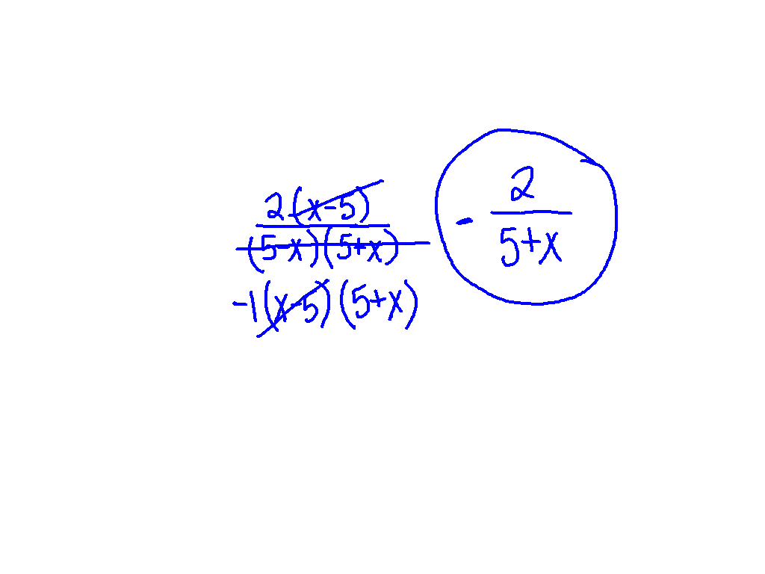
Simplify Rational Expressions
2x – 10
25 – x²

Slide 12
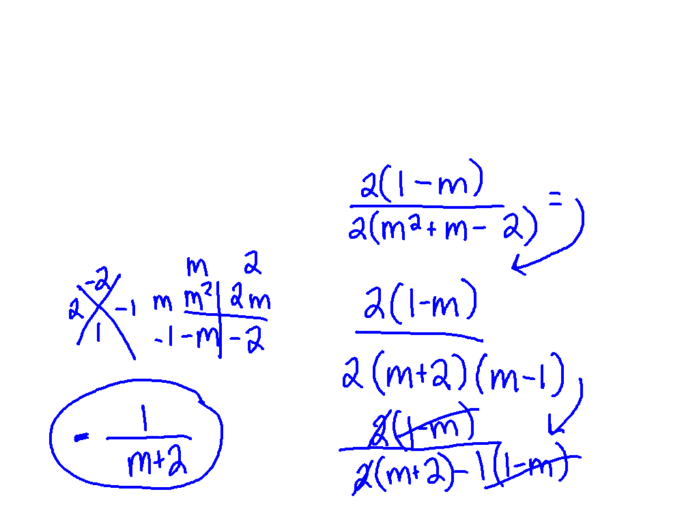
Simplify Rational Expressions
Ex. 6) 2 – 2m
2m² + 2m - 4

Slide 13
Time to Practice!
Pg. 890 # 2 – 7, 14 – 19

