Slide 2
Starter Challenge:
Take a TCAP Review Week Sheet from the front stool and work on Monday’s questions.

Slide 3
Objectives
I can and I will create and interpret scatterplots, and make and use a trend line.

Slide 4
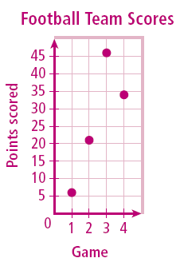
Check It Out!
The table shows the number of points scored by a high school football team in the first four games of a season. Graph a scatter plot using the given data.
Game | 1 | 2 | 3 | 4
Score | 6 | 21 | 46 | 34
Use the table to make ordered pairs for the scatter plot.
The x-value represents the individual games and the y-value represents the points scored in each game.
Plot the ordered pairs.

Slide 6
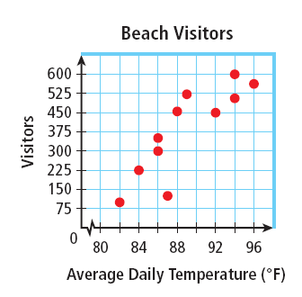
Describing Correlations from Scatter Plots
Describe the correlation illustrated by the scatter plot.
As the average daily temperature increased, the number of visitor increased.
There is a positive correlation between the two data sets.

Slide 7
Identifying Correlations
Identify the correlation you would expect to see between the pair of data sets. Explain.
the average temperature in a city and the number of speeding tickets given in the city
You would expect to see no correlation. The number of speeding tickets has nothing to do with the temperature.

Slide 8
Ex. 1) Identifying Correlations
the number of people in an audience and ticket sales
You would expect to see a positive correlation. As the number of people in the audience increases, ticket sales increase.

Slide 9
Ex. 2) Identifying Correlations
a runner’s time and the distance to the finish line
You would expect to see a negative correlation. As a runner’s time increases, the distance to the finish line decreases.

Slide 10
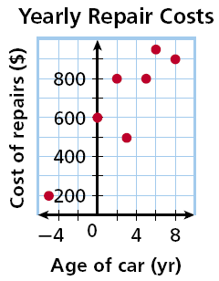
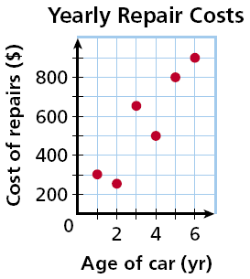
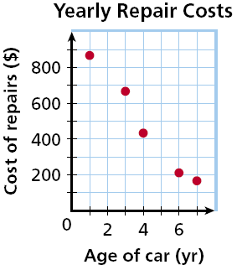
Matching Scatter Plots to Situations
Choose the scatter plot that best represents the relationship between the age of a car and the amount of money spent each year on repairs. Explain.
Graph A
Graph B
Graph C

Slide 11
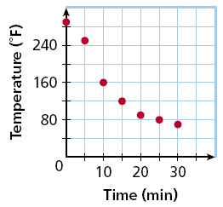
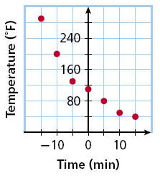
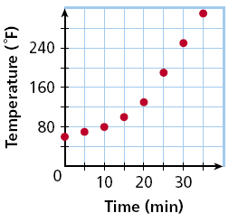
Check It Out!
Choose the scatter plot that best represents the relationship between the number of minutes since a pie has been taken out of the oven and the temperature of the pie. Explain.
Graph A
Graph B
Graph C

Slide 12
You can graph a function on a scatter plot to help show a relationship in the data. Sometimes the function is a straight line. This line, called a trend line or line of best fit, helps show the correlation between data sets more clearly. It can also be helpful when making predictions based on the data.

Slide 13
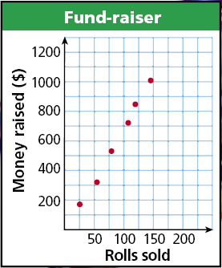
Check It Out!
Based on the trend line, predict how many wrapping paper rolls need to be sold to raise $500.
Find the point on the line whose
y-value is 500. The corresponding x-value is about 75.
Based on the data, about 75 wrapping paper rolls is a reasonable prediction of how many rolls need to be sold to raise $500.

Slide 14
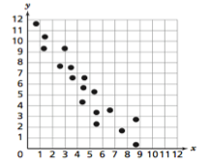
How to draw a trend line.

Slide 15
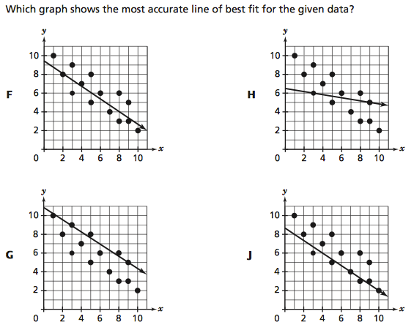

Slide 16
Time to Practice!

Slide 17
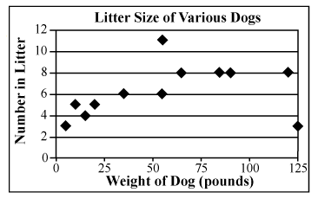
Dr. Kruckeberg recorded the weights of various dogs and the number of puppies in each dog's litter. Her data is shown in the scatter plot below.
A. Dogs that weigh less than 25 pounds have fewer puppies than dogs that weigh over 100 pounds.
B. Litter size increases with weight up to about 55 pounds, and then litter size steadily decreases.
C. A dog that weighs 150 pounds will likely have between 3 and 6 puppies.
D. Dogs between 25 and 100 pounds tend to have more puppies than dogs that weigh less than 25 pounds.

Slide 18
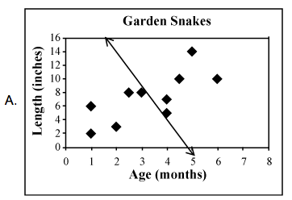
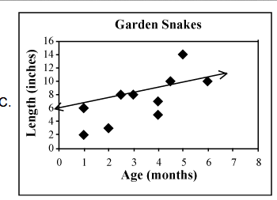
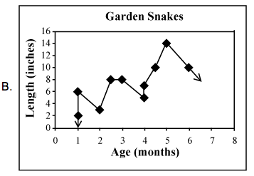
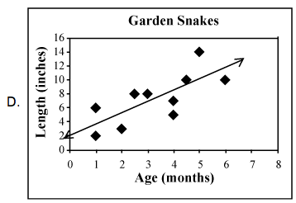
Which graph shows the trend line that John should use to predict the length of a snake that is older than 6 months?

