Slide 1
More Exponents! Rational Exponents
I CAN and I WILL simplify expressions containing rational exponents.

Slide 2
Some vocab…
Index: the small number to the left of the radical (√) that tells which root to take. ³ √8 = 2

Slide 3
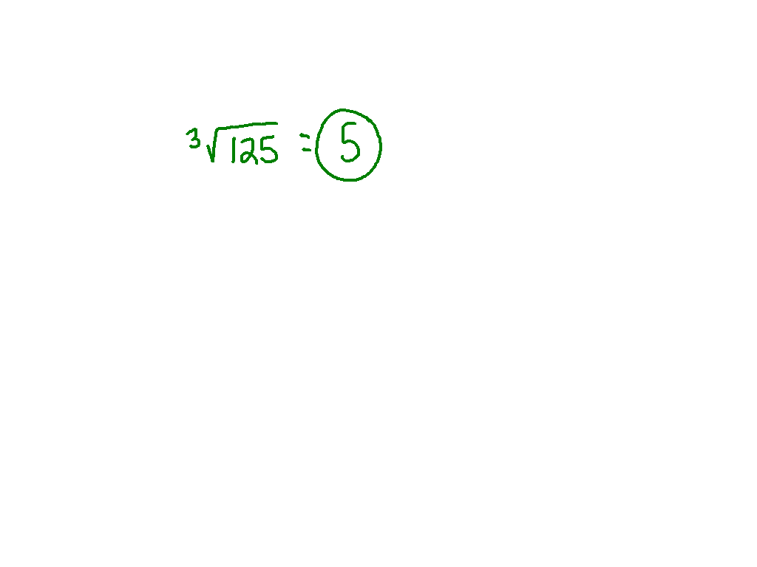
Watch This
125^{1/3}

Slide 4
Ex.)
64^{1/6} + 25^{1/2}

Slide 5
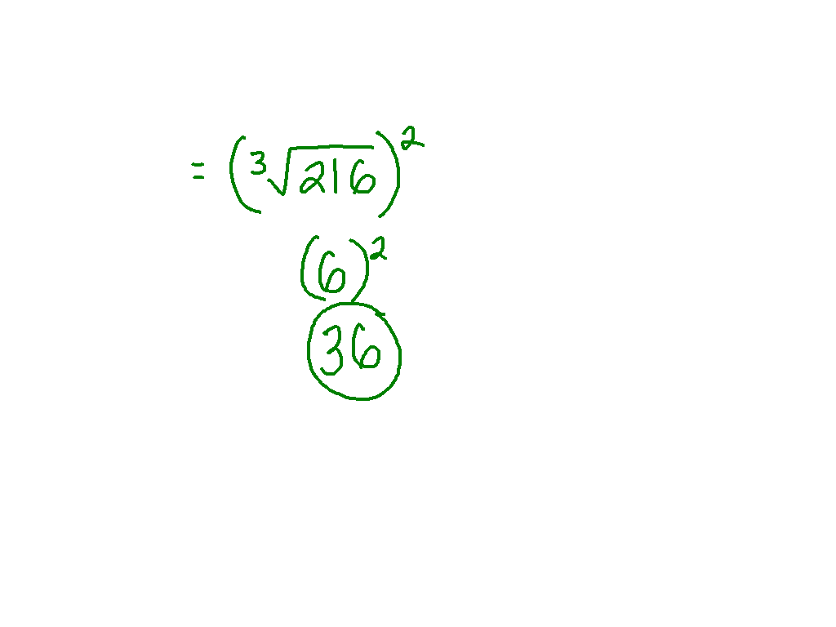
Watch This
216^{2/3}

Slide 6
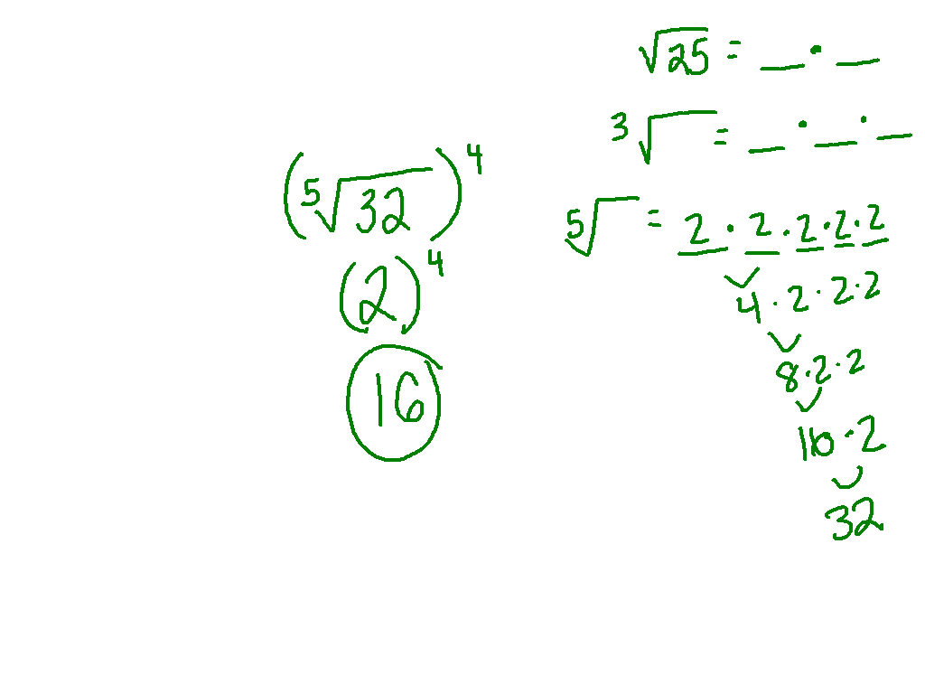
Ex.)
32^{4/5}

Slide 7
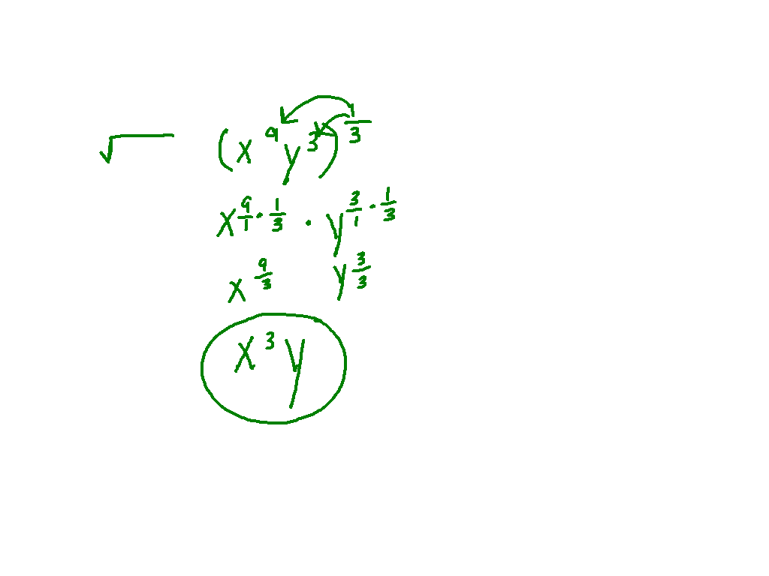
Watch This
³ √x⁹y³

Slide 8
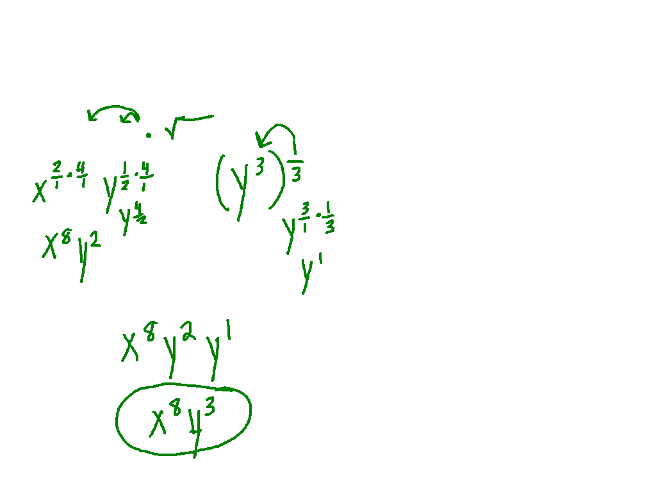
Ex)
(x²y^{1/2})⁴ ³√y³

Slide 9
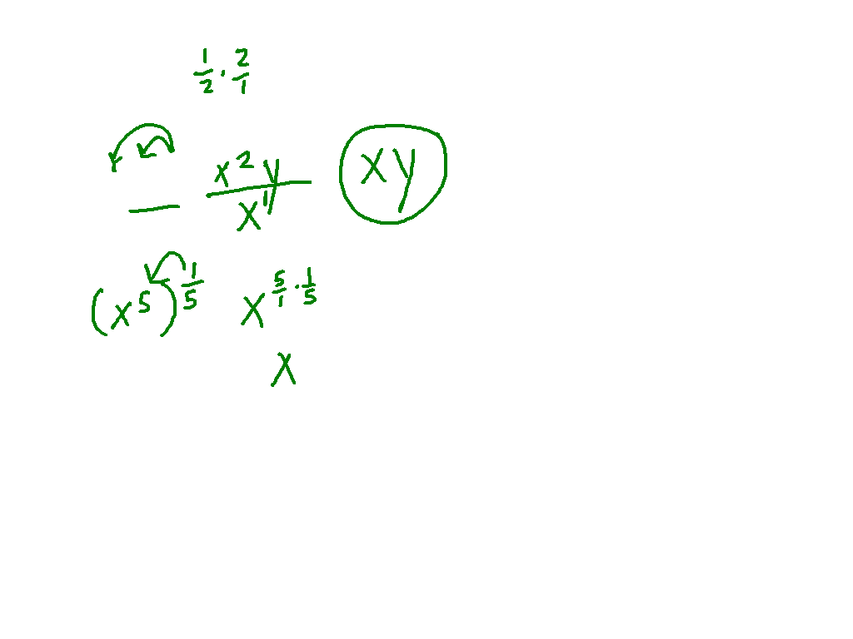
Ex)
(xy^{1/2})²
⁵√x⁵

Slide 10
Practice!
Pg. 491 # 23 - 30

