Slide 1
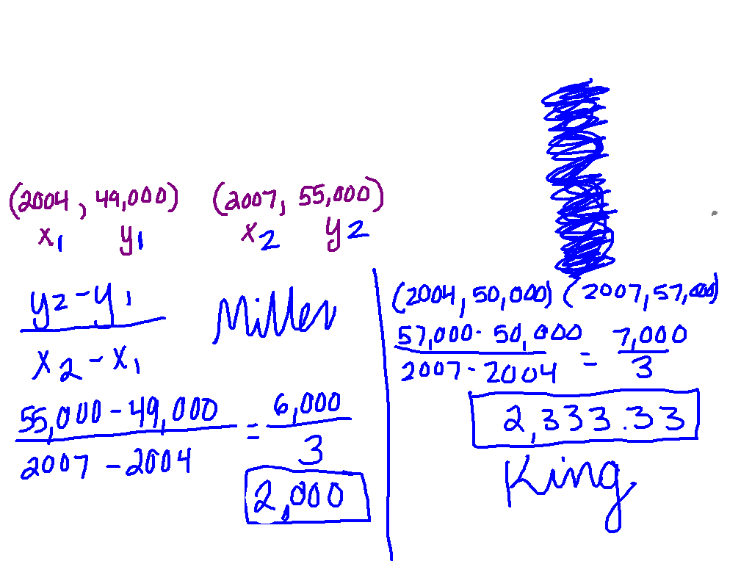
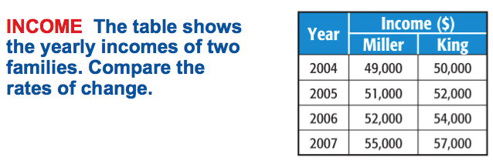

Slide 2
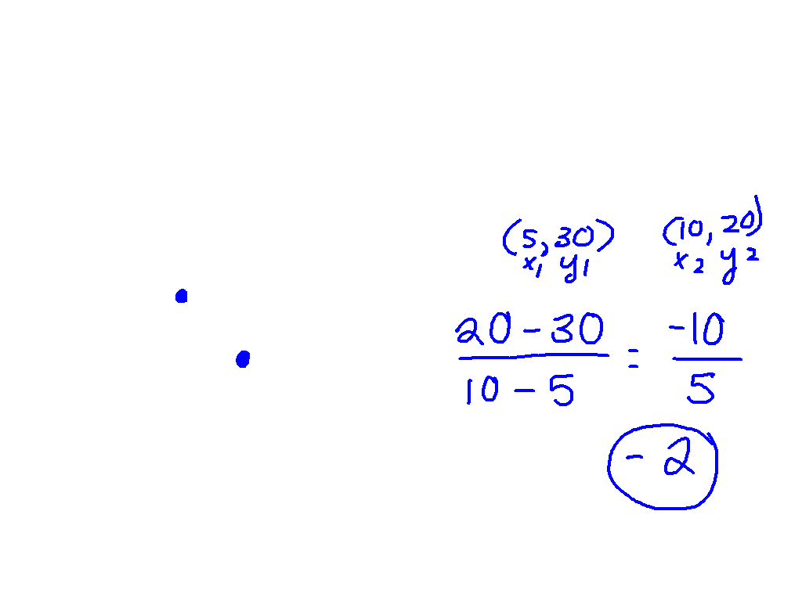
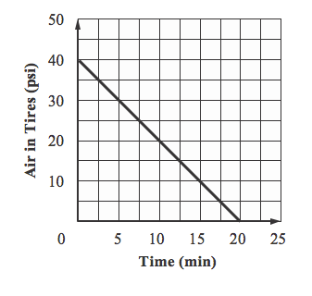
Let’s Try Together

Slide 3
Rate of Change Practice

Slide 4
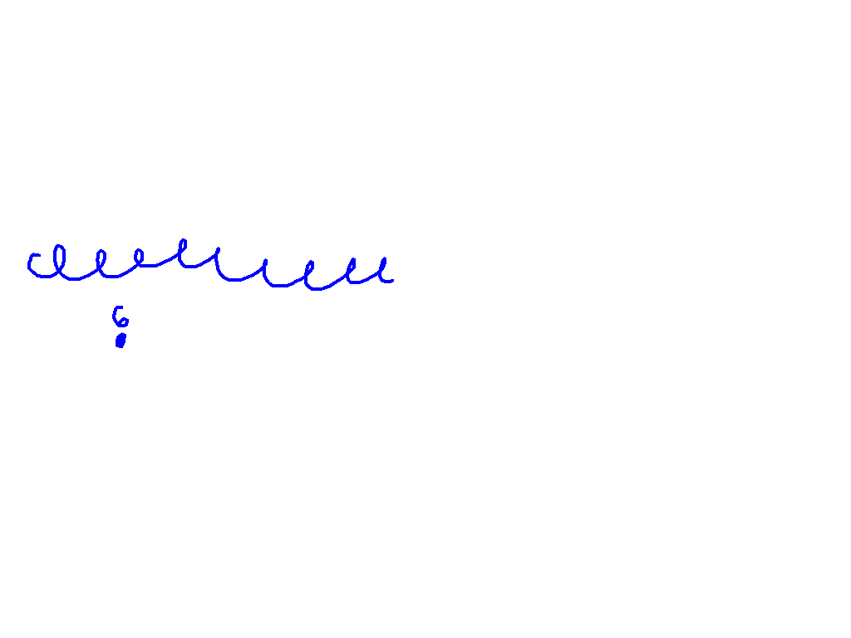
What are we doing?
1) Creating new base partners.
#1 – 8, Rate of Change Practice
You choose:
Rational/Irrational, Exponents, Scientific Notation Review (0.5 points each)
Equations and Pythagorean Theorem Review (1 point each)

Slide 5
03
59
58
57
56
55
54
53
52
51
50
49
48
47
46
45
44
43
42
41
40
39
38
37
36
35
34
33
32
31
30
29
28
27
26
25
24
23
22
21
20
19
18
17
16
15
14
13
12
11
10
09
08
07
06
05
04
03
02
01
00
Back to Clock Home
Countdown Clock By Dr. Jeff Ertzberger

Slide 6
02
59
58
57
56
55
54
53
52
51
50
49
48
47
46
45
44
43
42
41
40
39
38
37
36
35
34
33
32
31
30
29
28
27
26
25
24
23
22
21
20
19
18
17
16
15
14
13
12
11
10
09
08
07
06
05
04
03
02
01
00
Back to Clock Home
Countdown Clock By Dr. Jeff Ertzberger

Slide 7
01
59
58
57
56
55
54
53
52
51
50
49
48
47
46
45
44
43
42
41
40
39
38
37
36
35
34
33
32
31
30
29
28
27
26
25
24
23
22
21
20
19
18
17
16
15
14
13
12
11
10
09
08
07
06
05
04
03
02
01
00
Back to Clock Home
Countdown Clock By Dr. Jeff Ertzberger

Slide 8
00
59
58
57
56
55
54
53
52
51
50
49
48
47
46
45
44
43
42
41
40
39
38
37
36
35
34
33
32
31
30
29
28
27
26
25
24
23
22
21
20
19
18
17
16
15
14
13
12
11
10
09
08
07
06
05
04
03
02
01
00
Back to Clock Home
Countdown Clock By Dr. Jeff Ertzberger

Slide 9
What are we doing?
1) Creating new base partners.
#1 – 8, Rate of Change Practice
You choose:
Rational/Irrational, Exponents, Scientific Notation Review (0.5 points each)
Equations and Pythagorean Theorem Review (1 point each)

Slide 10
Get your desk ready for partner practice.

Slide 11
00
10
09
08
07
06
05
04
03
02
01
00
Back to Clock Home
Countdown Clock By Dr. Jeff Ertzberger

Slide 12
1st Base Partner

Slide 13
00
45
44
43
42
41
40
39
38
37
36
35
34
33
32
31
30
29
28
27
26
25
24
23
22
21
20
19
18
17
16
15
14
13
12
11
10
09
08
07
06
05
04
03
02
01
00
Back to Clock Home
Countdown Clock By Dr. Jeff Ertzberger

Slide 14
What are we doing?
1) Creating new base partners.
#1 – 8, Rate of Change Practice
You choose:
Rational/Irrational, Exponents, Scientific Notation Review (0.5 points each)
Equations and Pythagorean Theorem Review (1 point each)

Slide 15
Move desks back.

Slide 16
00
45
44
43
42
41
40
39
38
37
36
35
34
33
32
31
30
29
28
27
26
25
24
23
22
21
20
19
18
17
16
15
14
13
12
11
10
09
08
07
06
05
04
03
02
01
00
Back to Clock Home
Countdown Clock By Dr. Jeff Ertzberger

