Slide 1
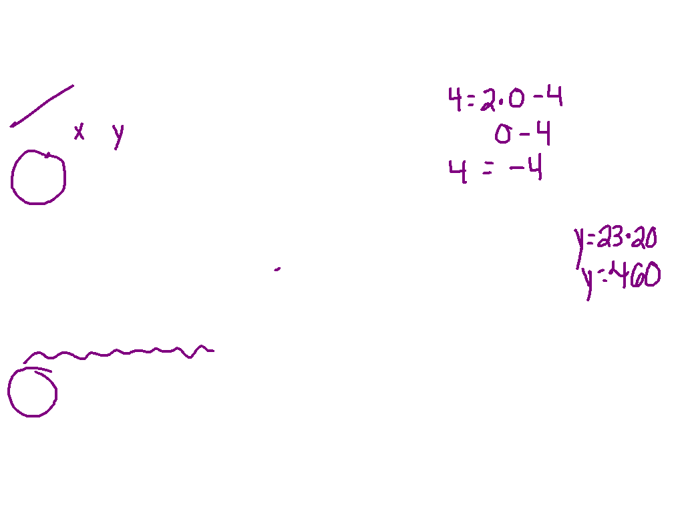
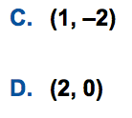
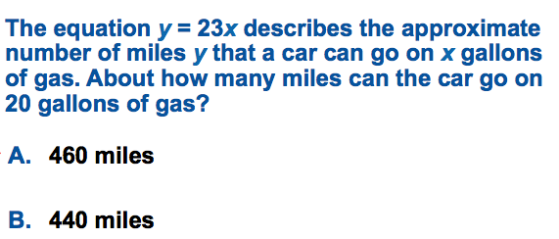
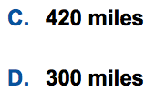

Slide 2
Rate of Change
I CAN and I WILL define and find rate of change.

Slide 3
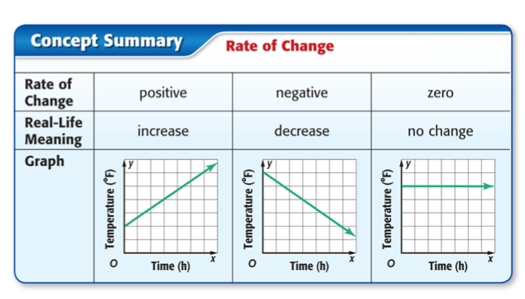

Slide 4
What is rate of change?
Rate: A ratio that compares two quantities.
Rate of Change: ratio describing how one quantity changes in relation to another quantity.
y₂ – y₁
x₂ – x₁

Slide 5
Watch This:

Slide 6
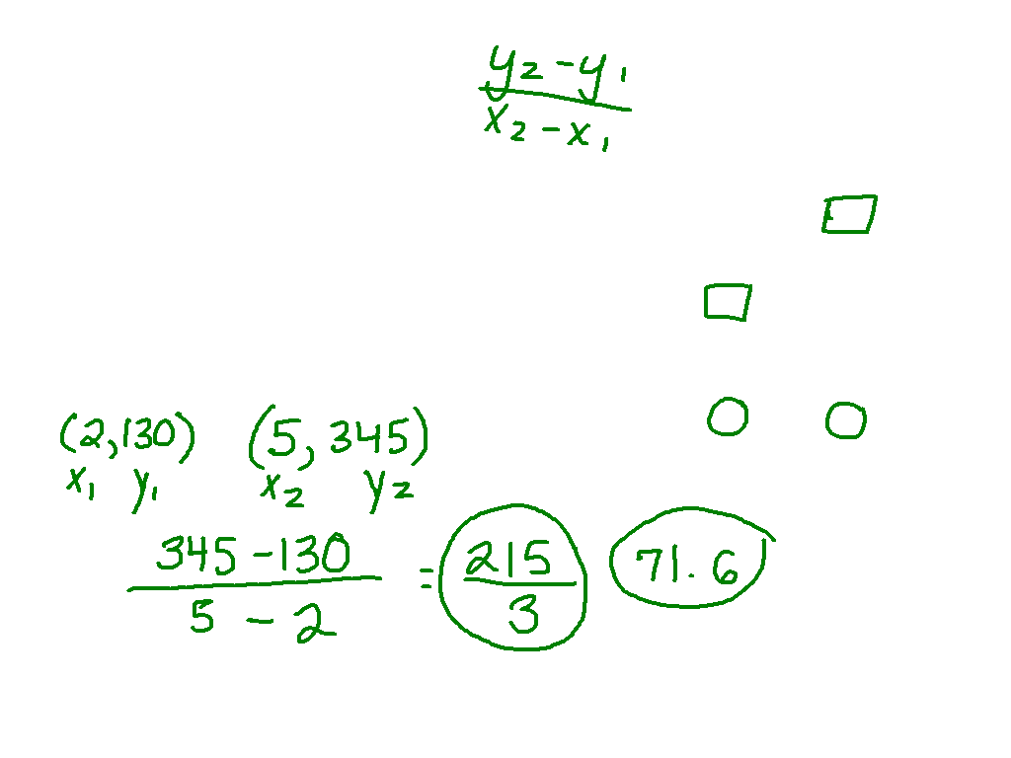
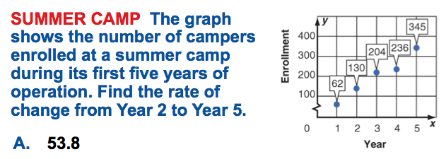
Ex. 1)

Slide 7
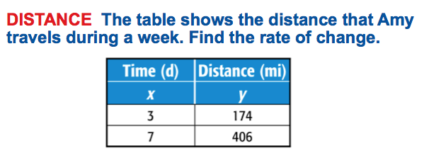
Watch This:

Slide 8
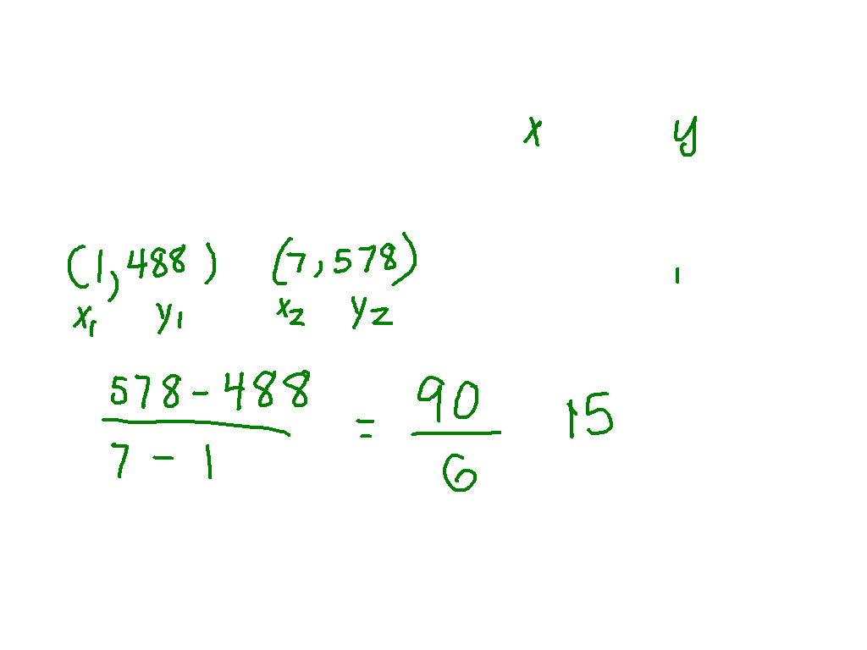
Ex. 2)

Slide 9
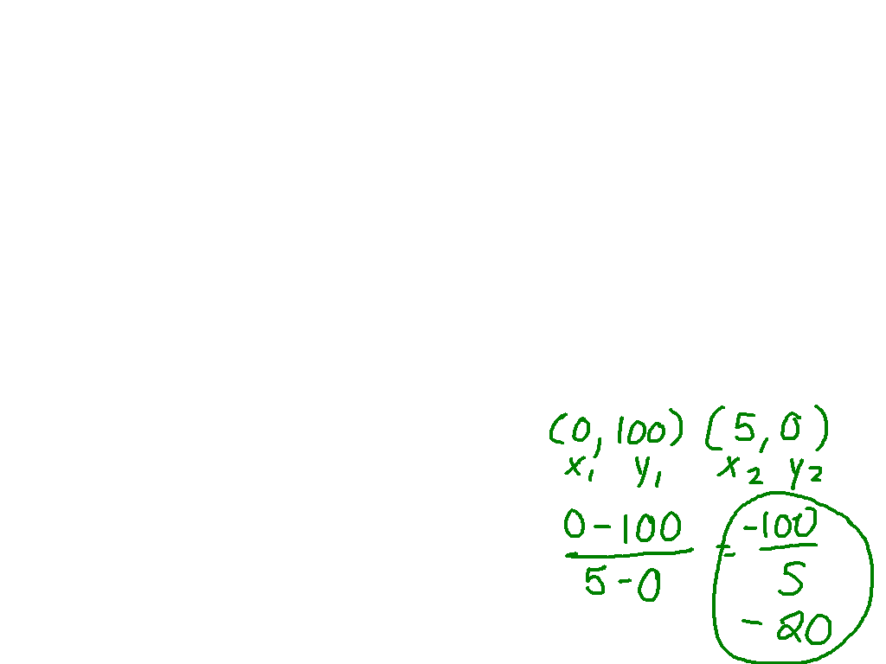
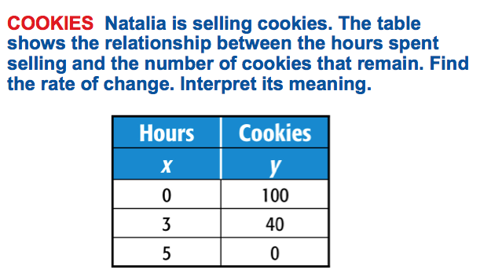
Ex. 3)

