Slide 1
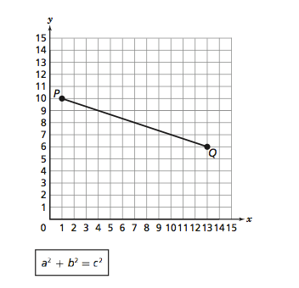
What is the value of the line segment PQ?

Slide 2
Pythagorean Word Problems
I CAN and I WILL solve real world problems using the Pythagorean Theorem.

Slide 3
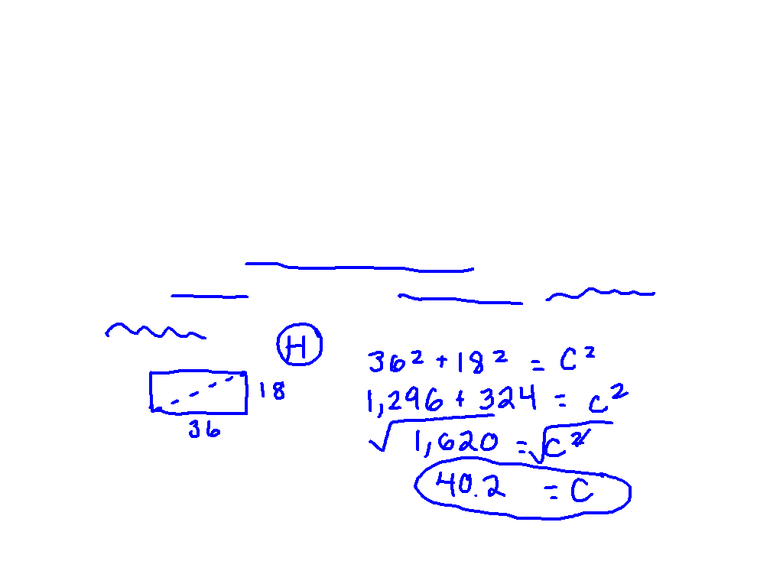
Let’s Try Together
Seth made a small rectangular table for his workroom. The sides of the table are 36" and 18". What is the diagonal (from corner to corner) length of the table?

Slide 4
Get your desk ready for partner practice.

Slide 5
00
10
09
08
07
06
05
04
03
02
01
00
Back to Clock Home
Countdown Clock By Dr. Jeff Ertzberger

Slide 6
1st Base Partner

Slide 7
00
45
44
43
42
41
40
39
38
37
36
35
34
33
32
31
30
29
28
27
26
25
24
23
22
21
20
19
18
17
16
15
14
13
12
11
10
09
08
07
06
05
04
03
02
01
00
Back to Clock Home
Countdown Clock By Dr. Jeff Ertzberger

Slide 8
What am I doing?
On your own sheet of paper, complete the Pythagorean Theorem word problems.
Tell me if you are finding the hypotenuse or the leg.
Remember, drawing pictures helps!

Slide 9
What am I doing?
On your own sheet of paper, you are matching the number and its classification. You must justify your answer!
Identifying the function rule.
Quiz

Slide 10
Move desks back.

Slide 11
00
45
44
43
42
41
40
39
38
37
36
35
34
33
32
31
30
29
28
27
26
25
24
23
22
21
20
19
18
17
16
15
14
13
12
11
10
09
08
07
06
05
04
03
02
01
00
Back to Clock Home
Countdown Clock By Dr. Jeff Ertzberger

Slide 12
Post It Problem
A 15 foot ladder is leaning against a house. The base of the ladder is 3.5 feet from the house. About how many feet does the ladder reach on the side of the house? (Round to the nearest tenth!)

