Slide 1
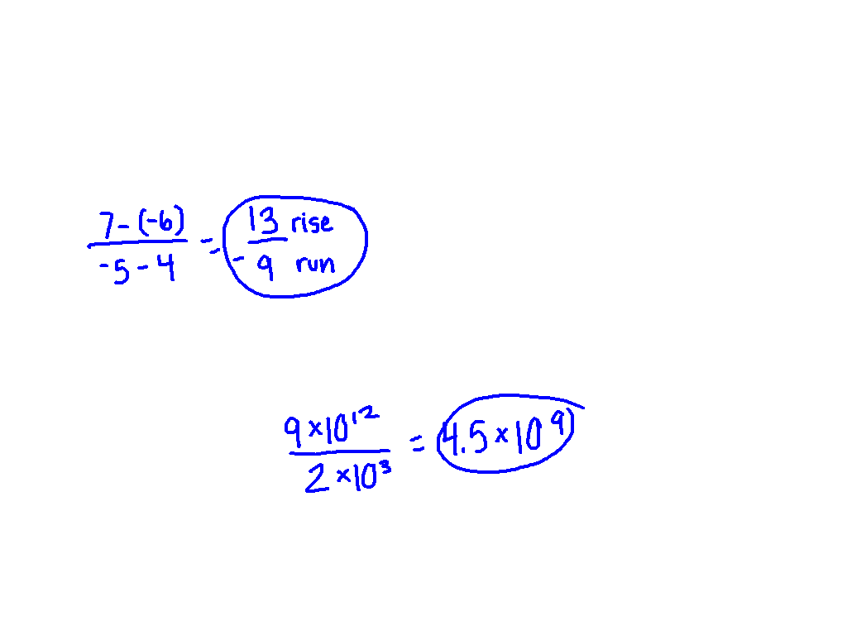
Starter Challenge

Slide 2
Test 1 Results
PHD: 90 – 100
Masters: 80 – 89
Bachelors: 70 – 79
Still Working: 69 or below
(80)
(80)
(83)
(74)

Slide 3
Pythagorean Theorem
I can and I will use the Pythagorean Theorem

Slide 4
Right Triangle
hypotenuse
leg
leg
Right angle

Slide 5
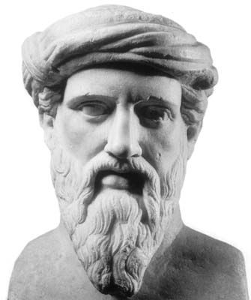
Pythagorean Theorem
The Pythagorean Theorem ONLY applies to right triangles where a and b are the legs and c is the hypotenuse.
Pythagoras
c
a
b
a² + b² = c²

Slide 6
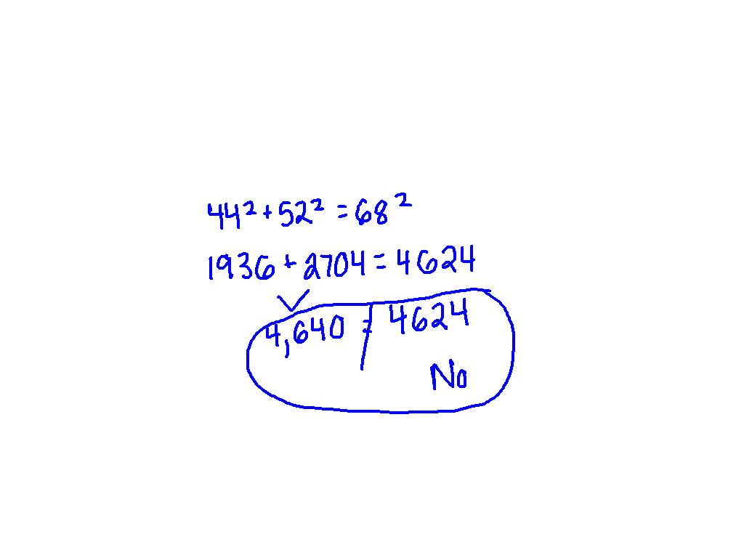
Is it a right triangle?
a = 44m b = 52m c = 68m

Slide 7
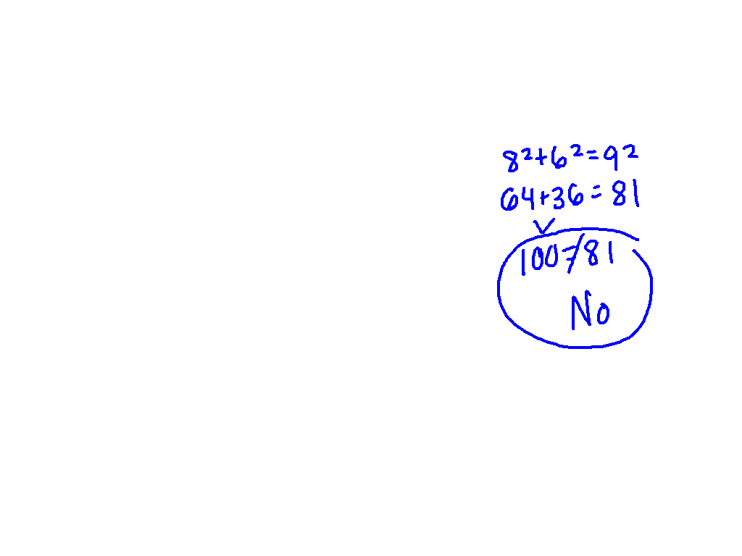
Ex. 1) Is it a right triangle
8 in.
6 in.
9 in.

Slide 8
Ex. 2) Is it a right triangle?
13 cm
5 cm
12 cm

Slide 9
What am I doing?
Pythagorean Theorem Assignment – Is it a right triangle?
Shade in only the triangles that are right triangles.
Be creative in how you shade them!
Keep you voices at the appropriate volume.

Slide 10
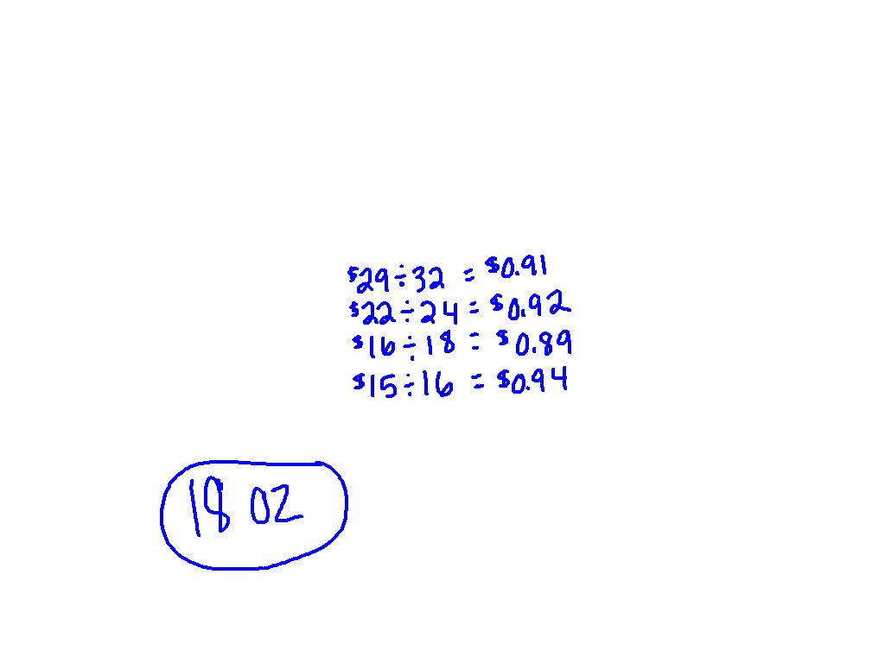
Starter Challenge
Turn in your Is It a Right Triangle? Practice.

Slide 11
Pythagorean Theorem
Objective: I CAN and I WILL find the missing values.
c
a
b
a² + b² = c²

Slide 12
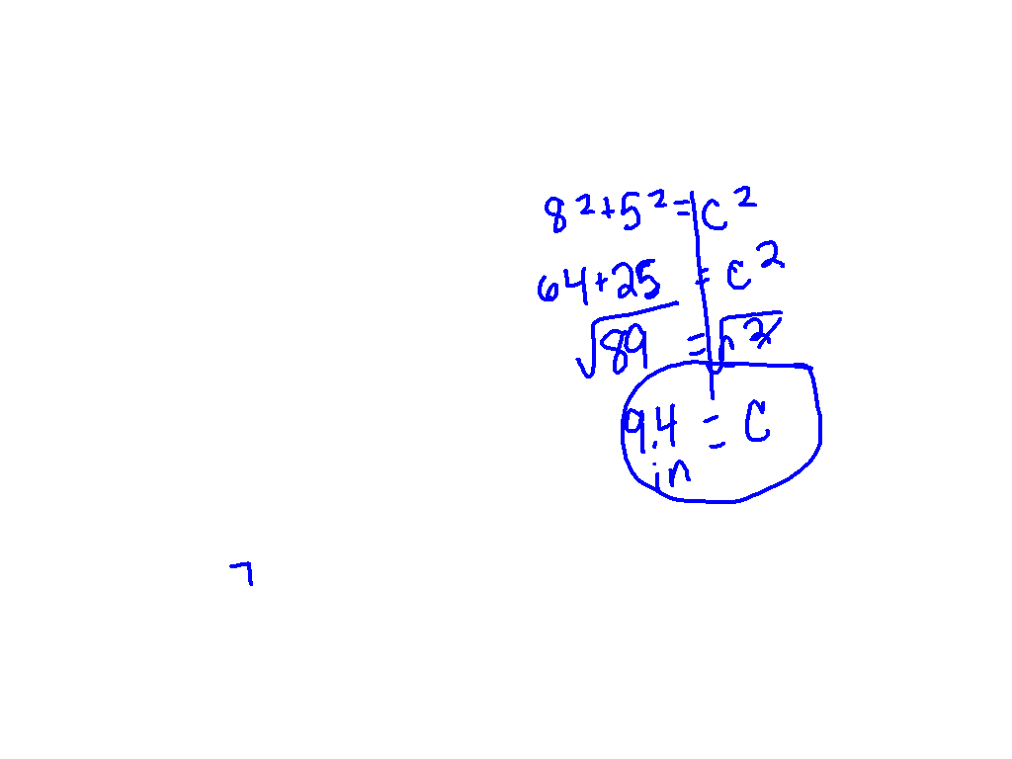
Find the Hypotenuse
8 in.
5 in.

Slide 13
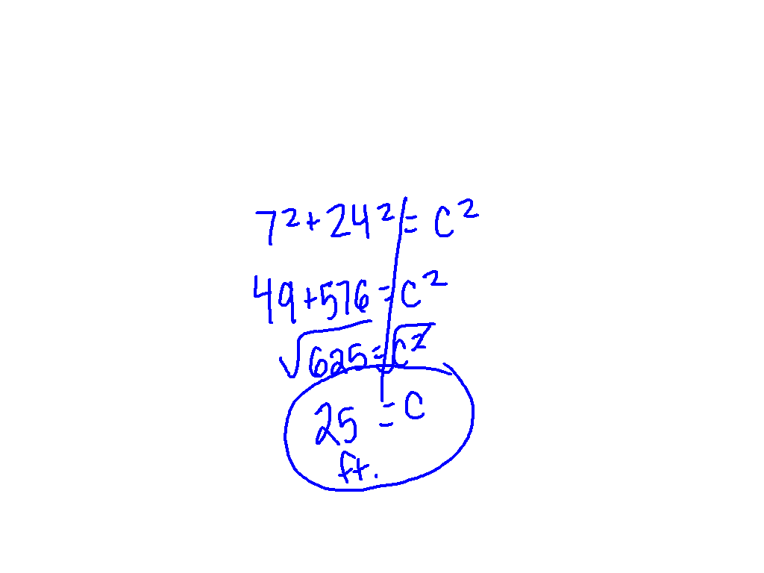
Ex. 3) Find the Hypotenuse
a=7ft b=24ft c=?

Slide 14
Ex. 4) Find the Hypotenuse
c
16ft.
30ft.

Slide 15
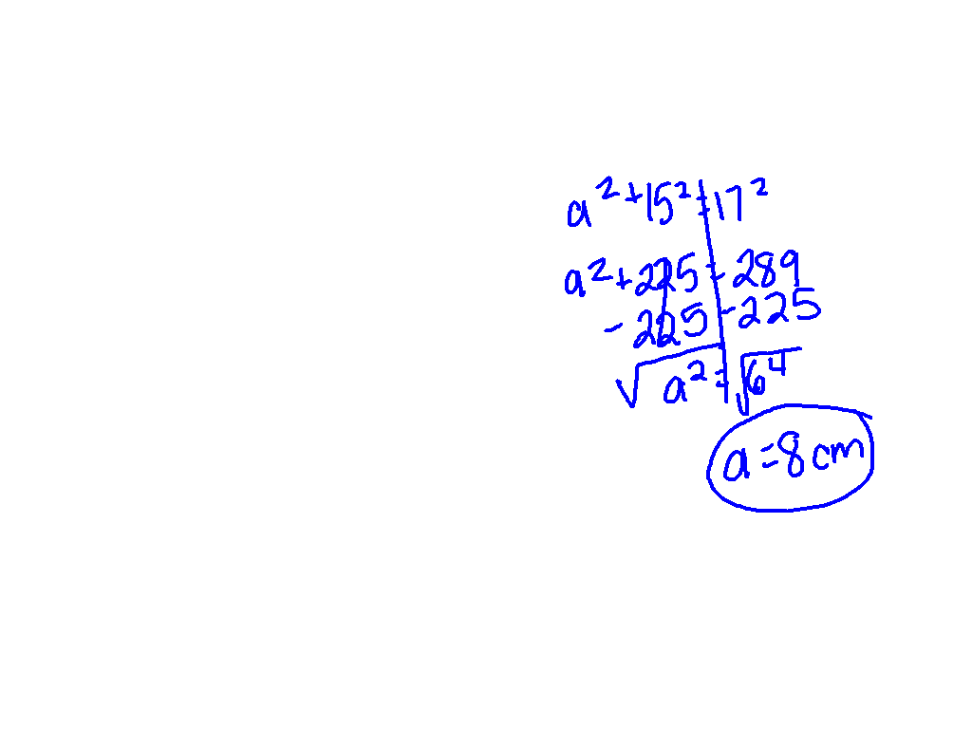
Find the missing value
17cm
15cm

Slide 16
Ex. 5) Find the missing value
a = 11ft b = ? c = 19ft

Slide 17
Ex. 6) Find the missing value
33
25

Slide 18
What am I doing?
Pythagorean Theorem Assignment
Show your work! (on separate sheet of paper if necessary)
Use your notes to help you.

Slide 19
Get your desks ready for partner practice

Slide 20
00
20
19
18
17
16
15
14
13
12
11
10
09
08
07
06
05
04
03
02
01
00
Back to Clock Home
Countdown Clock By Dr. Jeff Ertzberger

Slide 21
What am I doing?
Pythagorean Theorem Assignment
Show your work! (on separate sheet of paper if necessary)
Use your notes to help you.

Slide 22
Desks back into rows

Slide 23
00
20
19
18
17
16
15
14
13
12
11
10
09
08
07
06
05
04
03
02
01
00
Back to Clock Home
Countdown Clock By Dr. Jeff Ertzberger

Slide 24
Exit Ticket
Explain in words how you find the missing hypotenuse using the Pythagorean Theorem.

