Slide 1
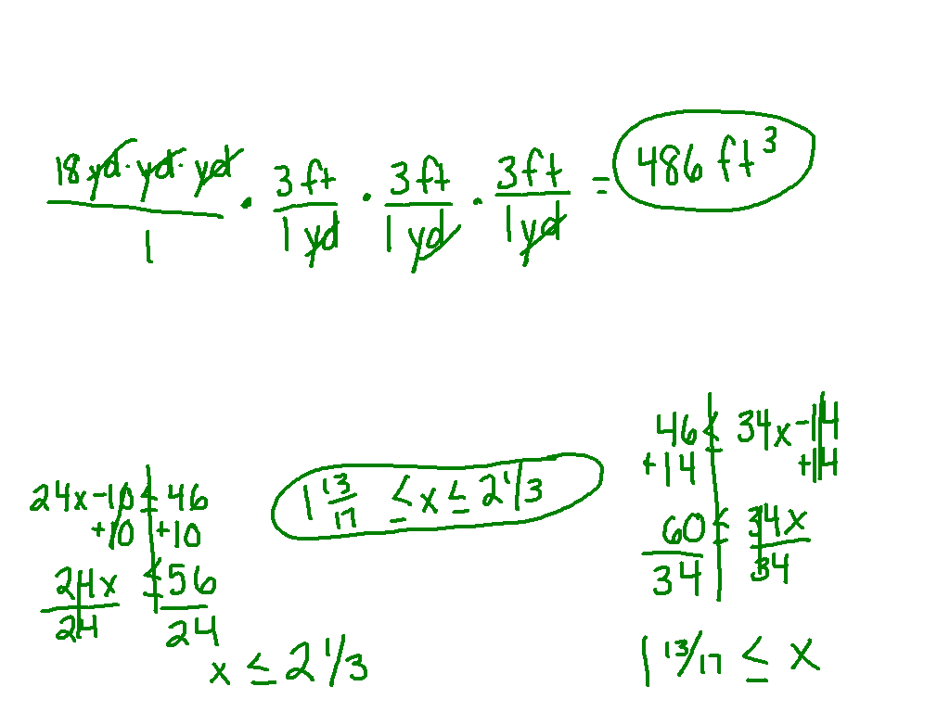
Starter challenge

Slide 2
Point-slope form
I can and I will graph a line and write an equation using point slope form.

Slide 3
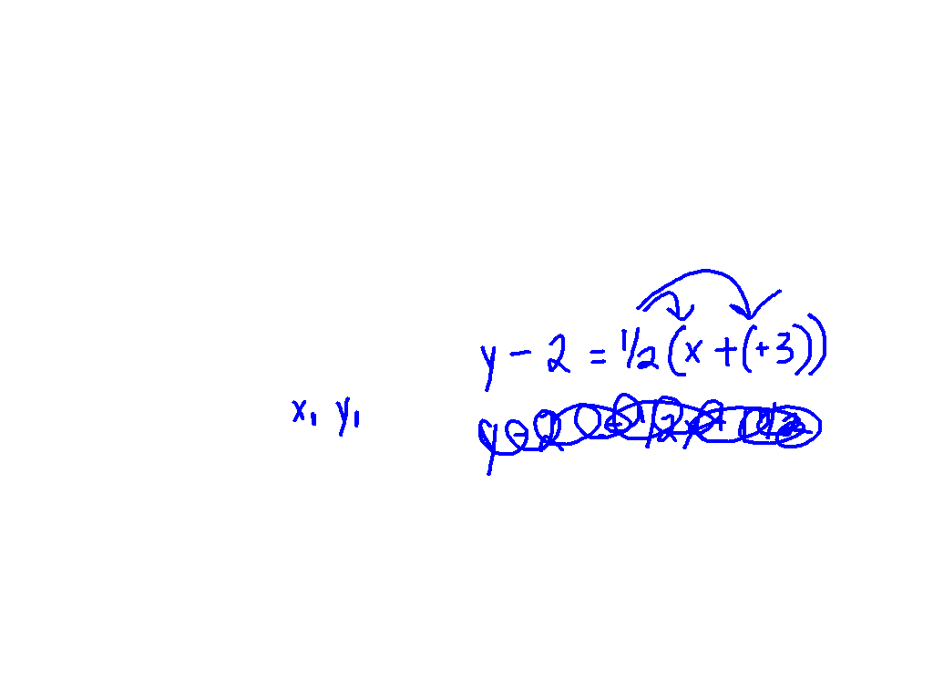
What is point-slope form?
y – y₁ = m(x – x₁)
Watch This
slope = ½; (-3, 2)

Slide 4
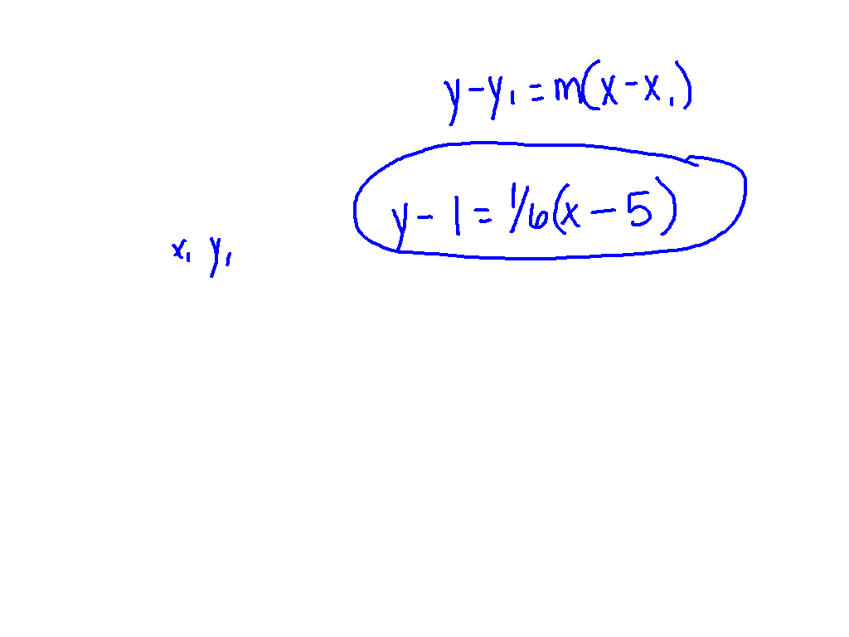
Ex. 1)
Write in point-slope form -
Slope: 1/6; (5,1)

Slide 5
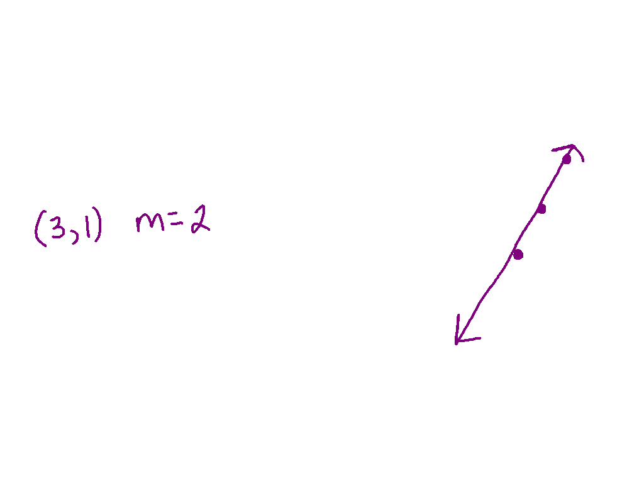
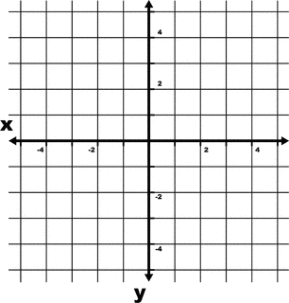
Watch this
Graph the line described by each equation –
y – 1 = 2(x – 3)

Slide 6
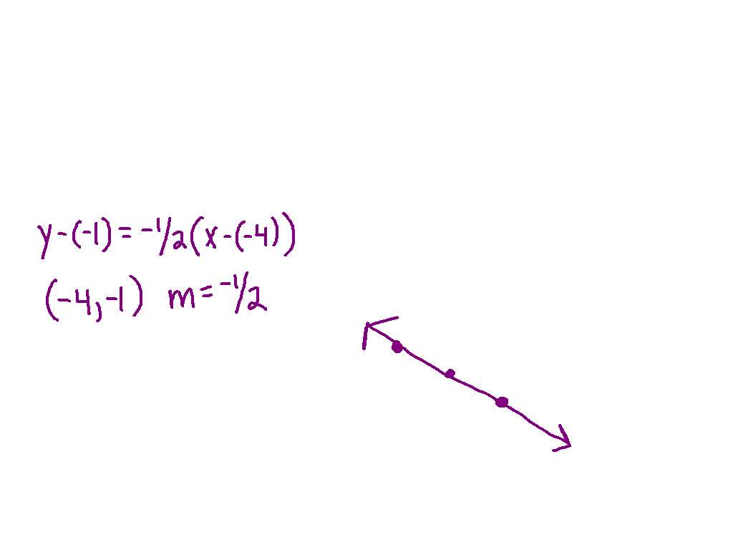
Ex 2)
Graph the line described by each equation –
y + 1 = - ½ (x + 4)

Slide 7
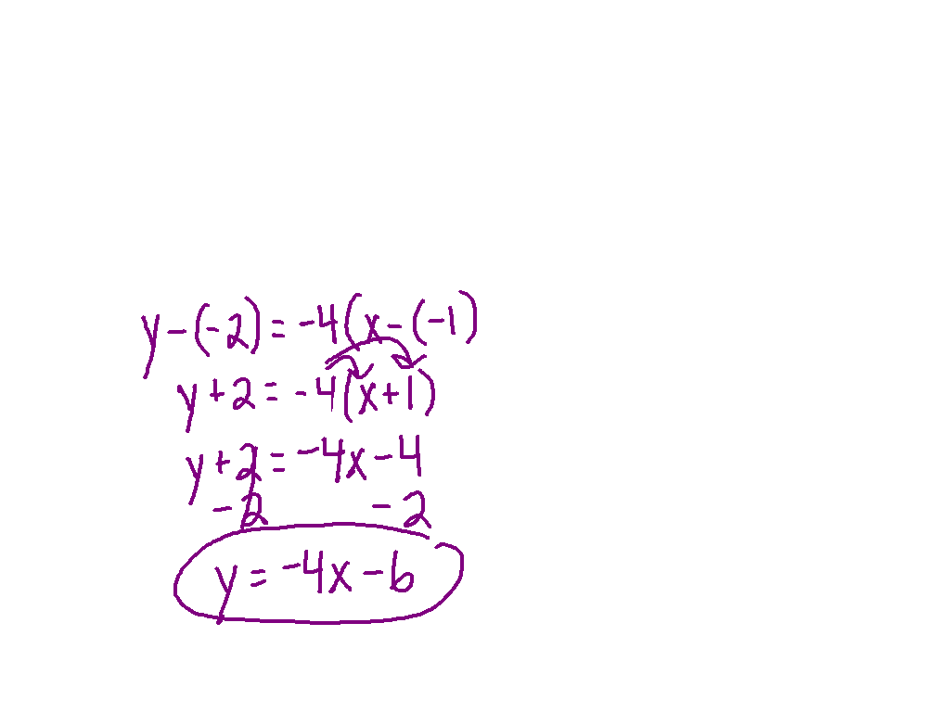
Watch this
Write the equation in slope-intercept form –
slope = -4, (-1, -2) is on the line.

Slide 8
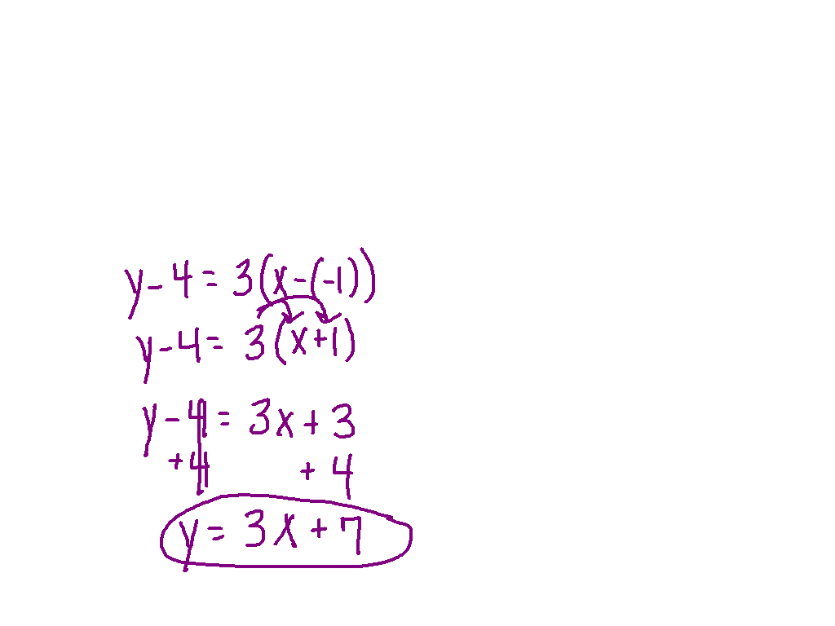
Ex 3)
Write the equation in slope-intercept form –
slope = 3, (-1, 4) is on the line.

Slide 9
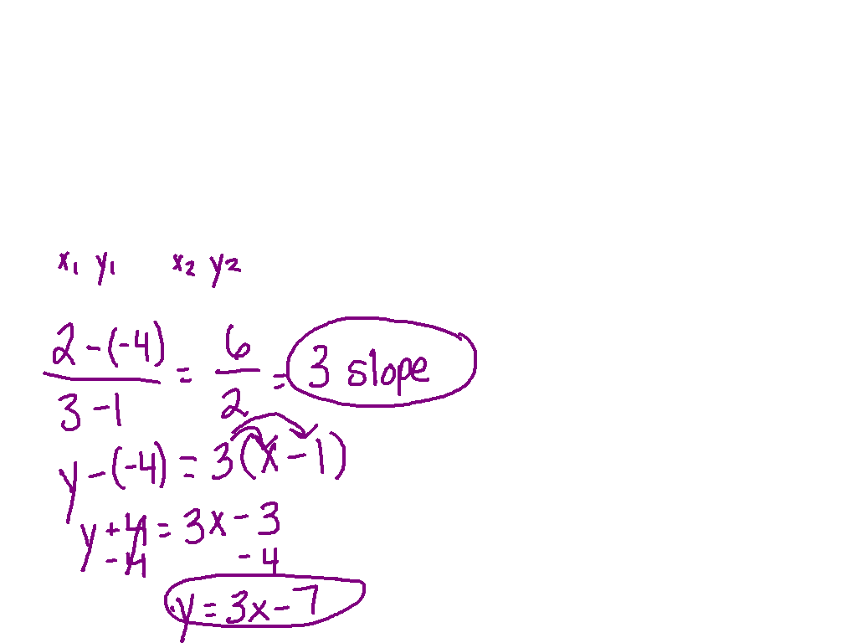
Ex 4)
Write the equation in slope-intercept form –
(1, -4) and (3, 2) are on the line.

Slide 10
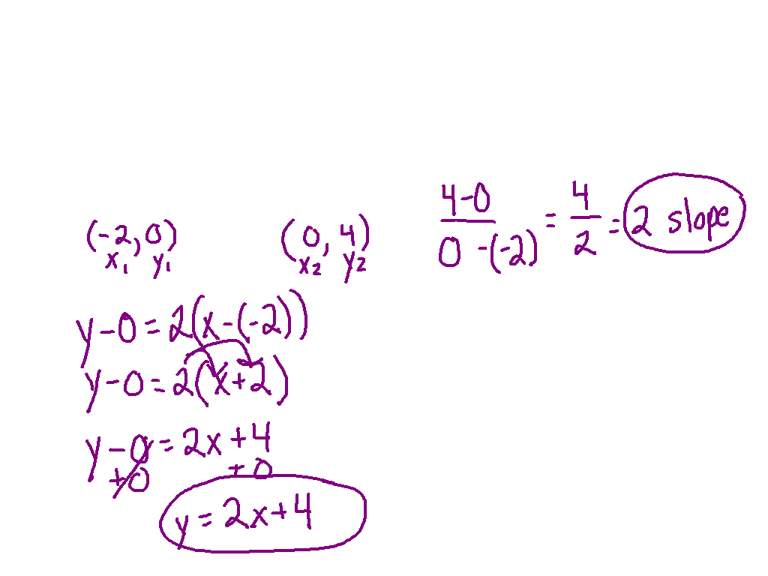
Ex 5)
Use the intercepts to find two points–
x-intercept = -2 and y-intercept = 4

Slide 11
Watch this
The points (4, 8) and (-1, -12) are on a line. Find the intercepts.

Slide 12
Ex 6)
The points (10, -3) and (5, 2) are on a line. Find the intercepts.

Slide 13
Practice! Pg. 355 # 1- 3, 7-12

