Slide 1
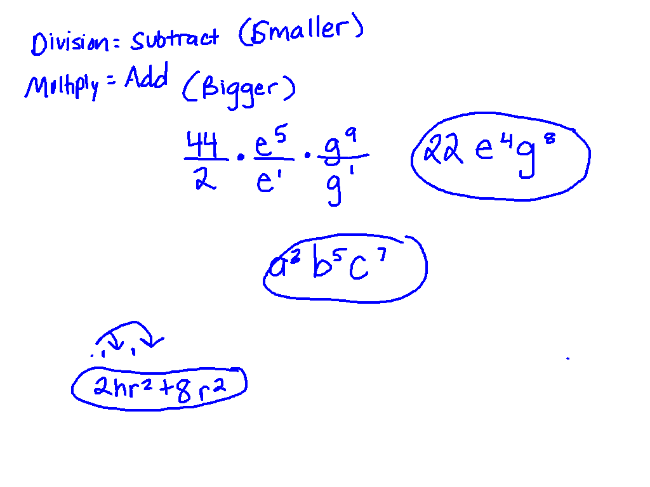
Starter Challenge
1.) 44e⁵g⁹
2eg
2.) a²b³c⁴ ab²c³
3.) 2r(hr + 4r)
Turn in your HW to your period’s tray on the ac. If you don’t have yours, fill out a homework excuse form.

Slide 2
Negative exponents
I CAN and I will write and solve problems using negative exponents.

Slide 3
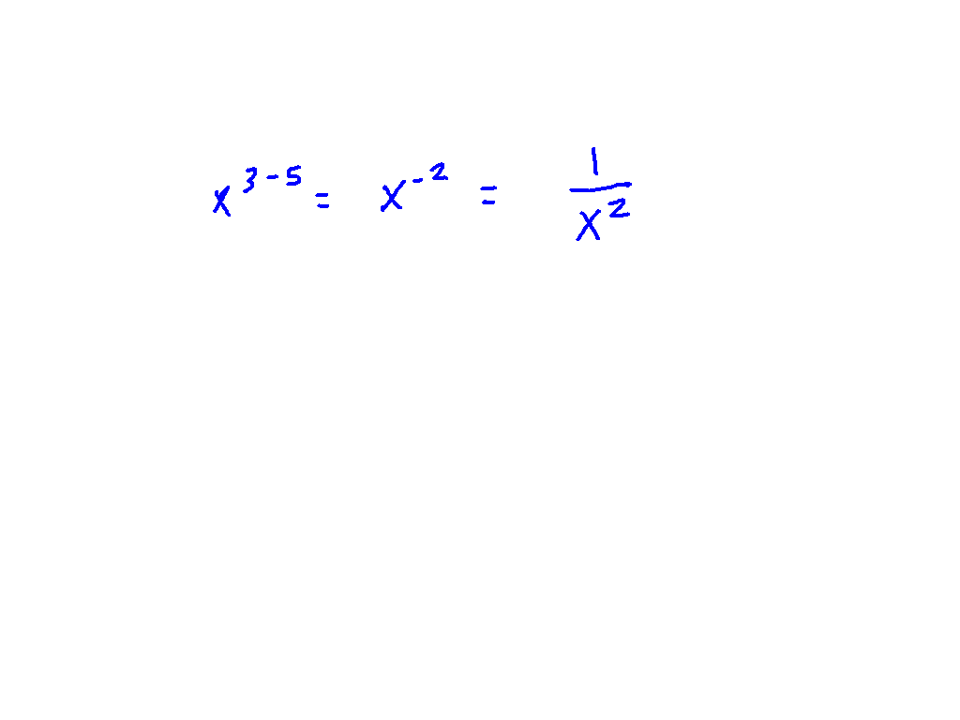
Dividing with negatives
x³
x⁵

Slide 4
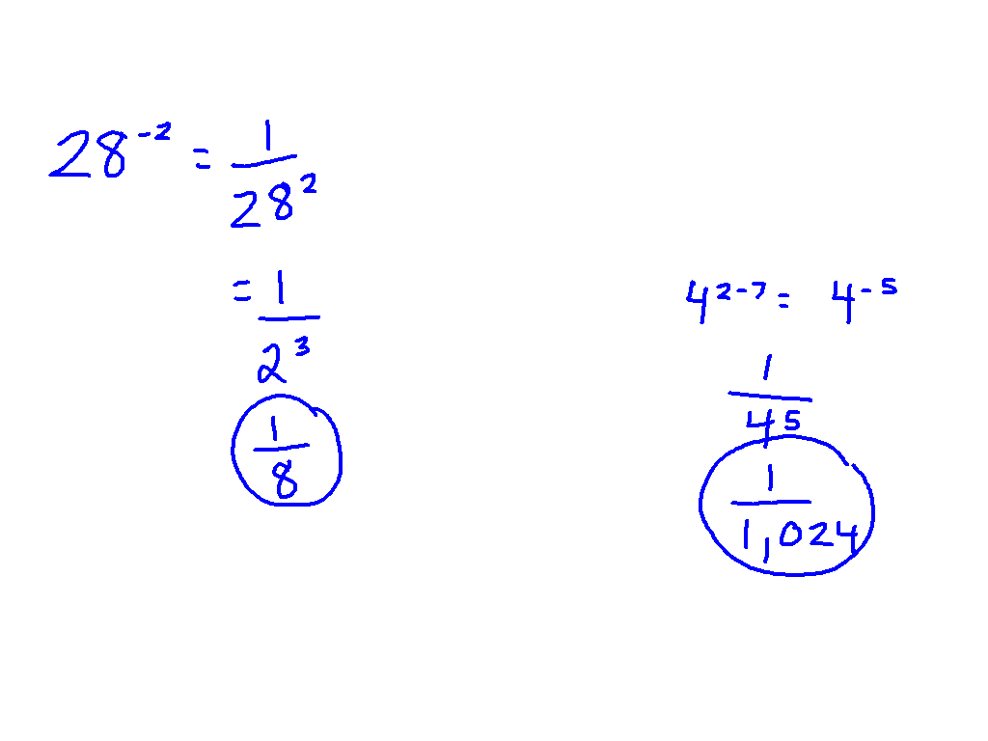
Write with only positive exponents
Ex. 1) 2⁻³
Ex. 2) 4²
4⁷

Slide 5
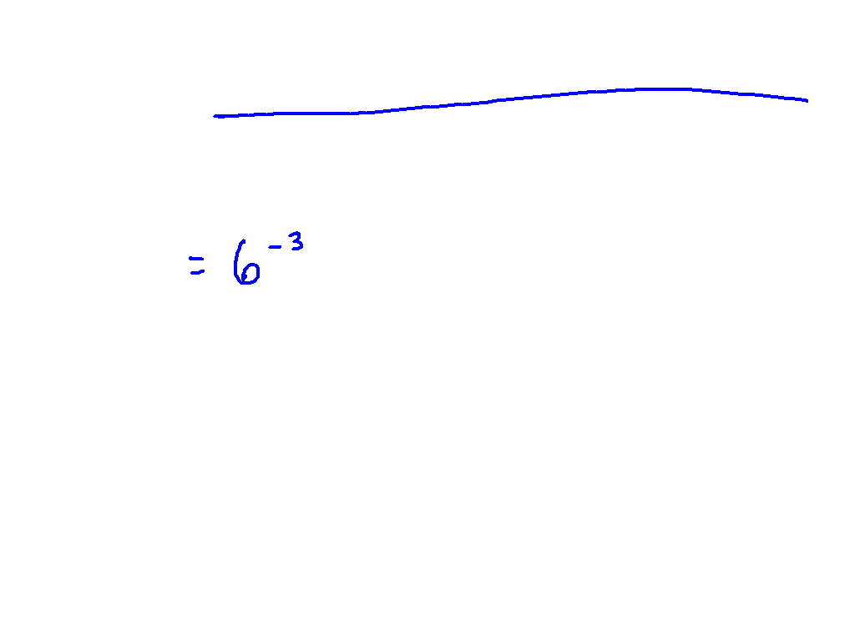
Write using negative exponents
Ex. 3) 1
6³

Slide 6
Write using negative exponents
1
25
Ex. 4) 1
27

Slide 7
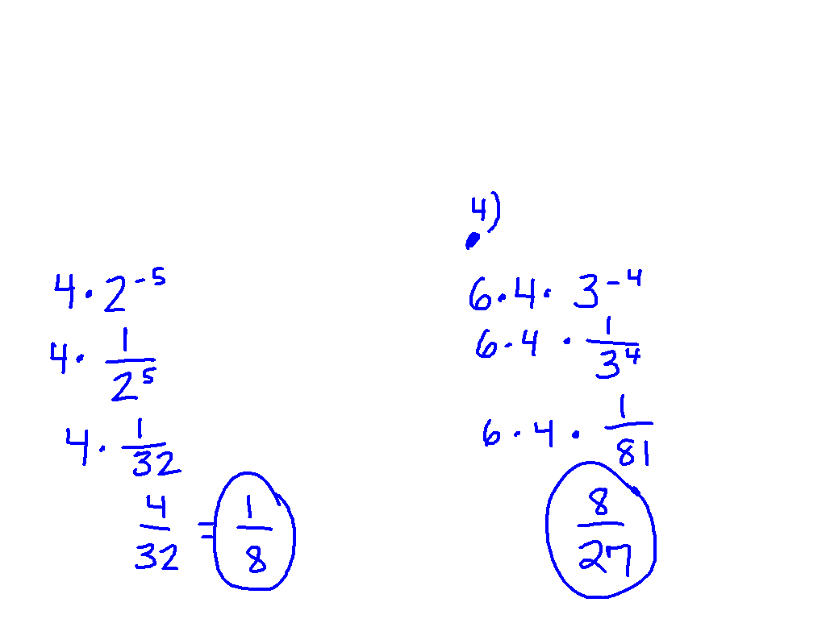
Solving the expression
4a⁻⁵, a = 2
Ex. 5) 6mn^{-4,} m = 4 and n = 3

Slide 8
Practice
Pg. 502 – 503, # 18-25 and #38 – 39

Slide 9
Starter challenge
1)
2)
3) -w²(5w⁷⁾

