Slide 1
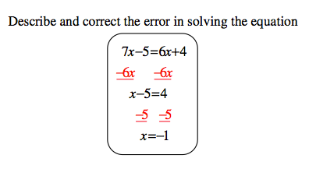
Starter Challenge
1)
2)

Slide 2
Multiplying & dividing with exponents
I CAN and I WILL multiply and divide exponents.

Slide 3
Quick Review
What 2 properties do you think we are going to practice that we learned yesterday?

Slide 4
Multiplying
4³ 4⁵

Slide 5
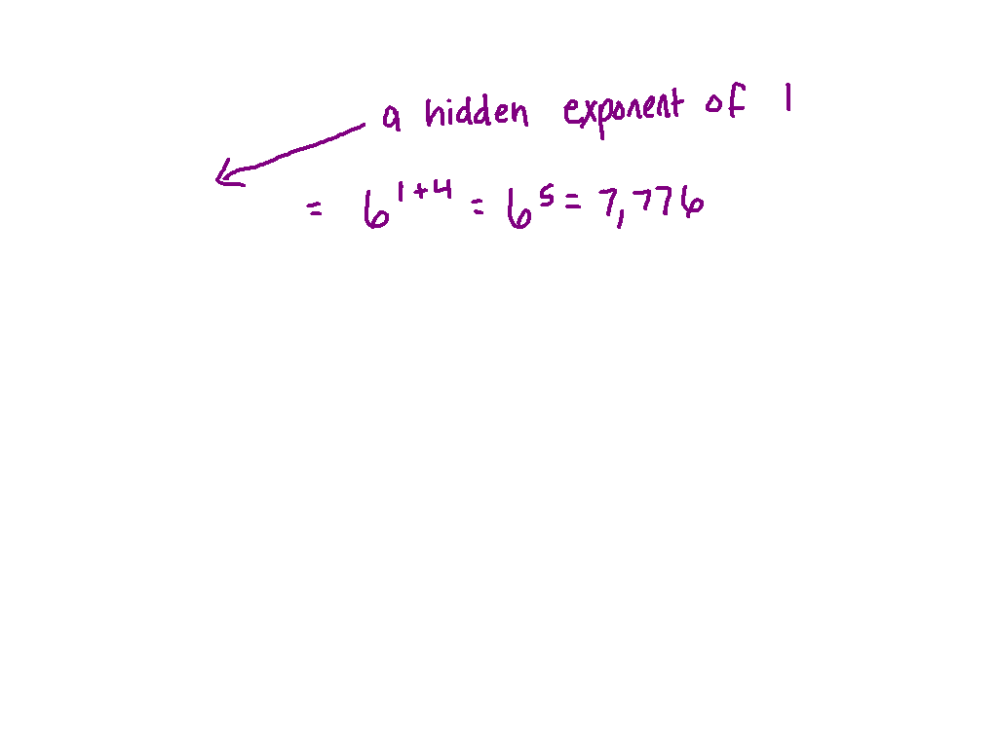
Multiplying
Ex. 1) 6 6⁴

Slide 6
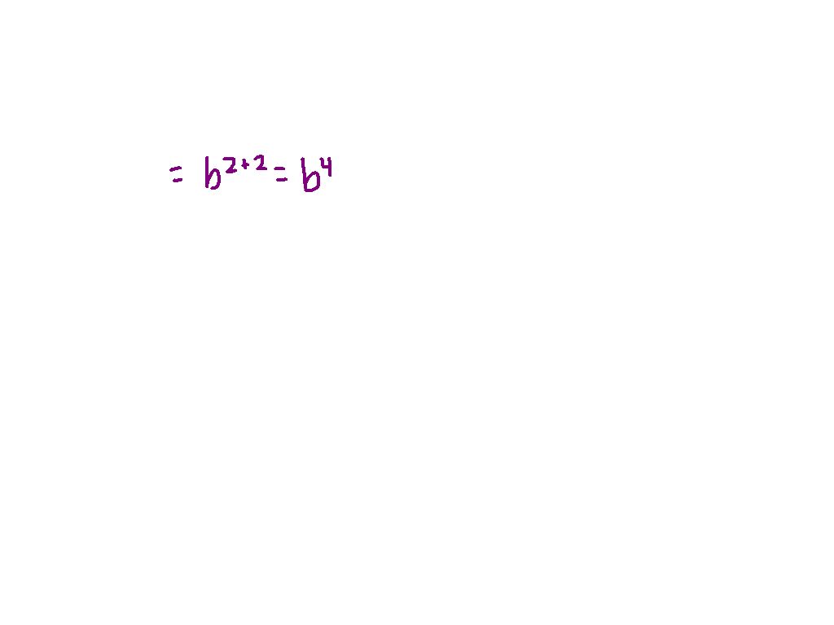
Multiplying
b² b²

Slide 7
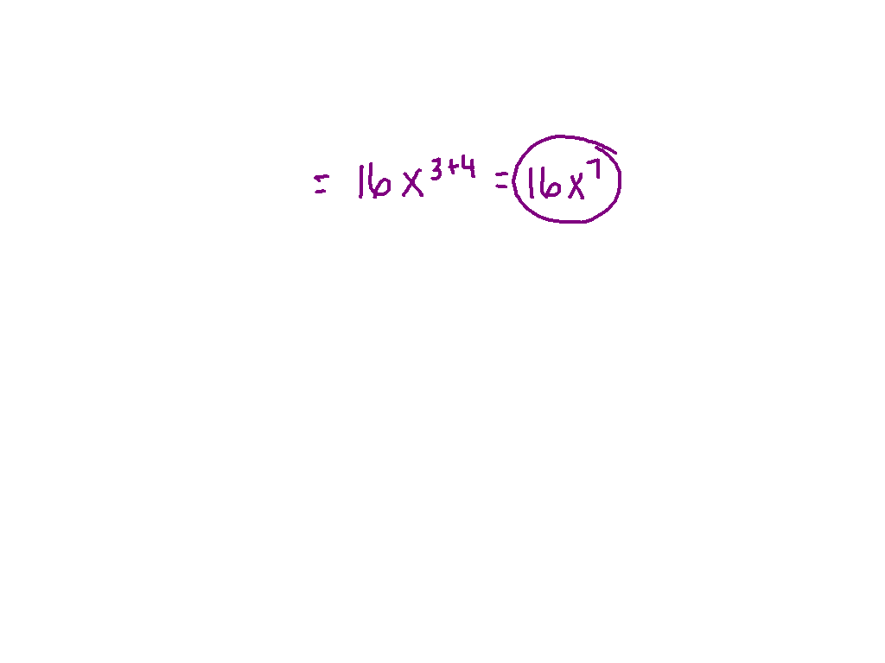
Multiplying
Ex. 2) 2x³ 8x⁴

Slide 8
You Try
5² 5³
5a² -3a⁴

Slide 9
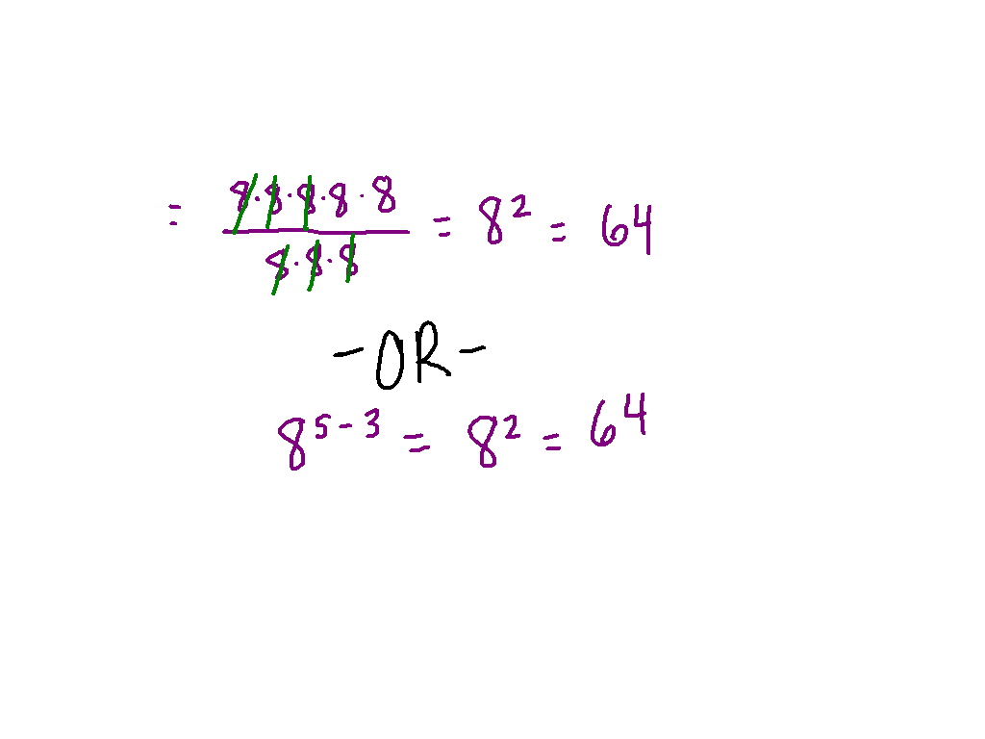
Dividing
8⁵
8³

Slide 10
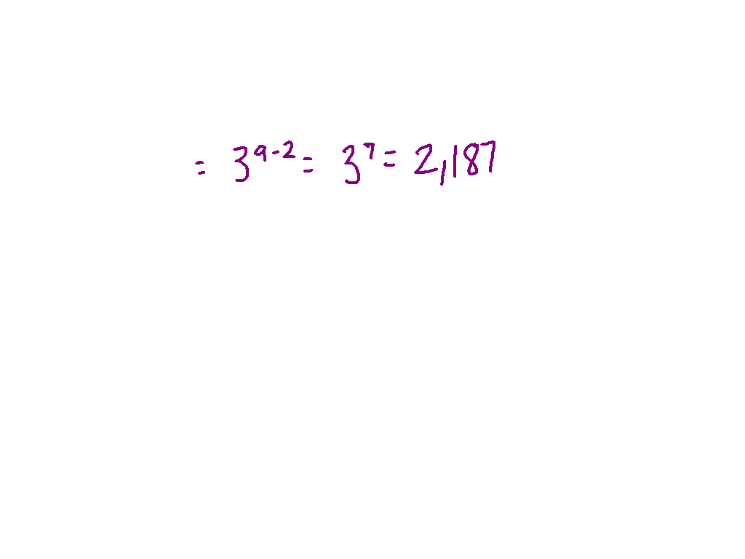
Dividing
Ex. 3) 3⁹
3²

Slide 11
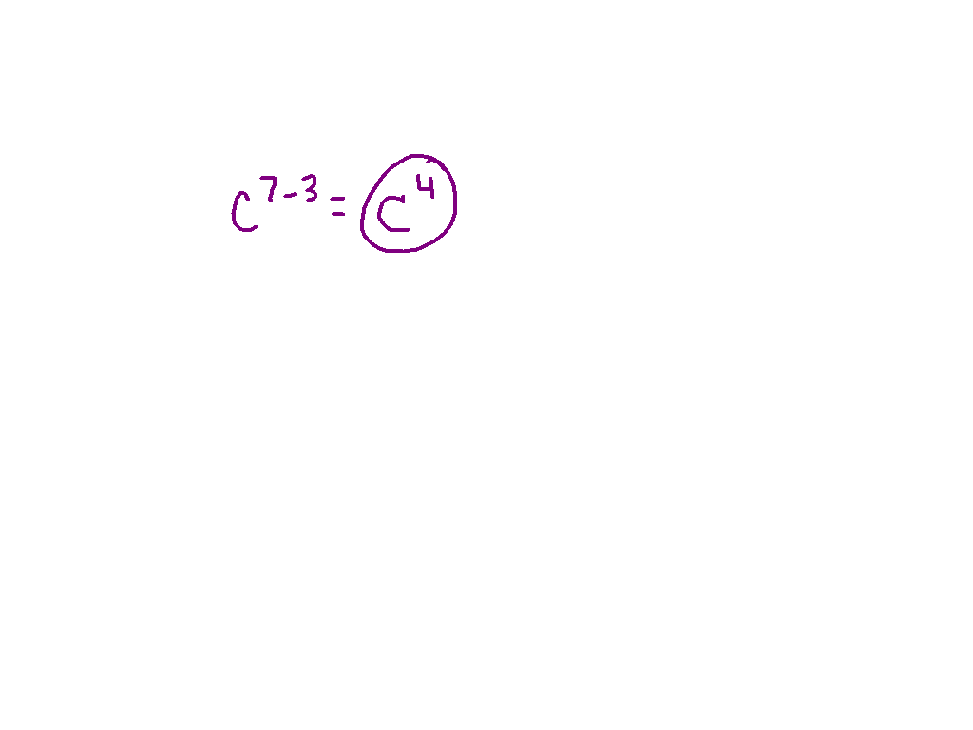
Dividing
c⁷
c³

Slide 12
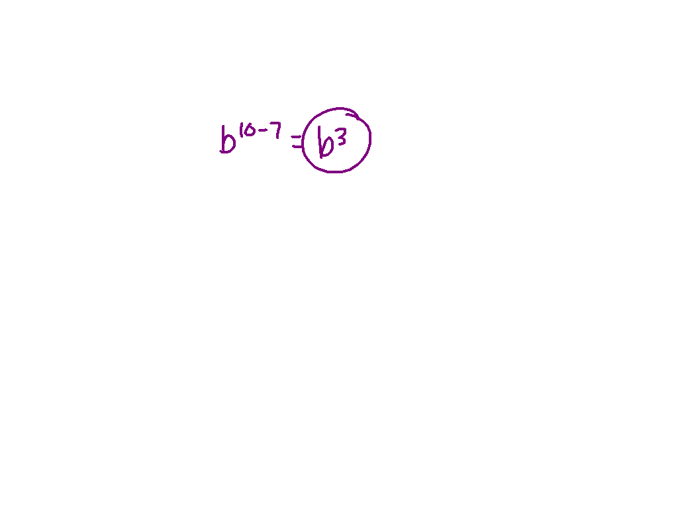
Dividing
Ex. 4) b¹⁰
b⁷

Slide 13
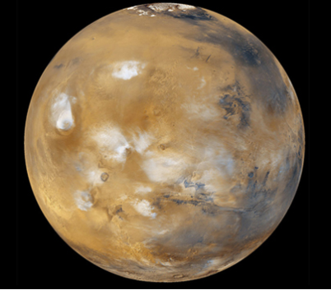
Word Problem
The table shows the approximate diameters of Earth, Mars, and Neptune. About how many times as great is Neptune’s diameter than Earth’s diameter?
Planet | Diameter
Earth | 2¹³
Mars | 2¹²
Neptune | 2¹⁵

Slide 14
Practice
This is homework, due tomorrow.
Pg. 497 – 498, #10 – 13, 18 – 21, 28 - 29

