Slide 1
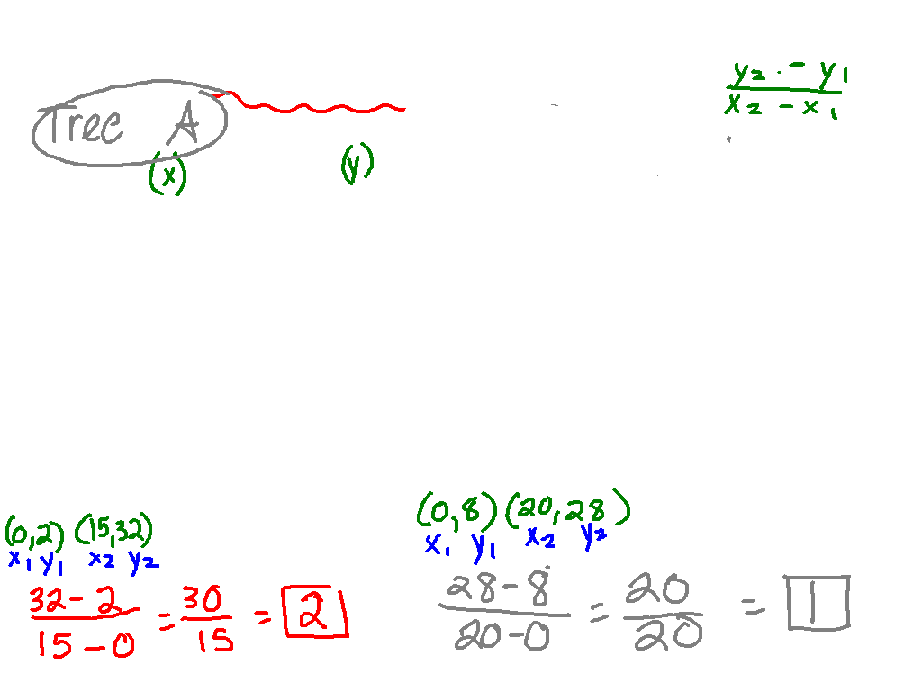
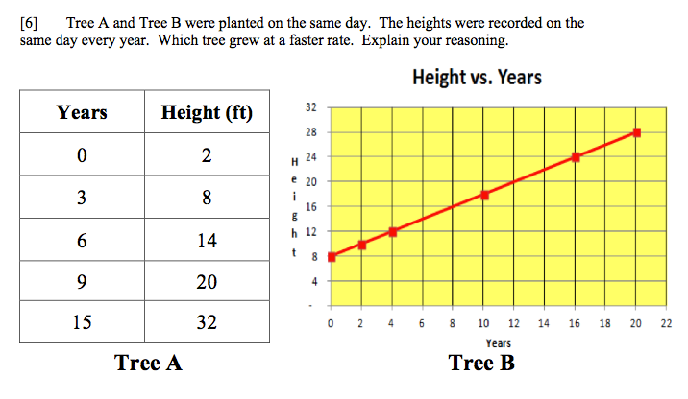

Slide 2
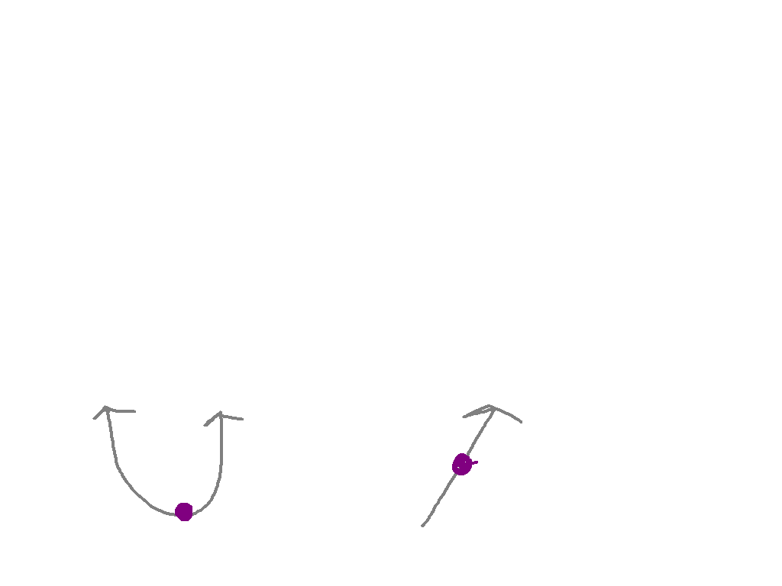
Multiple representations of linear functions
I CAN and I WILL represent functions as an equation, chart, and graph.

Slide 3
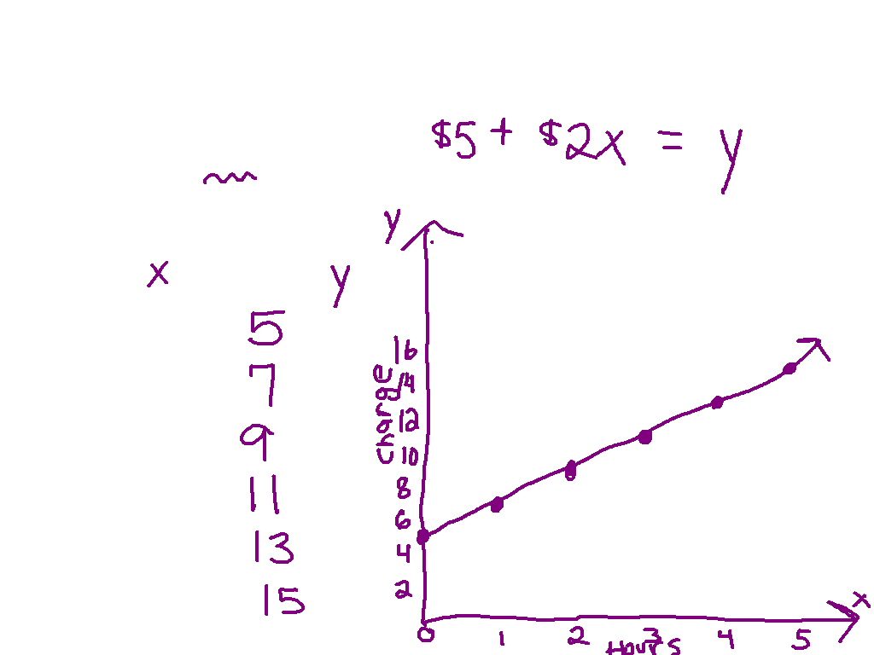
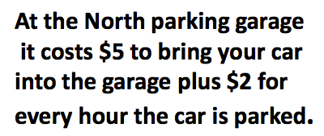
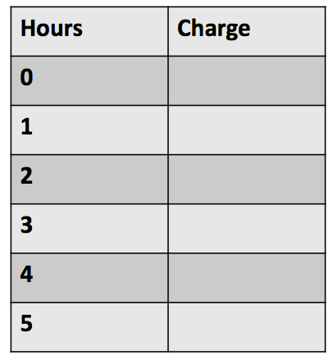
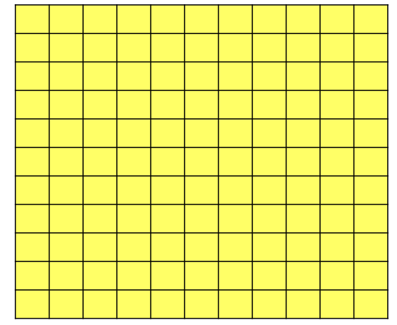
You Watch!

Slide 4
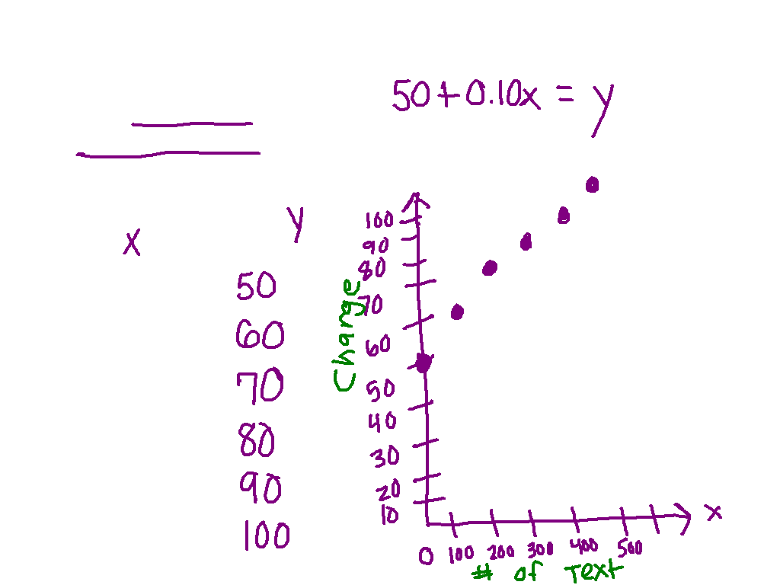
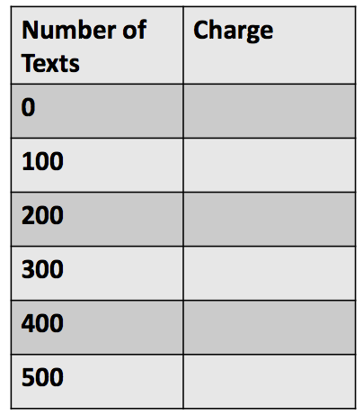
Ex. 1)
A monthly cell phone plan cost $50 per month and $0.10 for every text sent.

Slide 5
Get your desks ready for partner practice

Slide 6
00
10
09
08
07
06
05
04
03
02
01
00
Back to Clock Home
Countdown Clock By Dr. Jeff Ertzberger

Slide 7
3rd Base Partner

Slide 8
00
45
44
43
42
41
40
39
38
37
36
35
34
33
32
31
30
29
28
27
26
25
24
23
22
21
20
19
18
17
16
15
14
13
12
11
10
09
08
07
06
05
04
03
02
01
00
Back to Clock Home
Countdown Clock By Dr. Jeff Ertzberger

Slide 9
What are we doing?
Working on the Practicing Multiple Representations of Linear Functions Worksheet
Use your notes!
Talk at the appropriate volume level.

Slide 10
Move desks back into rows

Slide 11
00
45
44
43
42
41
40
39
38
37
36
35
34
33
32
31
30
29
28
27
26
25
24
23
22
21
20
19
18
17
16
15
14
13
12
11
10
09
08
07
06
05
04
03
02
01
00
Back to Clock Home
Countdown Clock By Dr. Jeff Ertzberger

