Slide 1
Solving Multi-Step Linear Inequalities
I CAN and I WILL solve inequalities with multiple steps.

Slide 2
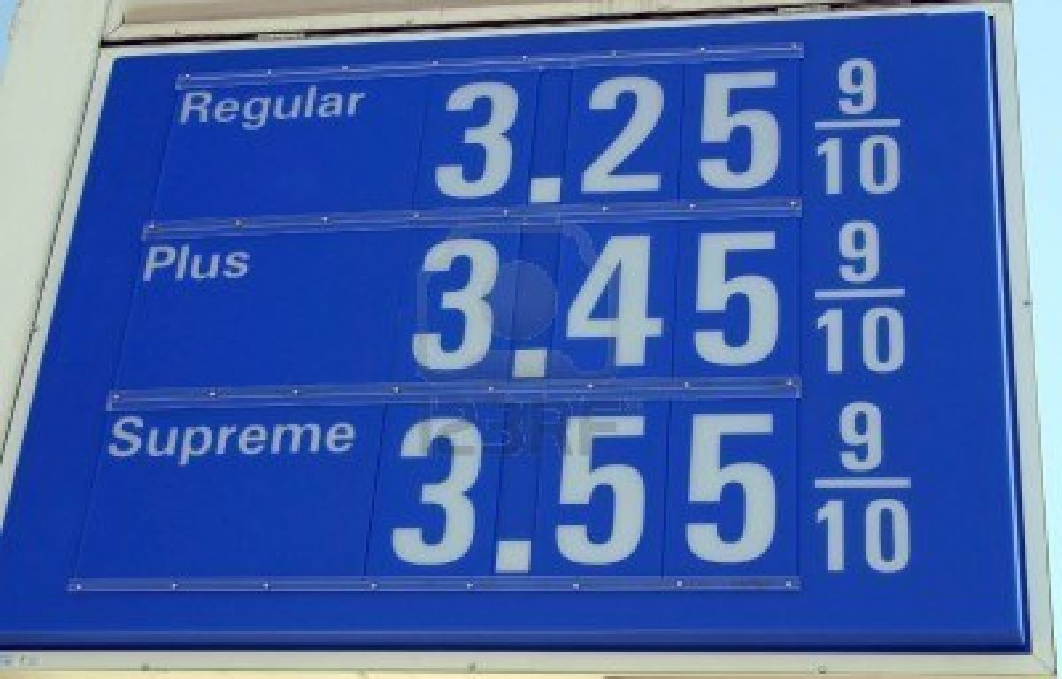
Why am I learning this?
A gas station charges $.10 less per gallon of gasoline if a
customer also gets a car wash ($8.00). What is the most regular gas you can buy if you also get a car wash and can spend at most $20.

Slide 3
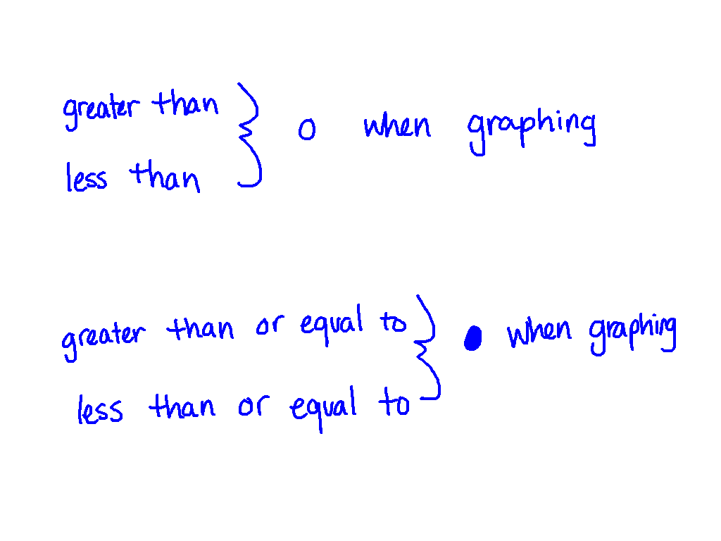
Things We Need to Know
>
<
>
<

Slide 4
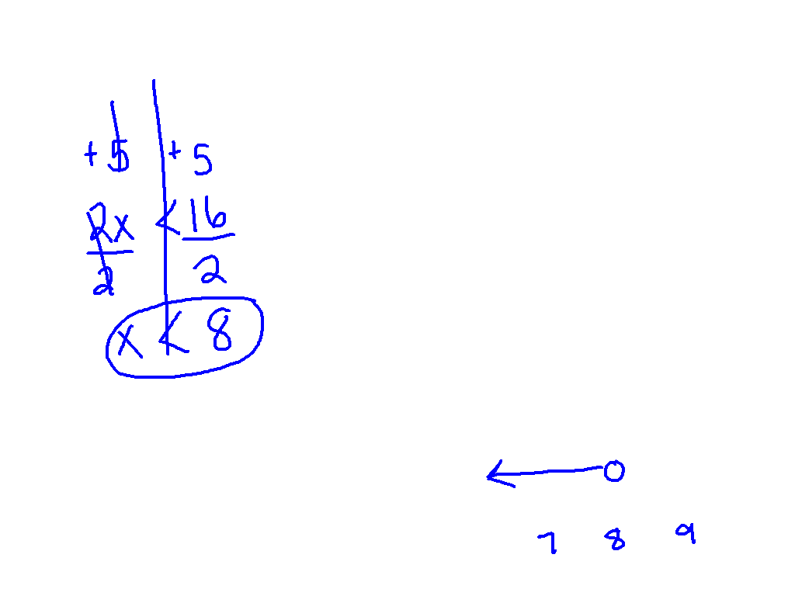
Watch This

Slide 5
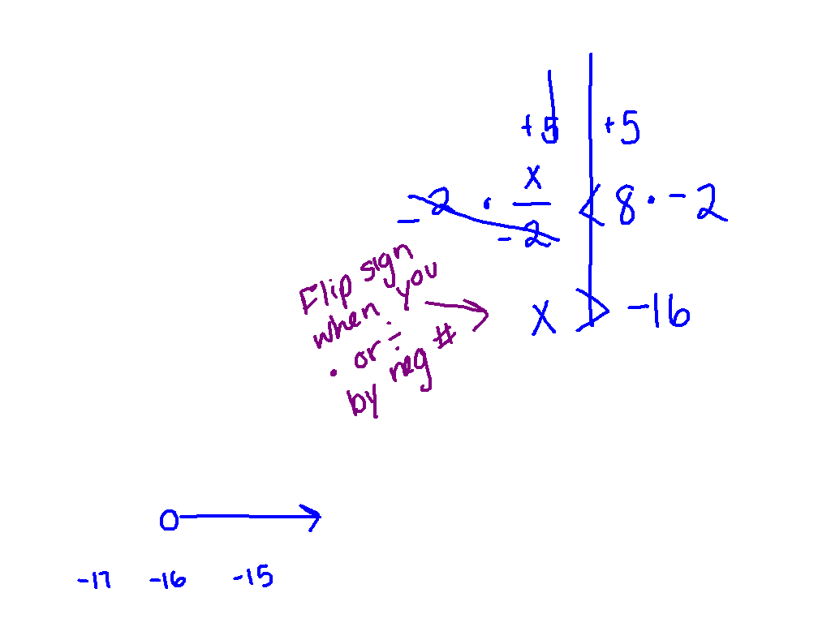
Ex 1)
-

Slide 6
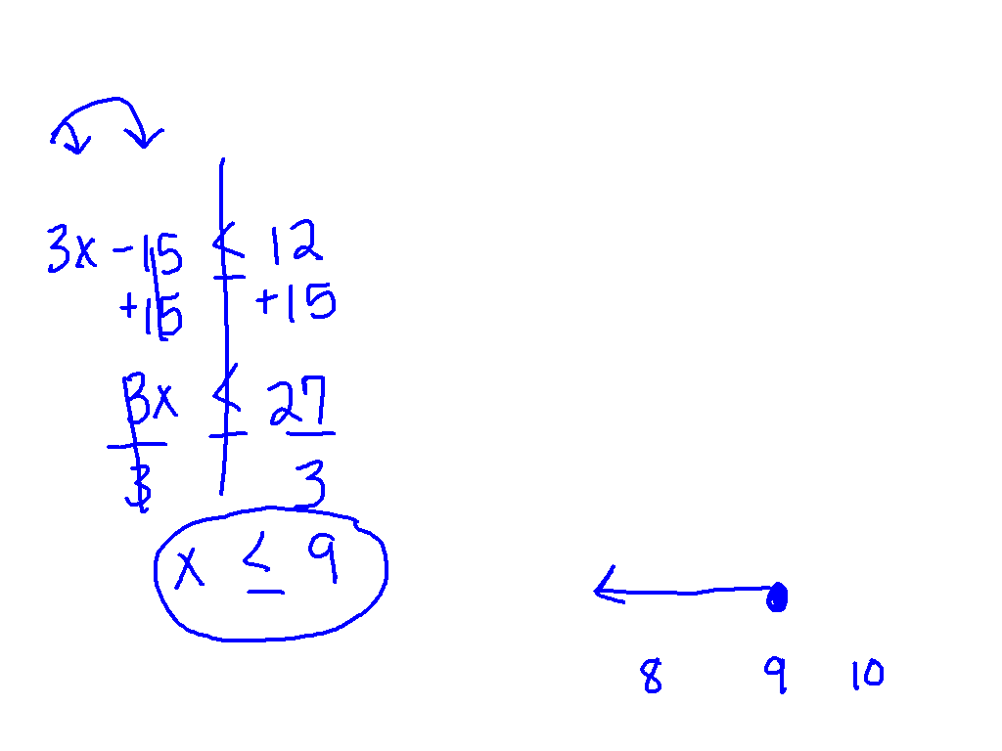
Ex. 2) On Your Own

Slide 7
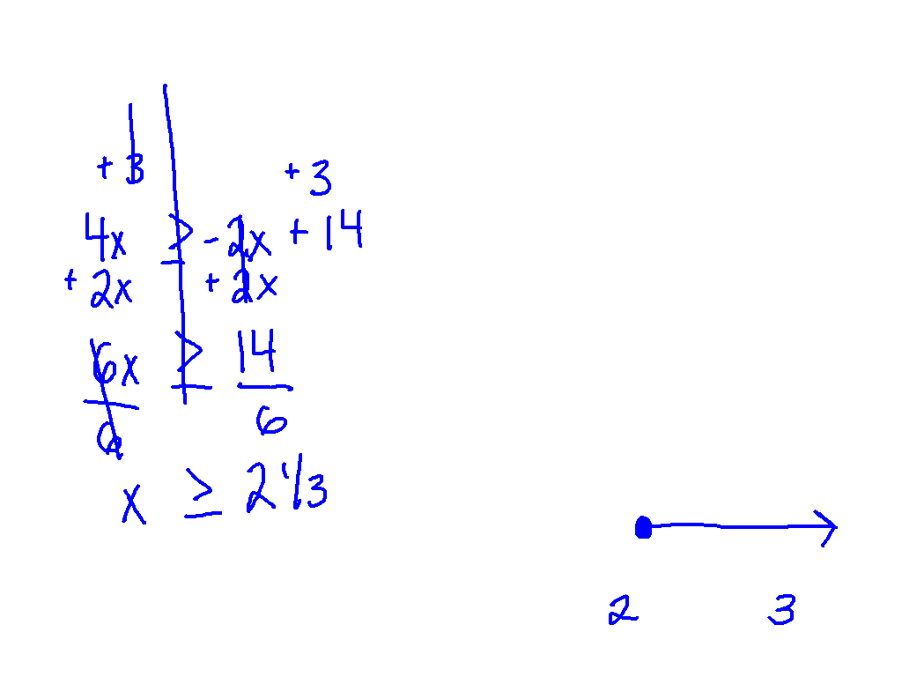
Ex. 3)

Slide 8
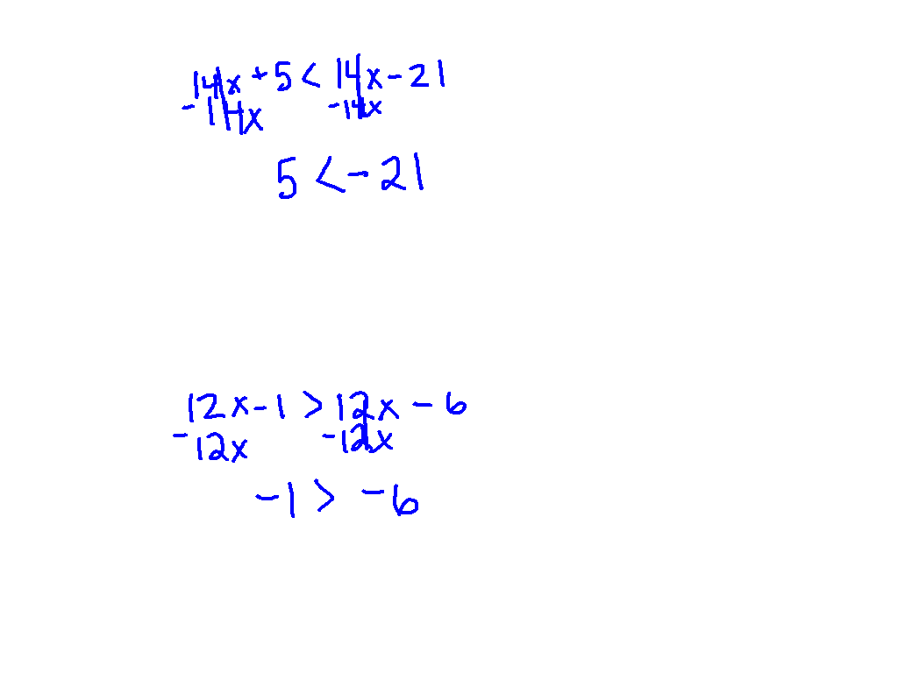
Ex. 4)
14x + 5 < 7(2x – 3)
There is no solution because 5 < -21 is false!
Ex. 5) 12x -1 > 6(2x -1)
All real numbers are solutions because
-1 > -6 is a true statement!!

Slide 9
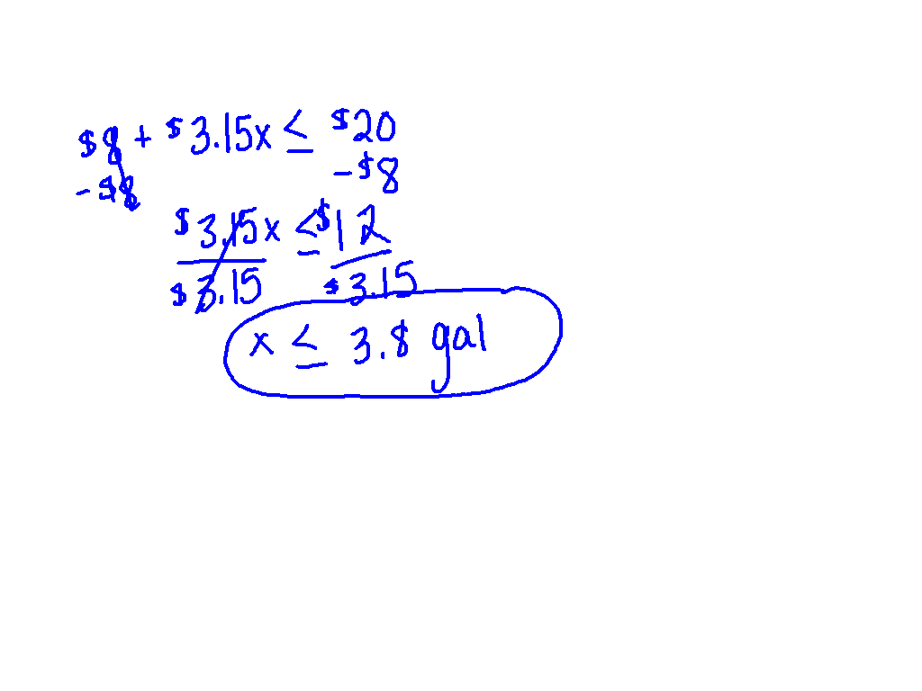
Why am I learning this?
A gas station charges $.10 less per gallon of gasoline if a
customer also gets a car wash ($8.00). What is the most regular gas you can buy if you also get a car wash and can spend at most $20.

