Slide 1
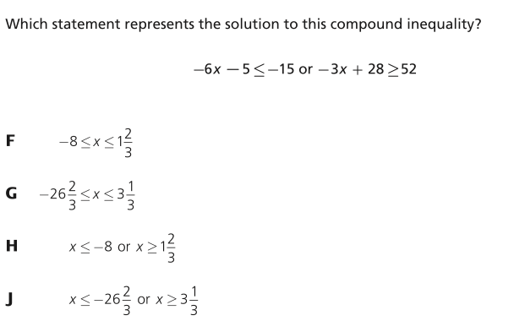

Slide 2
Inequality Word Problems
I CAN and I WILL solve real world problems using inequalities.

Slide 3
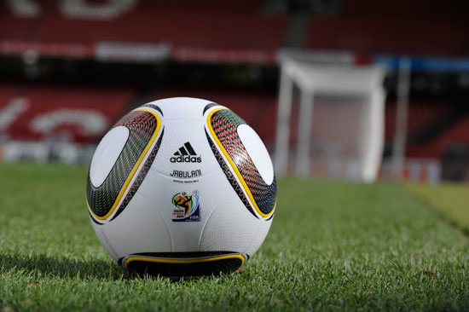
Let’s Try Together
The ball used at a soccer game may not weigh more than 16 ounces or less than 14 ounces at the start of the match. After 1.5 ounces of air was added to a ball, the ball was approved for use in a game. Write and solve a compound inequality to show how much the ball might have weighed before air was added.

Slide 4
Get your desk ready for partner practice.

Slide 5
00
10
09
08
07
06
05
04
03
02
01
00
Back to Clock Home
Countdown Clock By Dr. Jeff Ertzberger

Slide 6
What am I doing?
Completing your tangram.
Solve the word problems.
Word problems will be homework if you don’t finish.

Slide 7
Move desks back.

Slide 8
00
45
44
43
42
41
40
39
38
37
36
35
34
33
32
31
30
29
28
27
26
25
24
23
22
21
20
19
18
17
16
15
14
13
12
11
10
09
08
07
06
05
04
03
02
01
00
Back to Clock Home
Countdown Clock By Dr. Jeff Ertzberger

