Slide 1
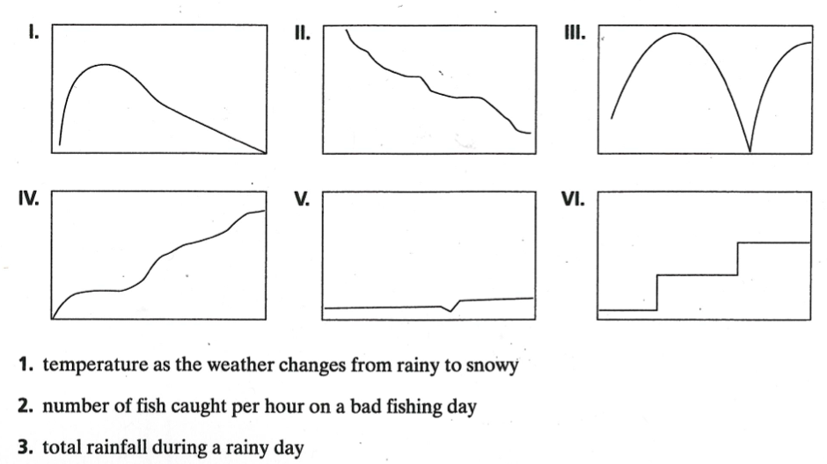
Choose the three graphs that go with the three statements below.

Slide 2
Graphing Functions
I CAN and I WILL graph a function.

Slide 3
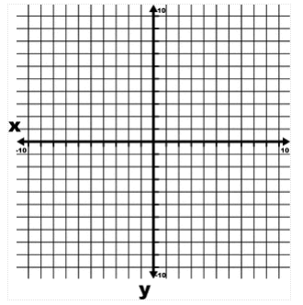
Given a domain…
f(x) = x² - 3; D: {-3, 0, 3, 6}

Slide 4
Ex 1) Given the domain
-2x + y = 3; D: {-3, 0, 3, 6}

Slide 5
Ex 2) All real numbers
g(x) = x + 2

Slide 6
On Your Own: All real numbers
y = x²

Slide 7
Ex 3) Finding Values Using Graphs
Use a graph of the function f(x) = -0.5x + 4 to find the value of f(x) when x = -4.

Slide 8
Ex 4) Problem Solving
A mouse can run 3.5 meters per second. The function y = 3.5x describes the distance in meters the mouse can run in x seconds. Graph the function and estimate how many meters a mouse can run in 2.5 seconds.

