Slide 1
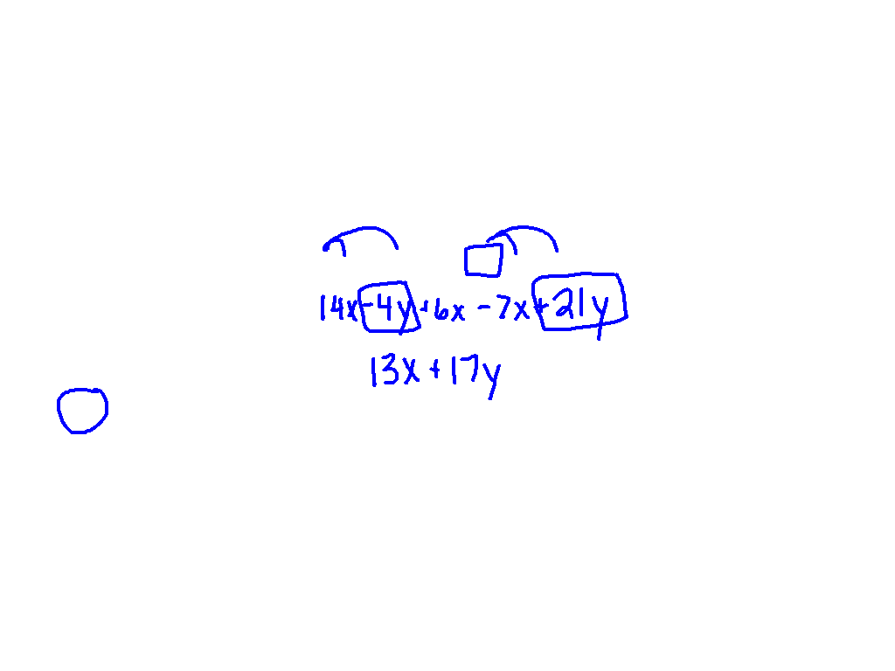
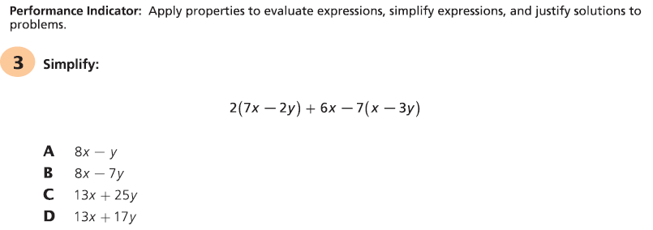
Starter Challenge

Slide 2
Objective:
I CAN and I WILL factor polynomials by using the greatest common factor.

Slide 3
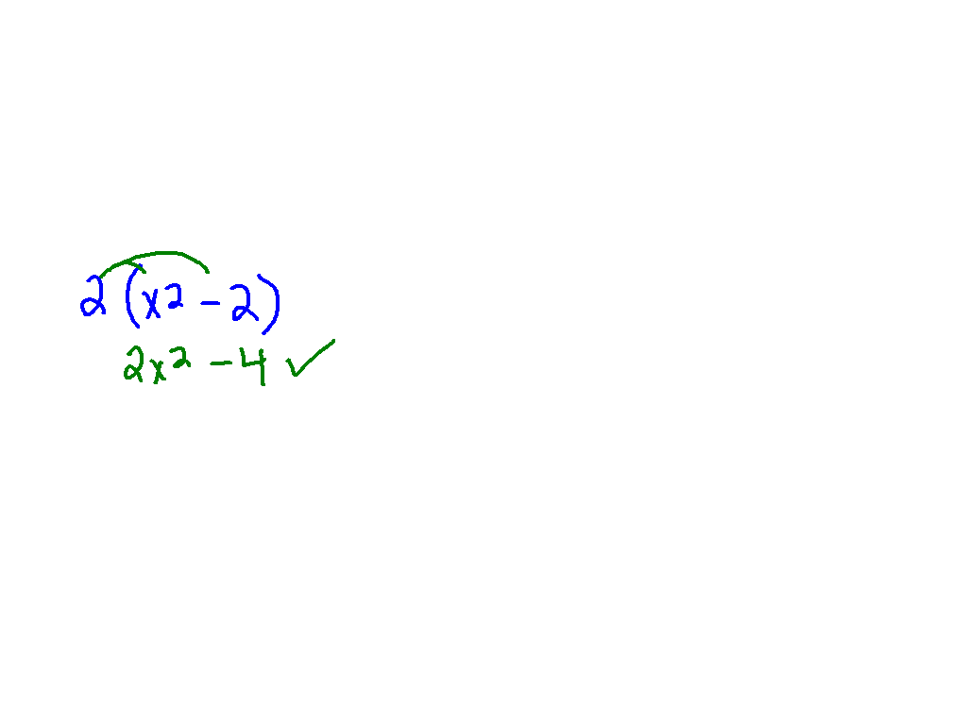
Watch This!
2x² – 4

Slide 4
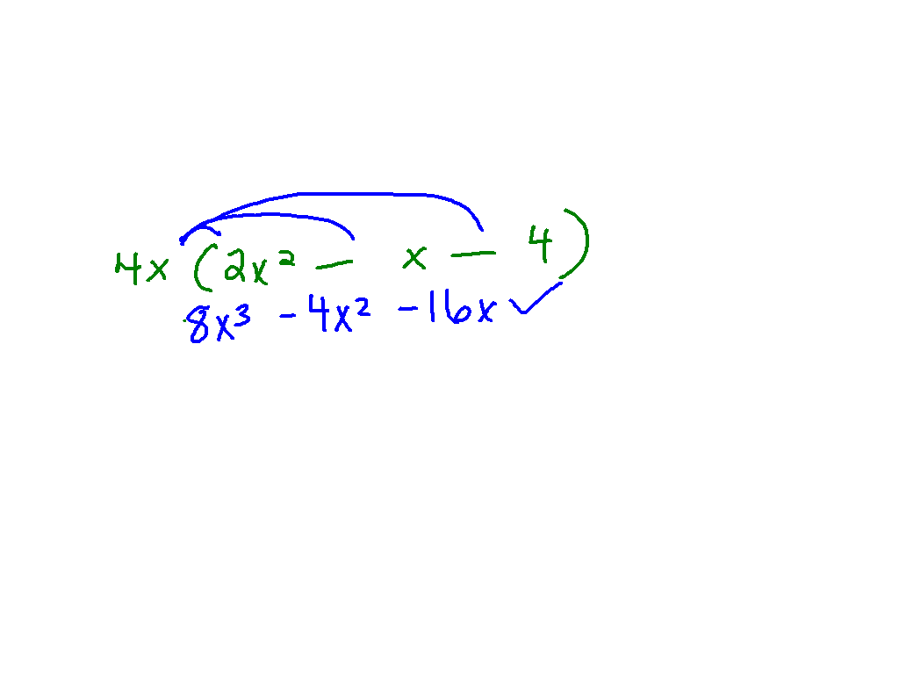
Ex. 1)
8x³ – 4x² – 16x

Slide 5
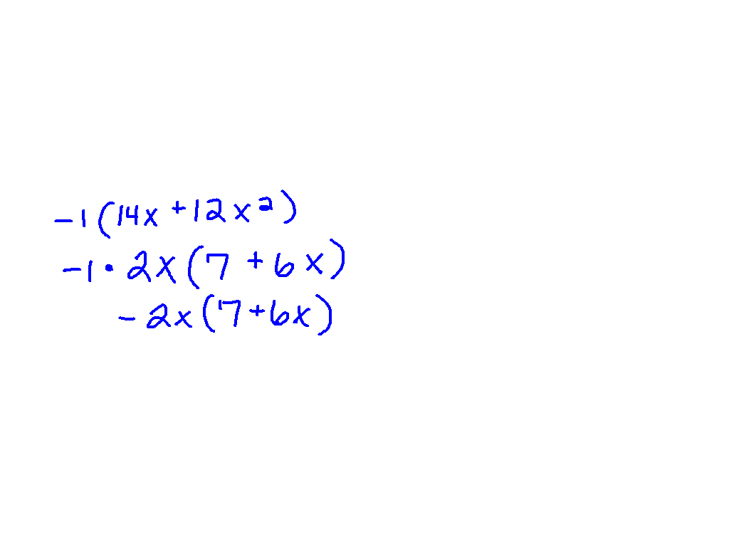
Watch This!
–14x – 12x²

Slide 6
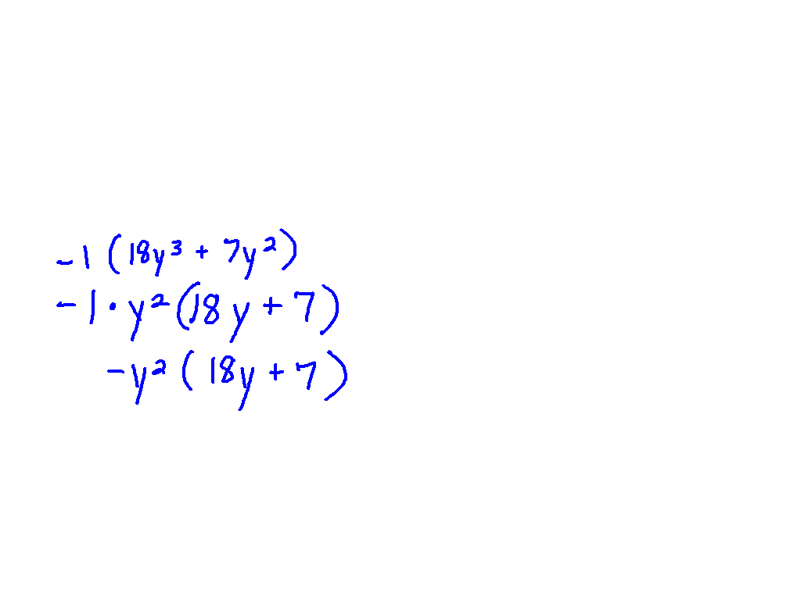
Ex. 2)
–18y³ – 7y²

Slide 7
Ex. 3)
5x² + 7

Slide 8
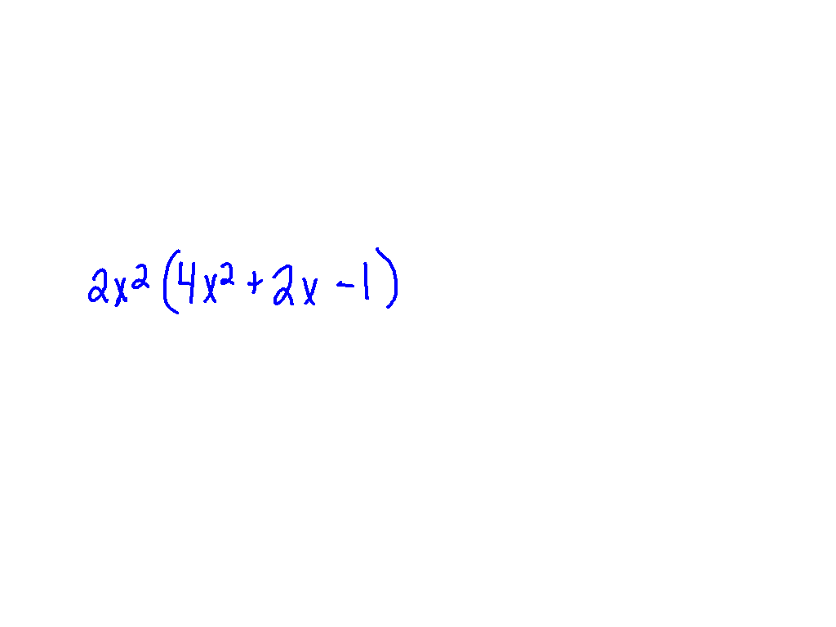
Ex. 4)
8x⁴ + 4x³ – 2x²

Slide 9
Sometimes the GCF of terms is a binomial. This GCF is called a common binomial factor. You factor out a common binomial factor the same way you factor out a monomial factor.

Slide 10
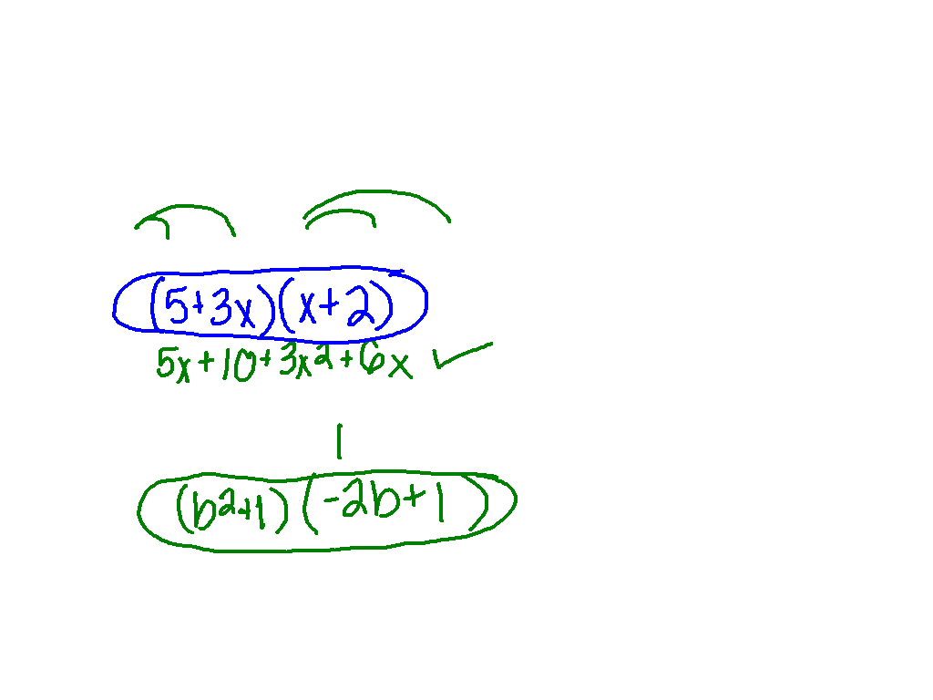
Watch This!
Factor each expression.
5(x + 2) + 3x(x + 2)
–2b(b² + 1)+ (b² + 1)

Slide 11
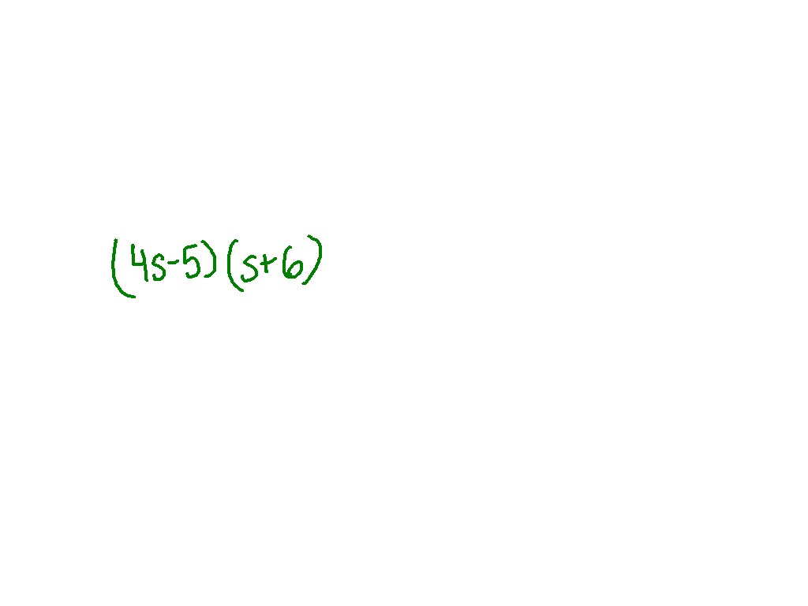
Example 5
Factor each expression.
4s(s + 6) – 5(s + 6)

Slide 12
You may be able to factor a polynomial by grouping. When a polynomial has four terms, you can make two groups and factor out the GCF from each group.

Slide 13
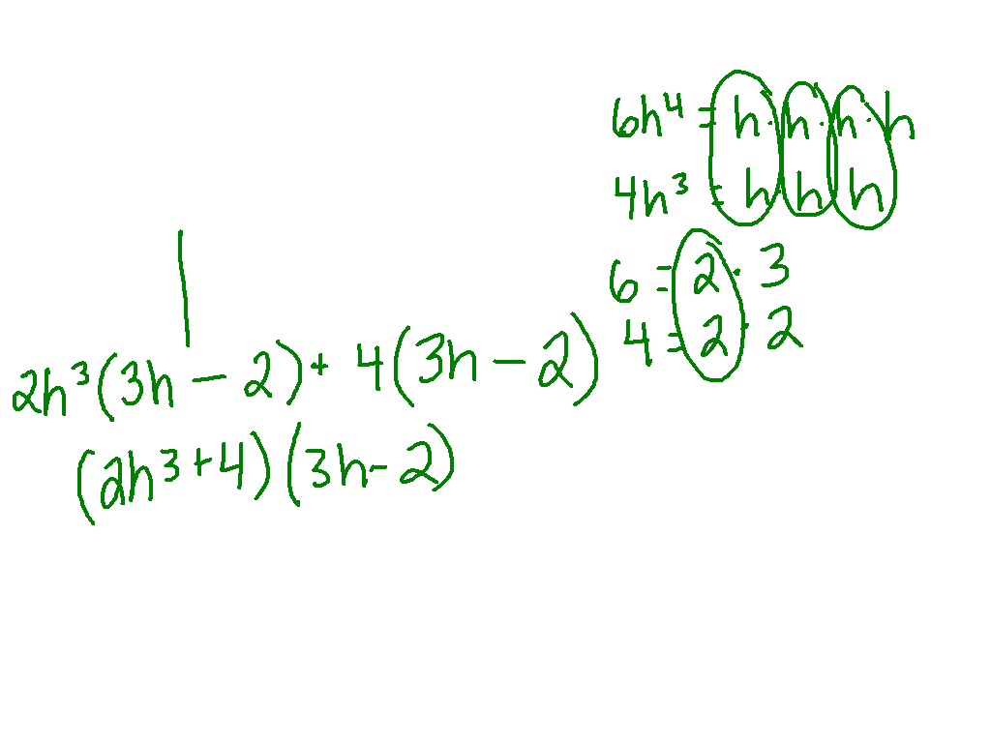
Ex. 6)
6h⁴ – 4h³ + 12h – 8

Slide 14
Helpful Hint
If two quantities are opposites, their sum is 0.
(5 – x) + (x – 5)
5 – x + x – 5
– x + x + 5 – 5
0 + 0
0

Slide 15
Recognizing opposite binomials can help you factor polynomials. The binomials (5 – x) and (x – 5) are opposites. Notice (5 – x) can be written as –1(x – 5).
–1(x – 5) = (–1)(x) + (–1)(–5)
Distributive Property.
= –x + 5
Simplify.
= 5 – x
Commutative Property of Addition.
So, (5 – x) = –1(x – 5)

Slide 16
Watch This!
Factor 2x³ – 12x² + 18 – 3x

Slide 17
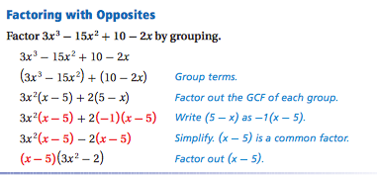
Example 5 from book:

Slide 18
Ex. 7)
15x² – 10x³ + 8x – 12

Slide 19
Ex. 8)
8y – 8 – x + xy

