Slide 1
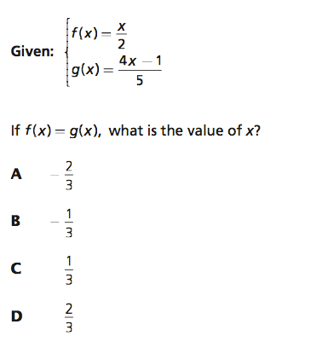
Starter challenge

Slide 2
Functions
Objective : I can and I will define and identify functions.

Slide 3
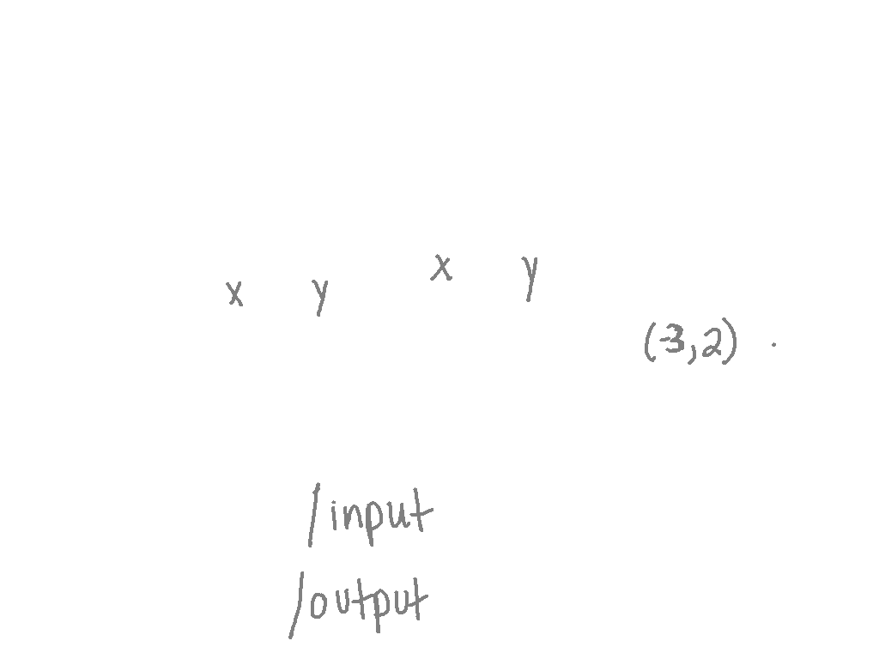
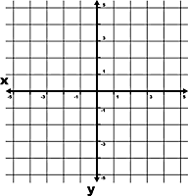
What is a relation?
Relation: A set of ordered pairs.
You can see relations displayed lots of different ways like:
(x, y)
Domain: the x’s
Range: the y’s
3 | 10
5 | 12
7 | 14
-1
0
1
1
3
5

Slide 4
When is a relation a function?
It’s a function when the first number (input or x) only has one second number (output or y).
Let’s look…is this relation a function?
X | -2 | 0 | 2 | 4
Y | -5 | -1 | 3 | 7

Slide 5
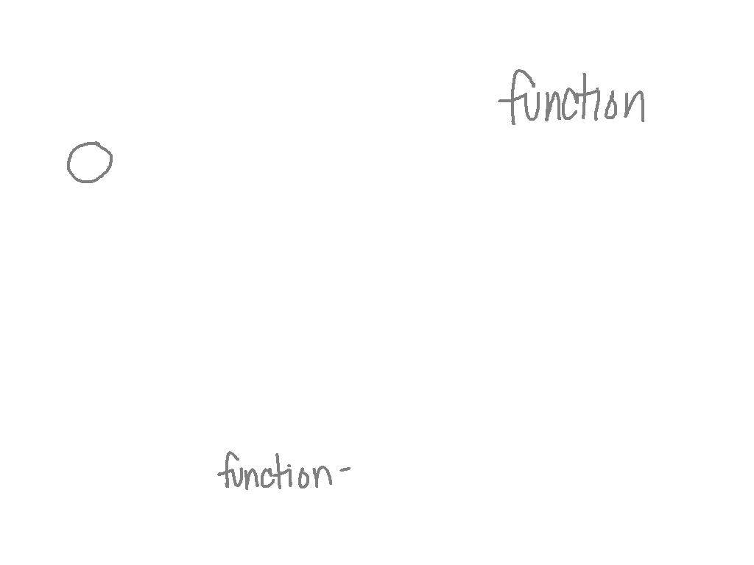
Strategies to solve
X | -2 | 0 | 2 | 4
Y | -5 | -1 | 3 | 7
Look at the x values (we call this domain).
If no two x values are alike, than the relation is a function.
If there would have been the same domains, as long as the y
values (range) were the same it still would be a function.
If they weren’t, it would not be a function.
Basically, every x can only have one y.

Slide 6
Is this a function?
1
2
3
5
6
7

Slide 7
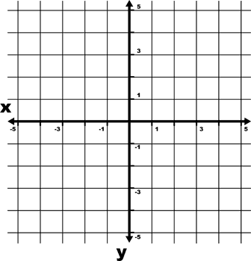
Is this a function?

Slide 8
Last one…is this a function?
{(-3, 5), (-2, -2), (1, -2), (3, 5), (-4, -1)}

Slide 9
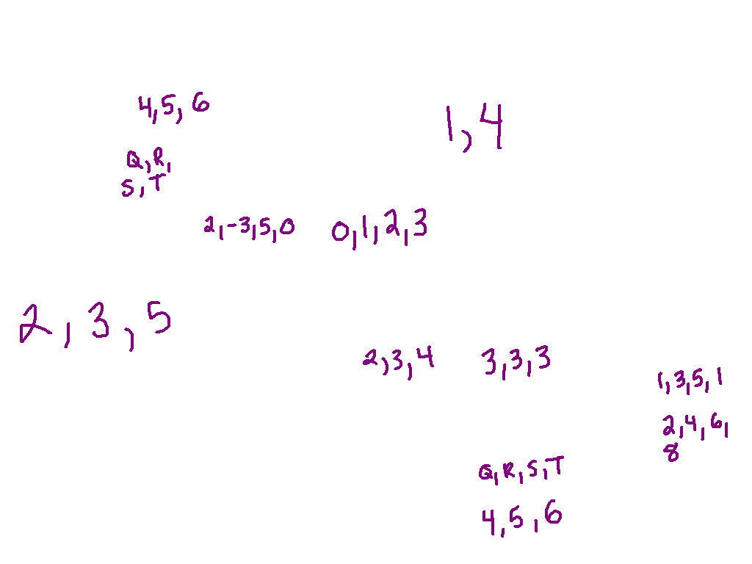

Slide 10
Vertical line test
y
y
y
y
x
x
x
x
Function
y
y
y
y
x
x
x
x

Slide 11
Vertical line test
y
y
y
y
x
x
x
x
Function
Function
y
y
y
y
x
x
x
x

Slide 12
Vertical line test
y
y
y
y
x
x
x
x
Function
Function
Not a
Function
y
y
y
y
x
x
x
x

Slide 13
Vertical line test
y
y
y
y
x
x
x
x
Function
Function
Not a
Function
Function
y
y
y
y
x
x
x
x

Slide 14
Vertical line test
y
y
y
y
x
x
x
x
Function
Function
Not a
Function
Function
y
y
y
y
x
x
x
x
Not a
Function
Function
Not a
Function
Not a
Function

Slide 15
Quick Review!
A relation is a set of _________________ __________________.
How do you know when a relation is a function?
What is the first thing you should check for when deciding if a relation is a function?

Slide 16
Function rule
Which equation shows how to determine the value of y when given the value of x? A. y = -3x
B. y = -3x + 1
C. y = 3x – 1
D. y = 4x

Slide 17
Writing Function Rules
Ex. 1)
X | Y
1 | 2
3 | 10
5 | 18
7 | 26

Slide 18
Writing Function Rules
Ex. 2)
X | Y
2 | 90
3 | 130
4 | 170
5 | 210

Slide 19
Writing the function rule & Creating an input/output chart
An artist charges his clients a $5 fee plus $10 for every person in a picture. Write a rule for the artist’s fee. Write ordered pairs for the artist’s fee when there are 1, 2, 3, and 4 people in the picture.

Slide 20
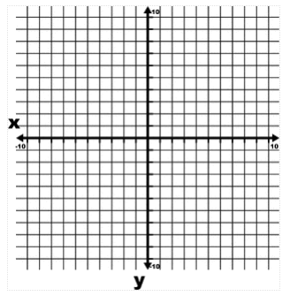
Graphing a function
y = 4x - 3

