Slide 1
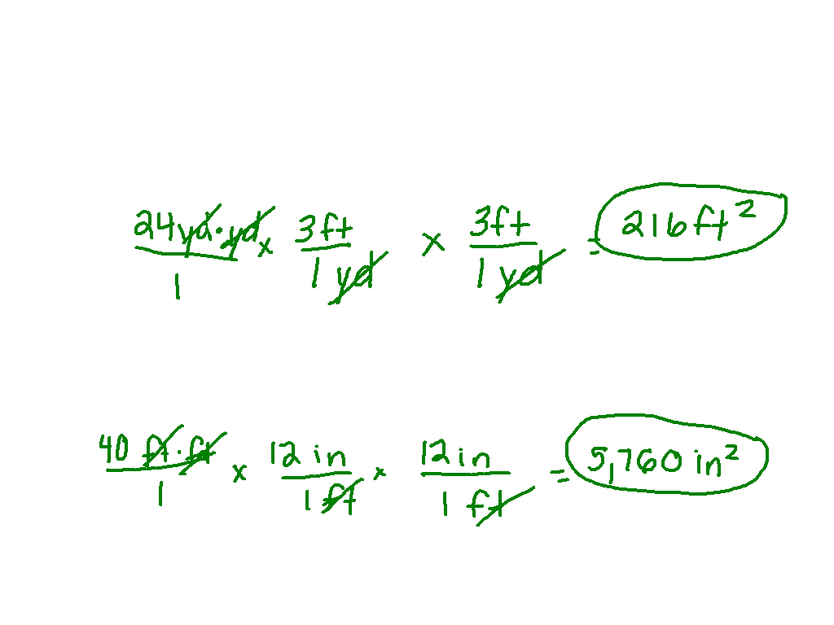
24 square yards = _____ square feet
(1 yd = 3ft)
Convert 40 square feet to square inches.
(1 ft = 12 in)

Slide 2
Solving Compound Inequalities
I can solve compound inequalities.

Slide 3
What do we already know about compound?
Travis will take his brother or sister to the concert.
Max will take his brother and sister to the concert.

Slide 4
Stand up when the statement applies to your number.
Greater than 15 or less than 2.
Less than 12 and greater than or equal to 8.
Greater than or equal to 3 and less than or equal to 2.
Greater than 2 or less than 3.

Slide 5
What is a Compound Inequality?
Two inequalities that are joined by the word AND or the word OR.
Notes:
Overlapping on number line

Slide 6
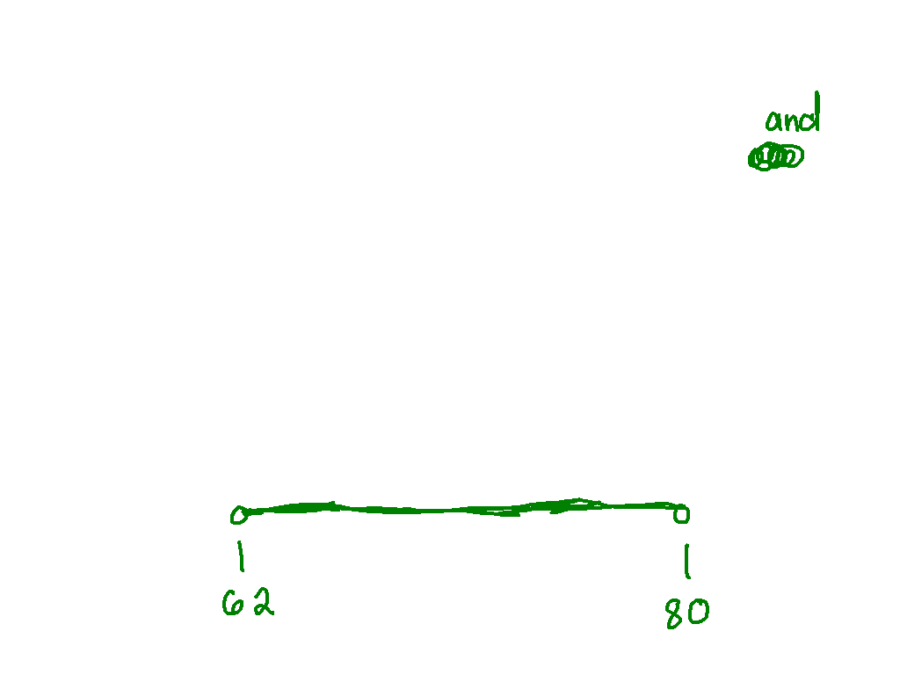
Writing Inequalities with AND
Today’s temperature will be above 62 F but not as high as 80 F.

Slide 7
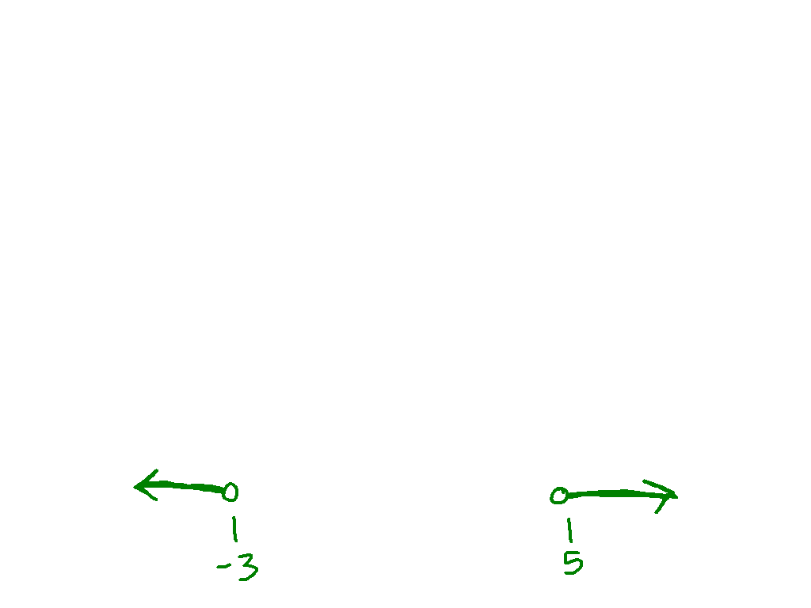
Writing Inequalities with OR
All real numbers that are less than -3 or greater than 5
x < -3 or x > 5

Slide 8
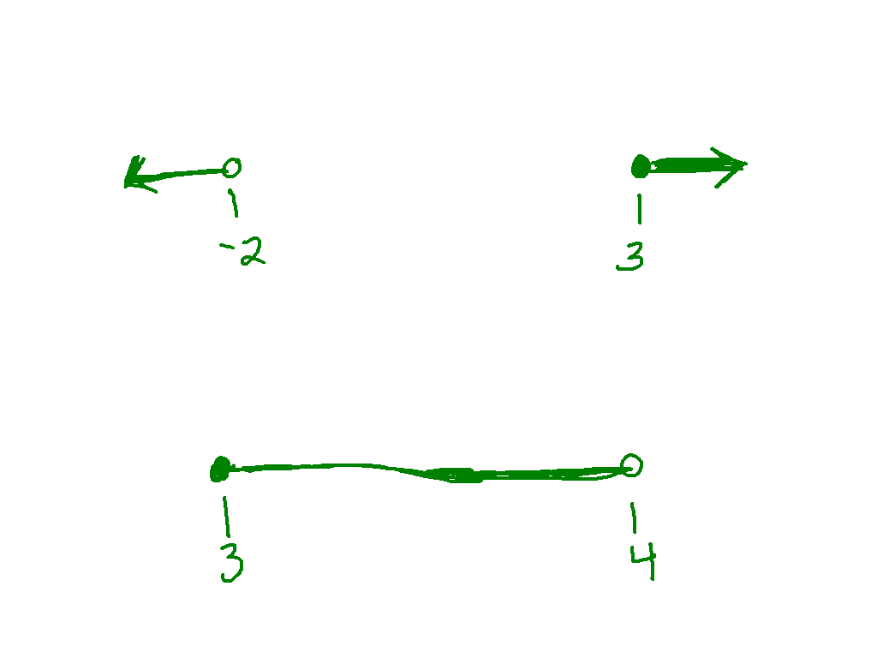
Ex. 1) x < -2 OR x > 3
Ex. 2) x < 4 AND x > 3

Slide 9
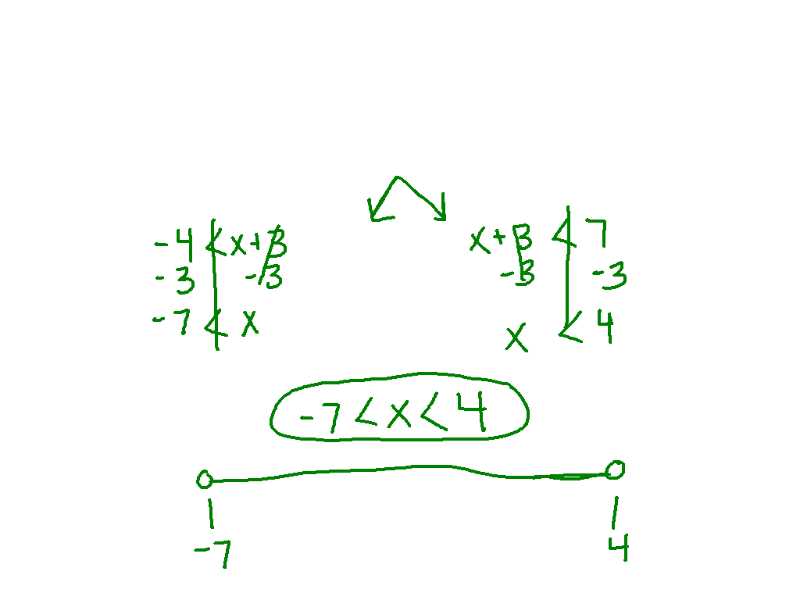
Solve and graph the compound inequality.

Slide 10
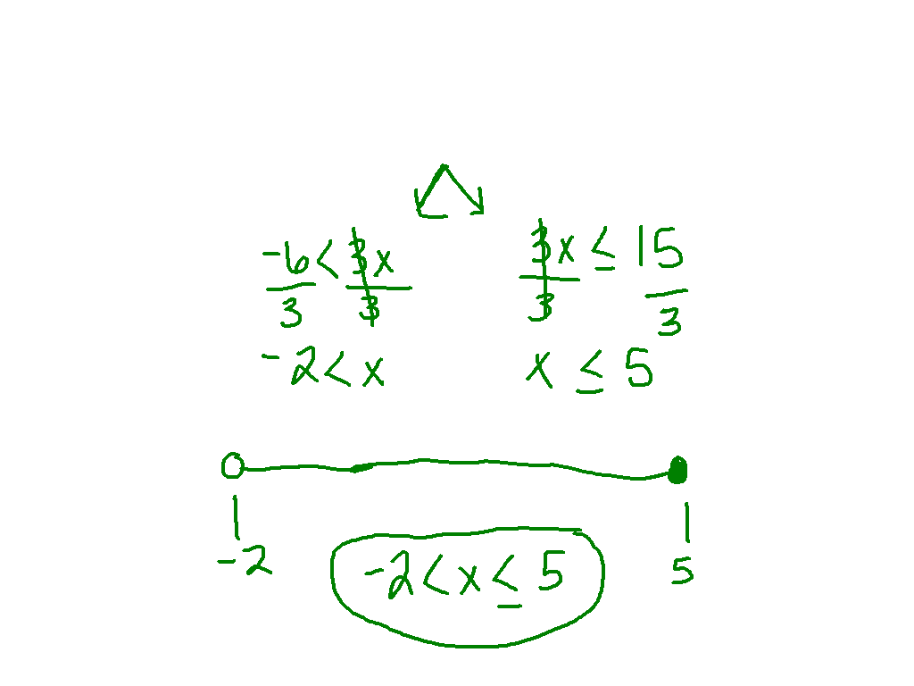
Ex. 3)
-6 < 3x < 15

Slide 11
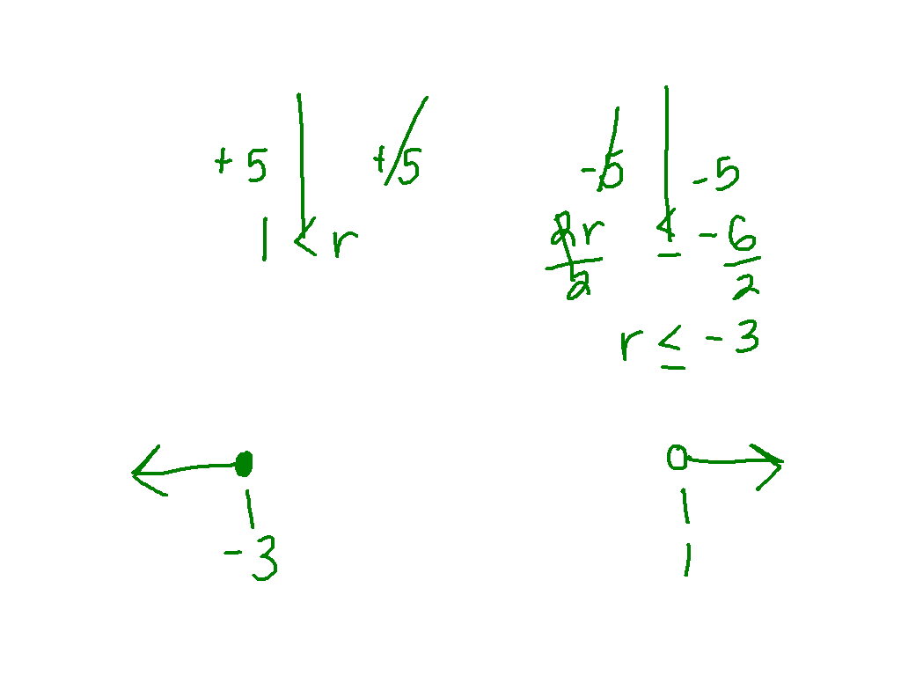
Ex. 4)
-4 < r – 5 or 2r + 5 < -1

Slide 12
On Your Own: Post It Problem
-50 < 7k + 6 < -8

