Slide 1
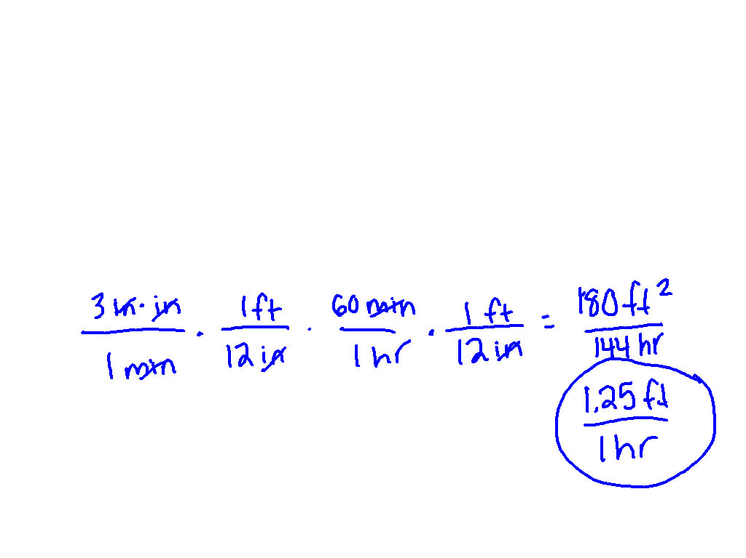
Melissa can crochet at an average rate
of 3 square inches per minute. What is this rate in square feet per hour?

Slide 2
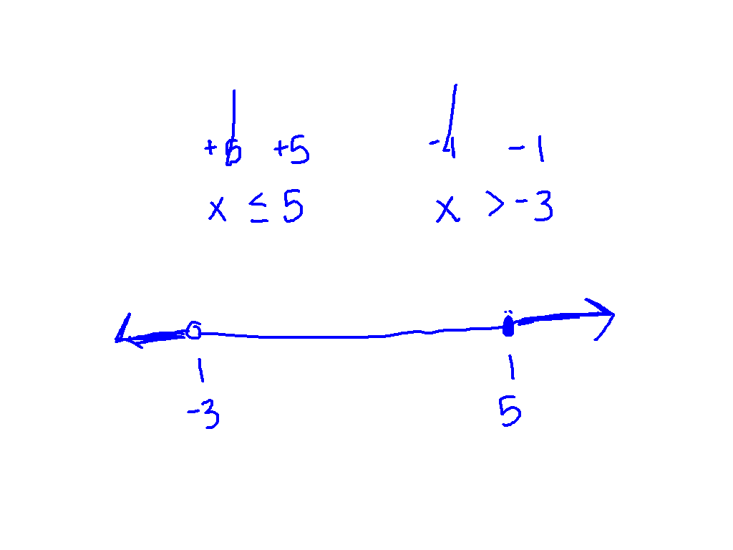
Identity
ALL NUMBERS

Slide 3
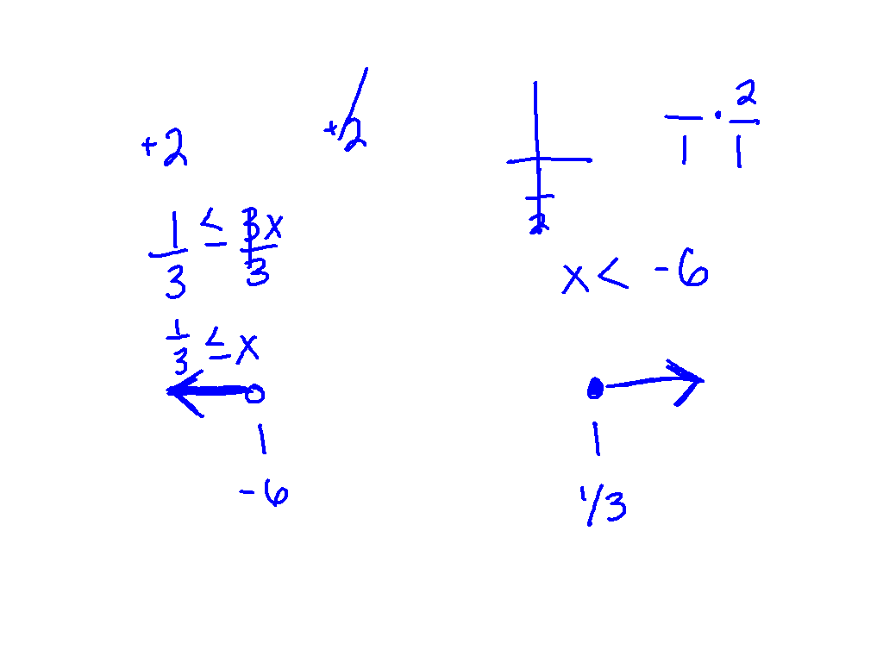
No Solution:
NO SOLUTION

Slide 4
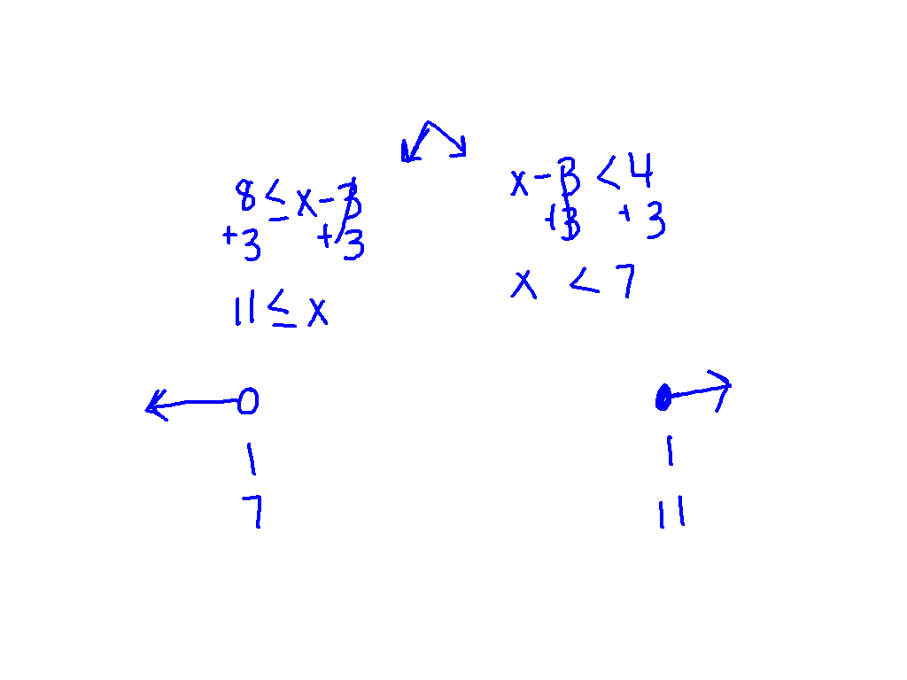
Ex. 5)
8 < x – 3 < 4
NO SOLUTION

Slide 5
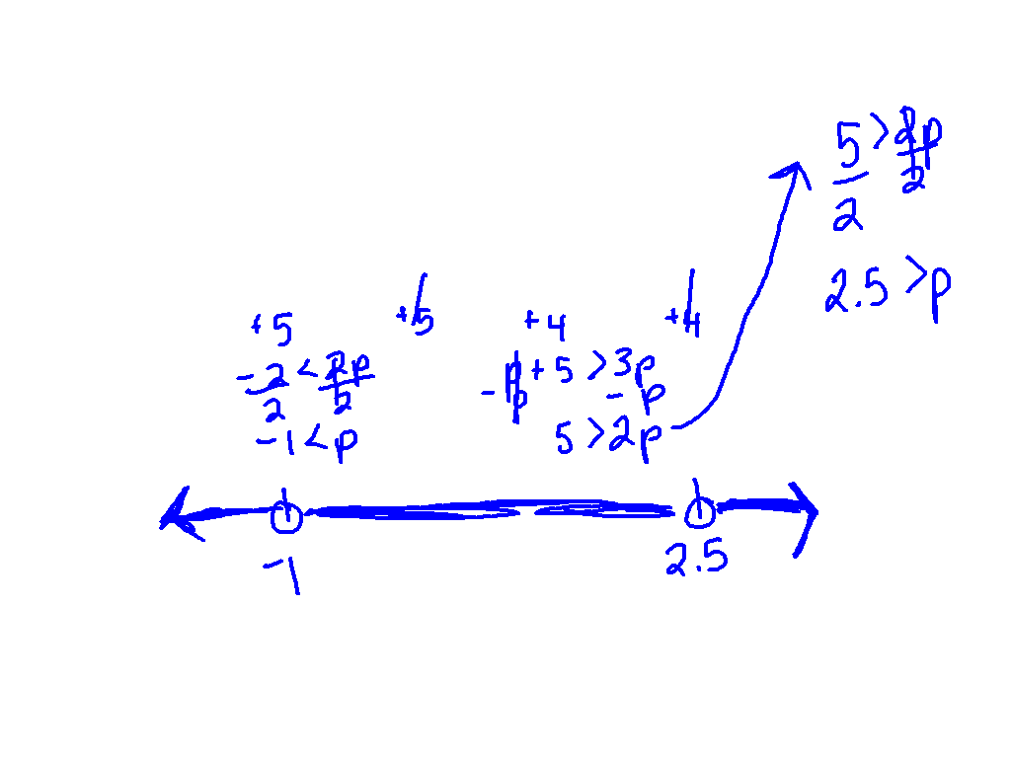
Ex. 6)
- 7 < 2p – 5 or p + 1 > 3p - 4
ALL NUMBERS

Slide 6
Get your desks ready for partner practice

Slide 7
00
20
19
18
17
16
15
14
13
12
11
10
09
08
07
06
05
04
03
02
01
00
Back to Clock Home
Countdown Clock By Dr. Jeff Ertzberger

Slide 8
What am I doing?
Show your work an a separate sheet of paper.
Graph on a number line.
Match the problems and the answers.
Glue AFTER you have identified the shape. (its an animal)

Slide 9
Desks back into rows

Slide 10
00
20
19
18
17
16
15
14
13
12
11
10
09
08
07
06
05
04
03
02
01
00
Back to Clock Home
Countdown Clock By Dr. Jeff Ertzberger

