Slide 1
Starter Challenge
1. Which of the following expressions represents 8 multiplied by a number y?
a) 8/y b) 8 + y c) y - 8 d) 8y
2.) 12 + (2 x 6) ÷ 3
3.) 3x + 4 = 13

Slide 2
Combining Like Terms
Objective: I can simplify problems with variables.

Slide 3
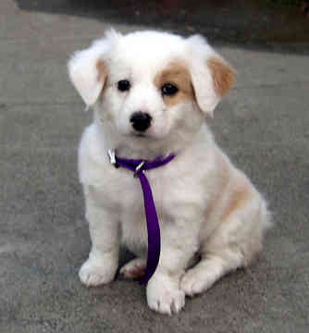
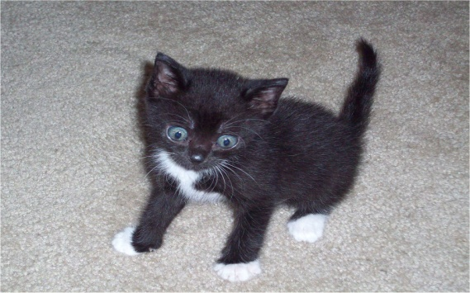
What does it mean to combine?

Slide 4
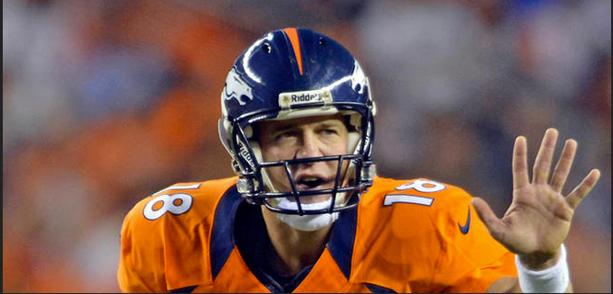
What would you combine?

Slide 5
Coefficients
A coefficient is the number beside the variable.
-2x
3y
11r
-14w

Slide 6
Coefficients
Some variables don’t have numbers, but they still have coefficients.
r
-e

Slide 7
Combining Like Terms
4r + 7r

Slide 8
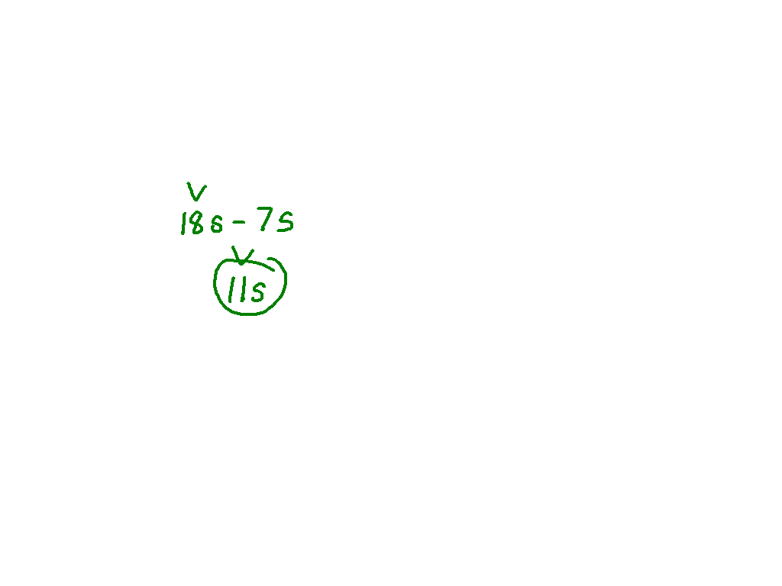
Combining Like Terms
Ex. 1) 15s + 3s – 7s

Slide 9
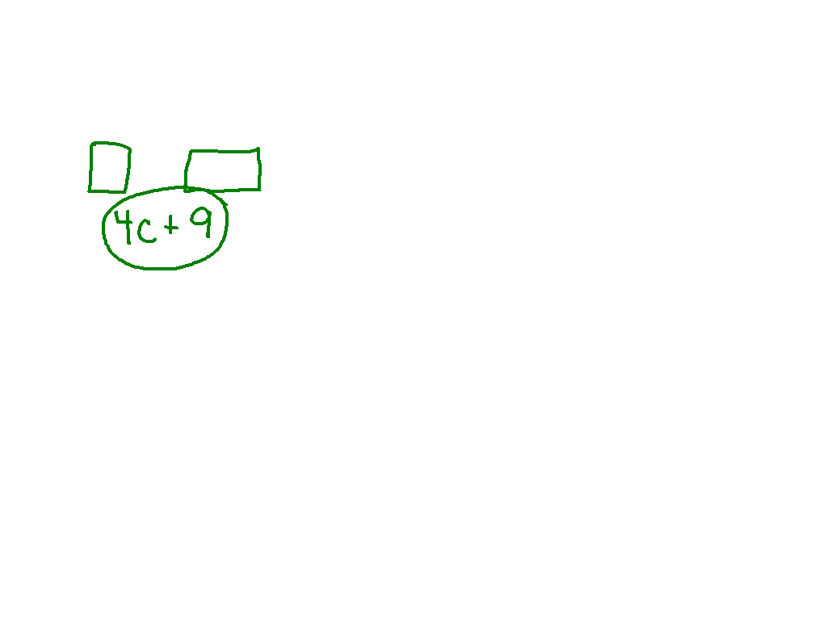
Simplifying Expressions
7c + 9 – 3c

Slide 10
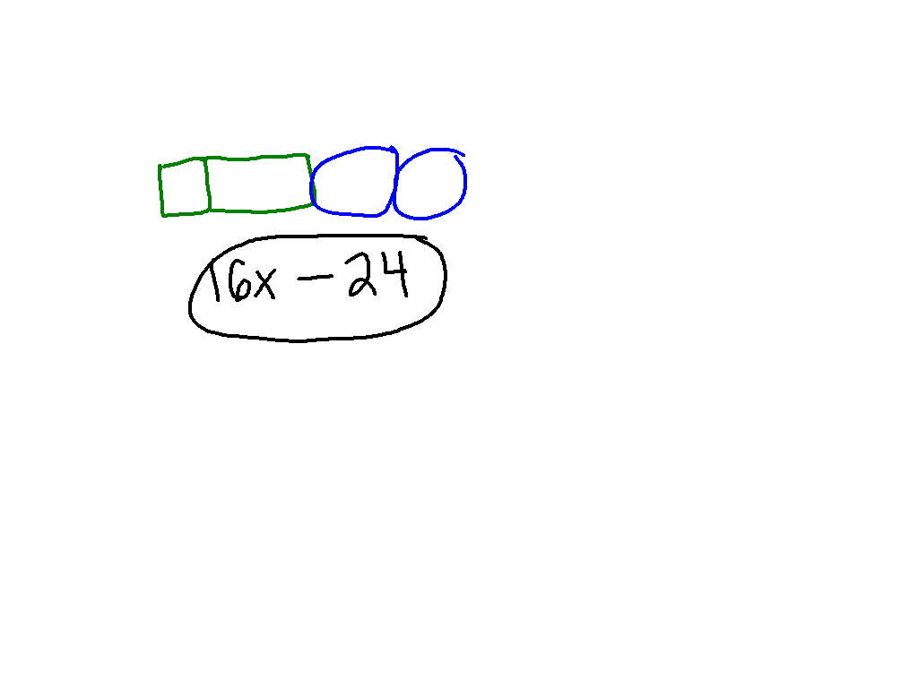
Simplifying Expressions
Ex. 2) 5x + 11x – 12 x 2

Slide 11
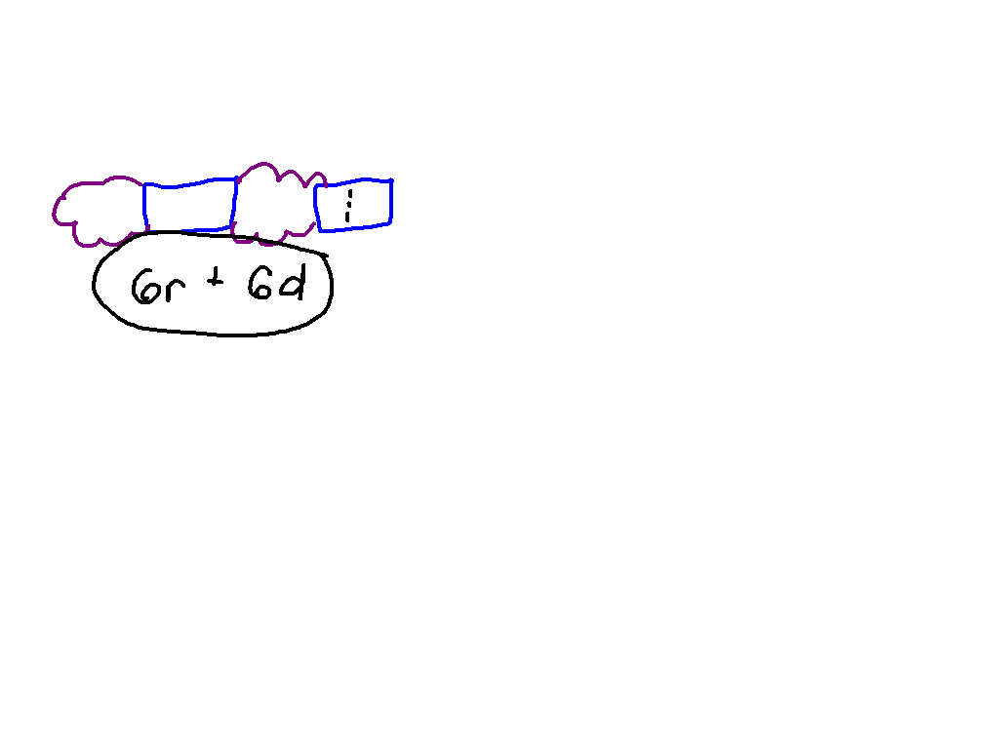
Post It Problem
12r + 5d – 6r + d

Slide 12
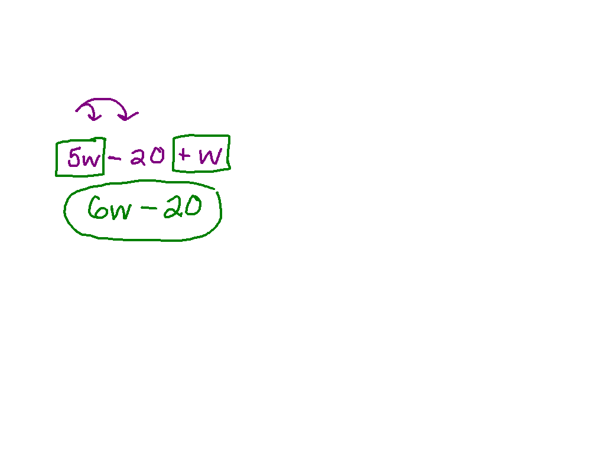
Simplifying Expressions with the Distributive Property
5(w – 4) + w

Slide 13
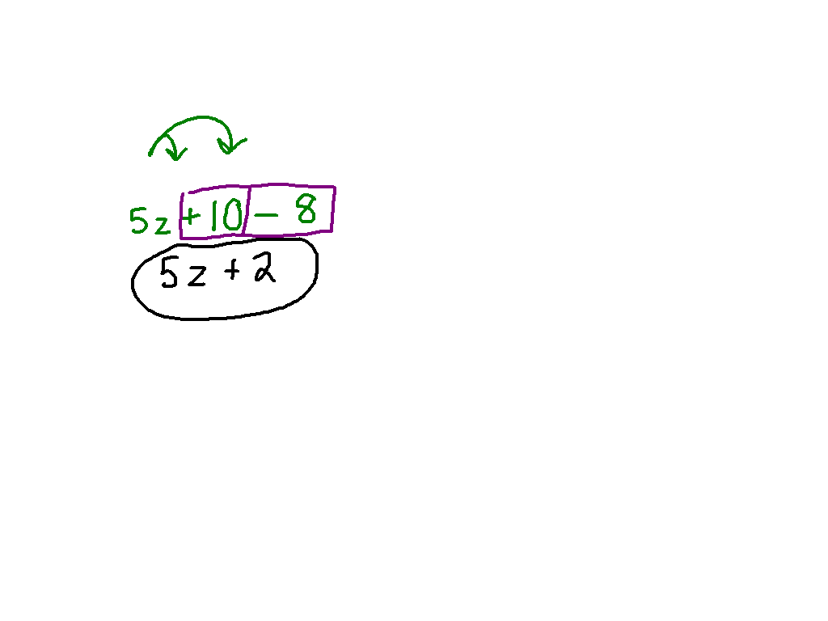
Simplifying Expressions with the Distributive Property
Ex. 3) 5(z + 2) - 8

Slide 14
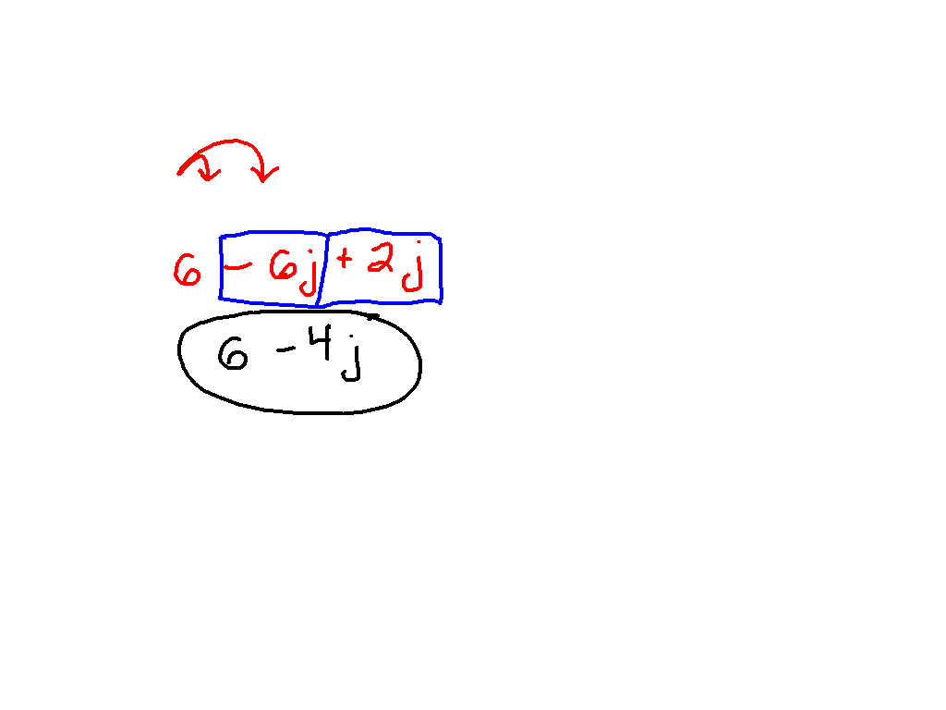
Simplifying Expressions with the Distributive Property
Ex. 4) 6(1 – j) + 2j

Slide 15
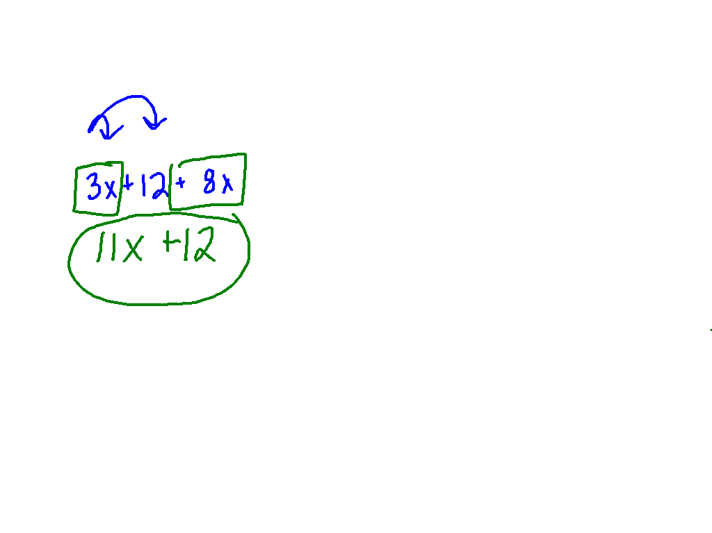
Post It Problem
3(x + 4) + 8x

