Slide 1
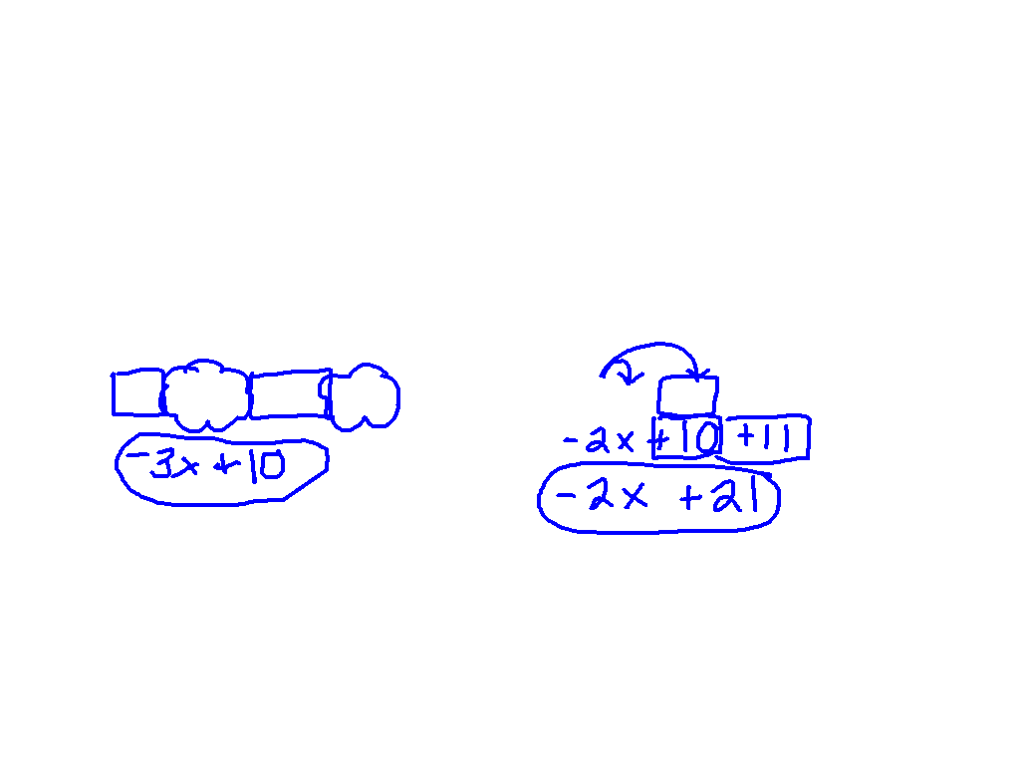
Starter Challenge
Combining Like Terms
Distributive Property
Simplify:
1) 2x + 12 – 5x - 2
Simplify:
2) -2(x – 5) + 11

Slide 2
Distributive / Combining equation
3(-5x + 12) + 4 = 120

Slide 3
What am I doing?
Solve the equations on a separate sheet of paper. There are 6 problems.
Find the answer (circled) and write the problem number above it.
Cut out the 7 pieces.
Match the problems and the answers. (They will be facing each other.)
You are making an animal. ☺

Slide 4
Exit ticket
2(x + 13) - 7

