Slide 1
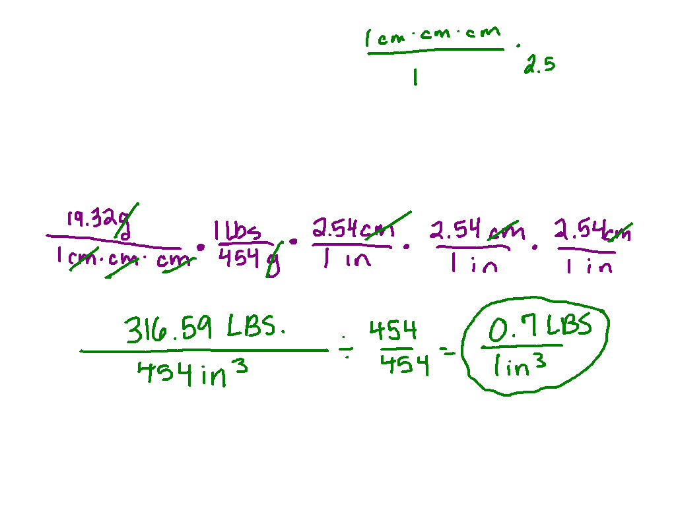
Starter Challenge
The density of gold is 19.32 grams per cubic centimeters. Convert to pounds per cubic inch. (1 lbs = 454 g) (1 in = 2.54 cm)

Slide 2
Solving Absolute Value Inequalities
I can write and/or solve inequalities and compound inequalities with absolute value.

Slide 3
Why are there absolute value inequalities?
Fire extinguishers contain pressurize water. The water presser should be 162.5 psi (pounds per square inch), but it is acceptable for the pressure to differ from this value by at most 12.5 psi. What is the range of acceptable pressures?

Slide 4
and
or
Less than
and
Greater
than
or
“Less Thand”
“Greator”

Slide 5
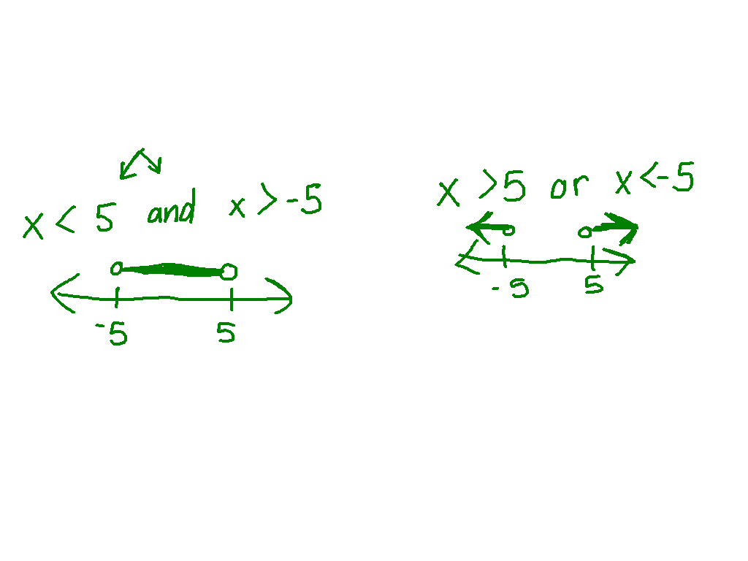
Ex. 1)
Ex. 2)

Slide 6
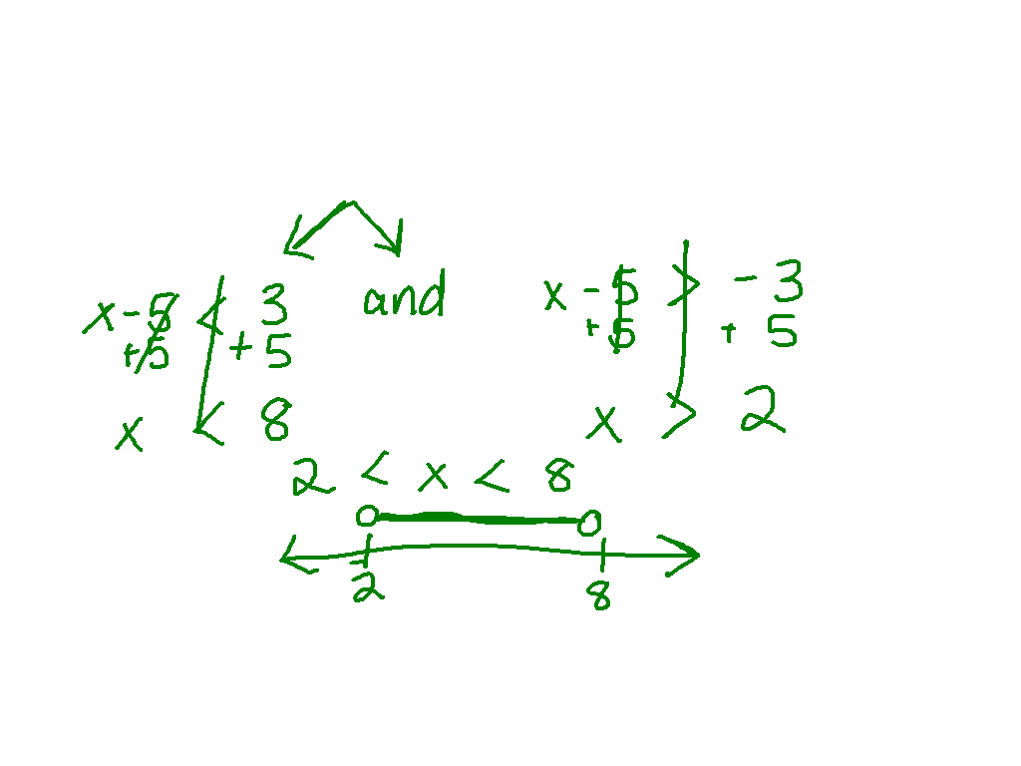
Watch This!

Slide 7
Ex. 3)

Slide 8
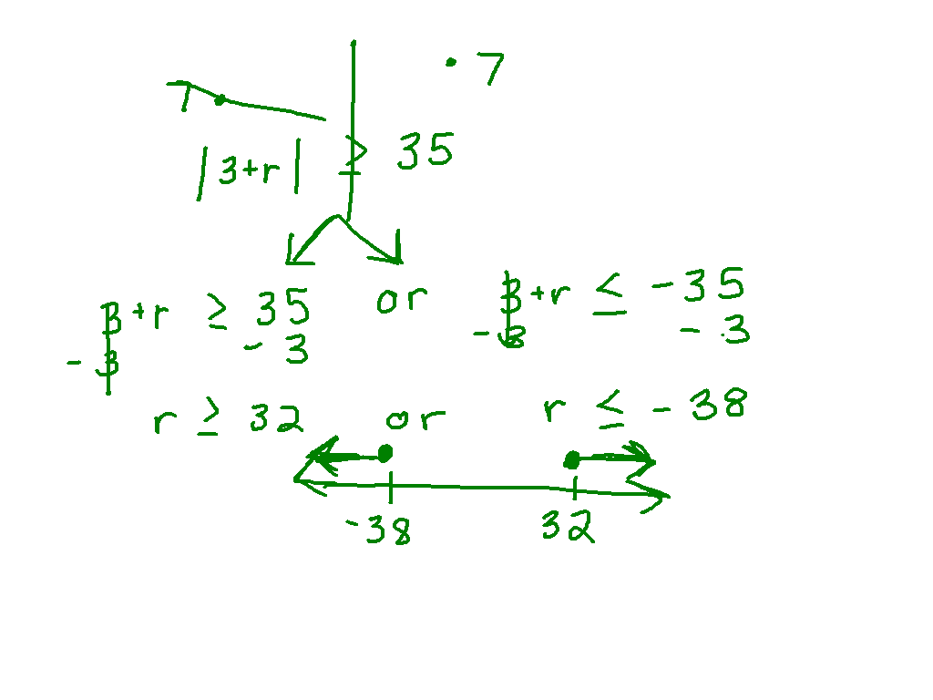
Ex. 4)
3 + r > 5
7

Slide 9
Post It Problem!

Slide 10
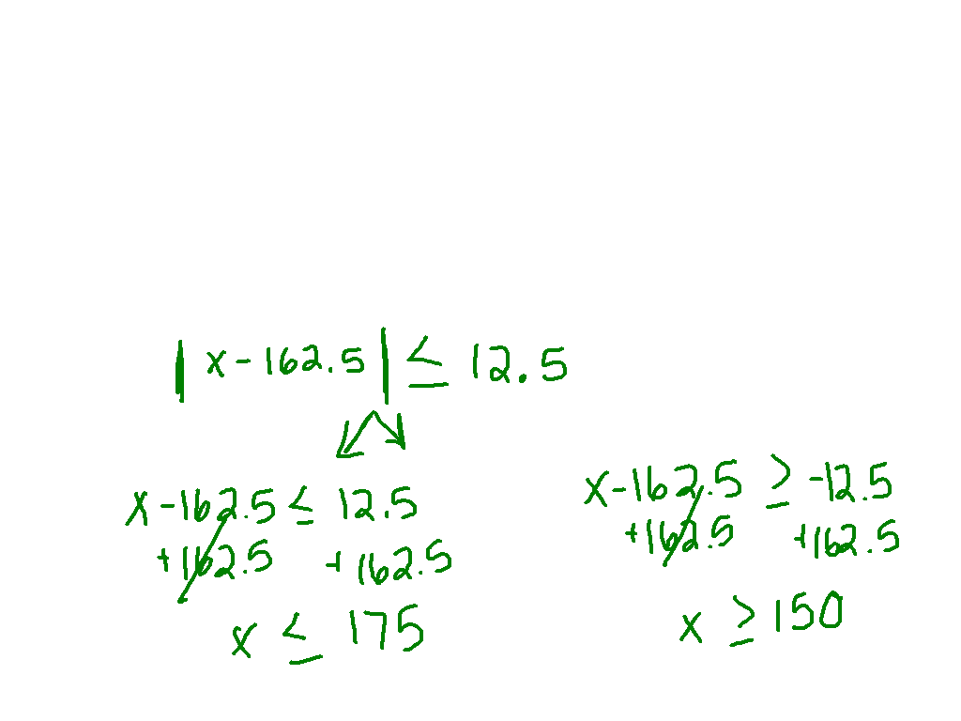
Why are there absolute value inequalities?
Fire extinguishers contain pressurize water. The water presser should be 162.5 psi (pounds per square inch), but it is acceptable for the pressure to differ from this value by at most 12.5 psi. What is the range of acceptable pressures?

Slide 11
Starter Challenge
A horse runs one furlong in 23 seconds. What is the horse’s speed in miles per hour? (1 furlong is 1/8 mile)
The density of silver is 10,490 kg/m³. Convert this to pounds per cubic foot.
(1 lb. = 0.454 kg and 1 ft = 0.914 m)

Slide 12
Ex 5)
A pediatrician recommends a baby’s bath water be 95 degrees, but it is acceptable for the temperature to vary by as much as 3 degrees. What is the acceptable range?

Slide 13
Special Cases
x – 6 + 7 > 2
x + 12 - 5 < -6

Slide 14
practice
Pg. 215 # 23 – 32

