Slide 1
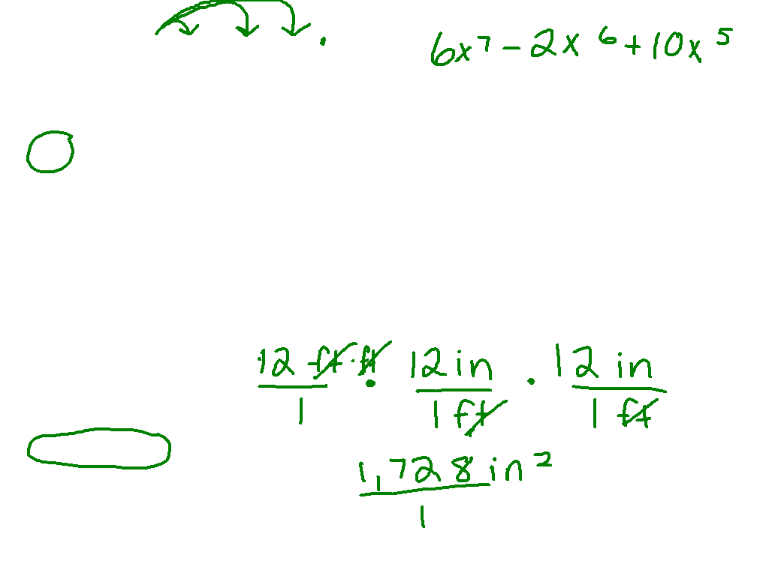
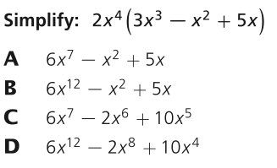
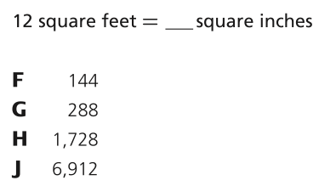

Slide 2
Slope Intercept
Form
I can and I will write and graph an equation using slope intercept form.

Slide 3
By the end of class…
You and your family spend $60 on tickets to a Nashville Predators game and $4 per hour for parking. C is the total cost and t is the time (in hours) your family parked their car.
Write an equation to model the situation.
Graph the equation
What is the total cost for your family after attending the hockey game for 4 hours?

Slide 4
Watch This:
Graph the line which passes through (-2, 1) and has a
slope of -3.
y
Steps
1) Plot the point.
2) Write slope as fraction
and count off other points.
-3
m = -3
=
1
-3
x
3
or m =
-1
+1
3) Draw line through points.

Slide 5
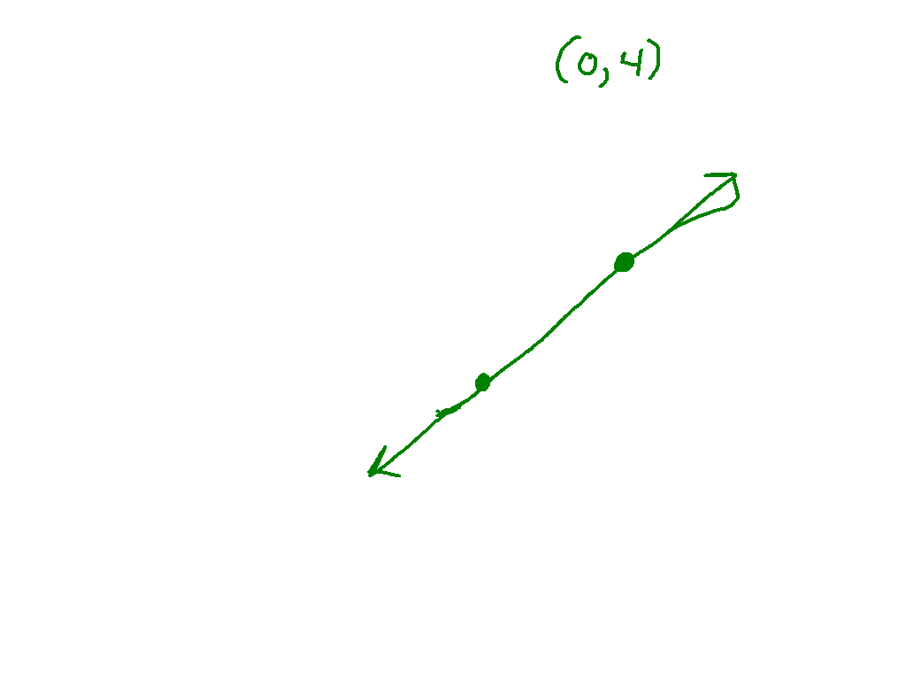
Ex. 1)
Graph the line with a y intercept of 4 and a
slope of .
3
4
y
Steps
1) Plot the point.
2) Write slope as fraction
and count off other points.
3
m =
4
x
-3
or m =
-4
3) Draw line through points.

Slide 6
Slope-Intercept Form of the Equation of a Line
The SLOPE of the line is m.
The y-INTERCEPT is b.

Slide 7
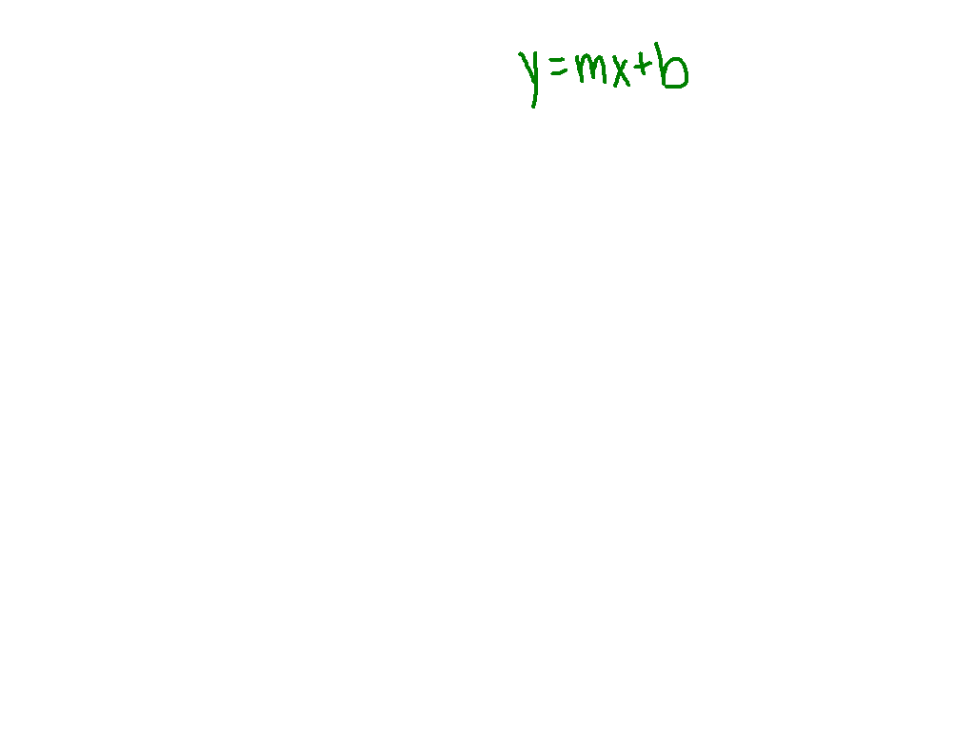
Ex. 2)
Find the slope and y-intercept of the following linear equations:
5
5
1) y = 3x + 4
3) y = x - 4
m =
b = -4
8
8
m = 3
b = 4
4) y = x -
2) y = -2x - 1
-2
1
m = -2
b = -1
9
4
-1
-2
m =
b =
9
4

Slide 8
Ex. 2)
Find the slope and y-intercept of the following linear equations:
5) y = -x + 2
6)
m = -1
b = 2
m =
b =

Slide 9
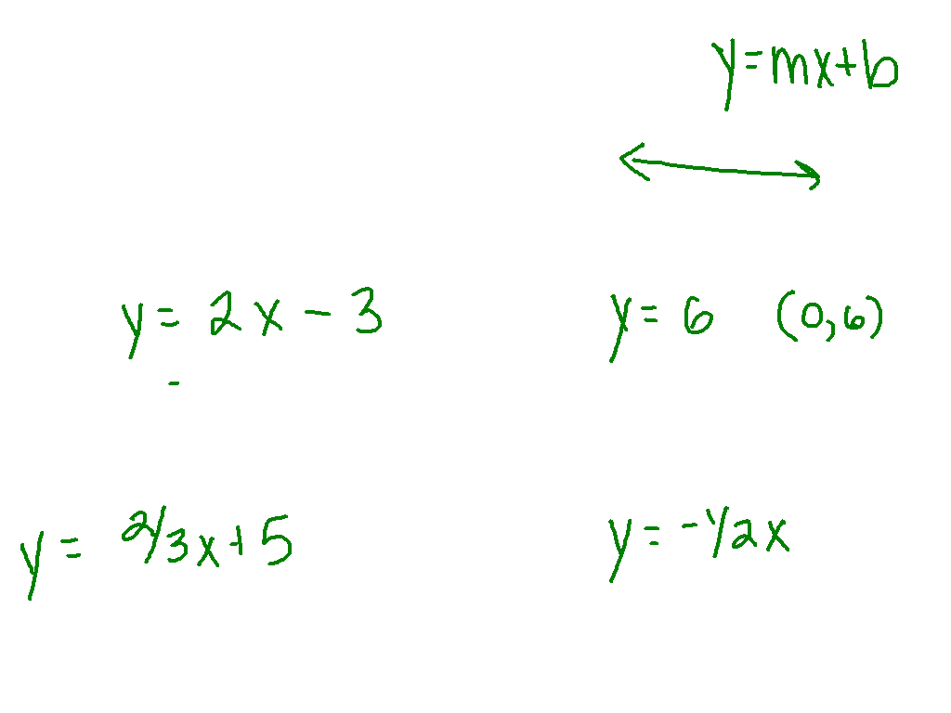
Ex. 3)
Write in slope intercept form.
m = 2, b = -3
m = 0, b = 6
y = 2x - 3
y = 6
m = , b = 5
m = , b = 0

Slide 10
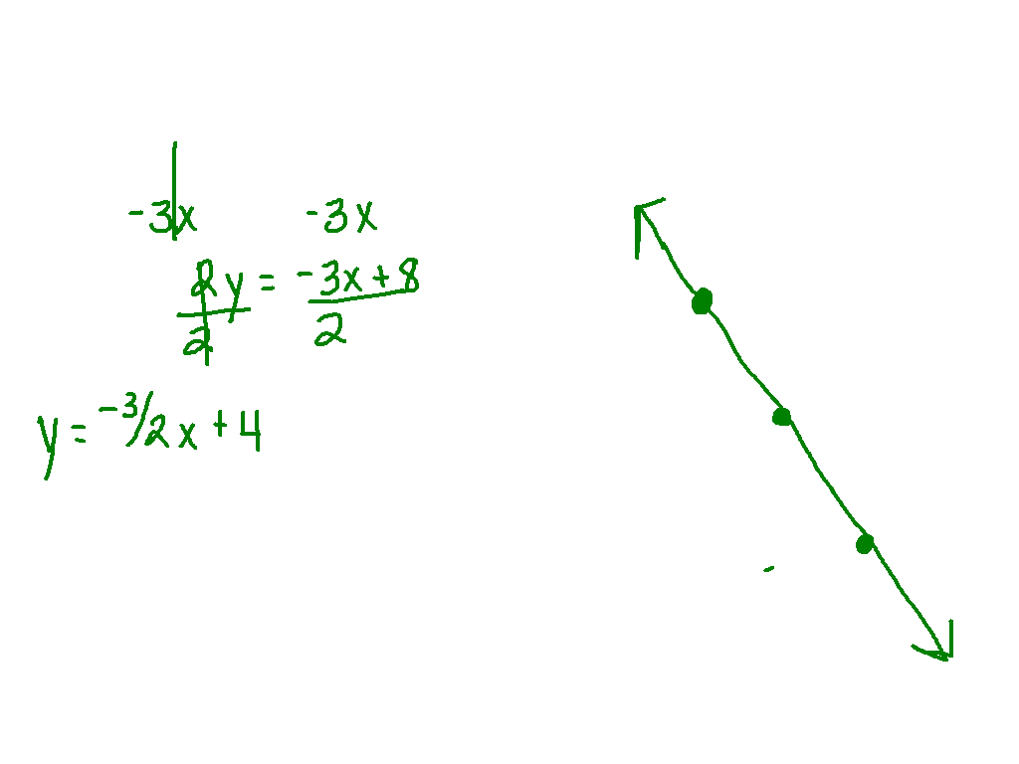
Ex. 4)
Graph the following linear equation using slope
and y-intercept.
y
x

Slide 11
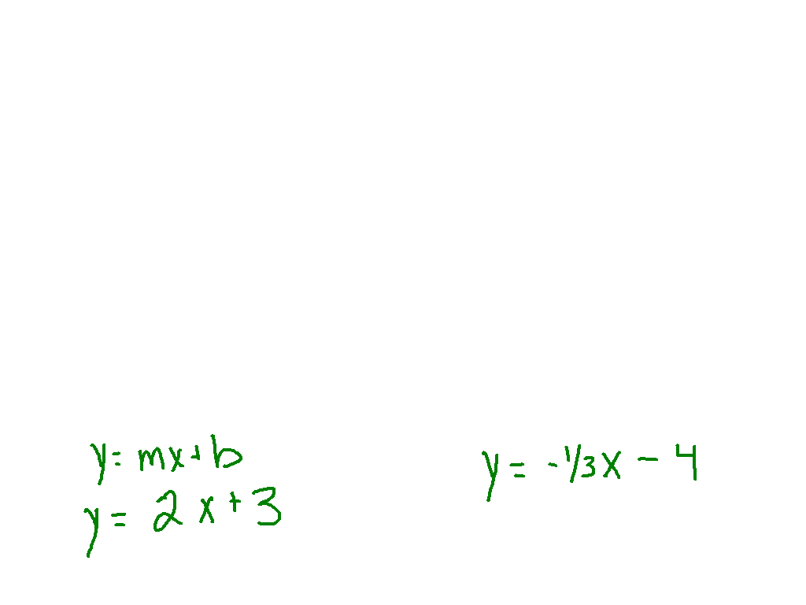
Write a linear equation in slope-intercept form
to describe each graph.
y
y
x
x
b = 3
b = -4
y = 2x + 3

Slide 12
By the end of class…
You and your family spend $60 on tickets to a Nashville Predators game and $4 per hour for parking. C is the total cost and t is the time (in hours) your family parked their car.
Write an equation to model the situation.
Graph the equation
What is the total cost for your family after attending the hockey game for 4 hours?

Slide 13
Equation
C=60 + 5t
or
C=5t + 60
m =
5
b =
60
Cost of the attending the
game?
$80.00

